Slide 1
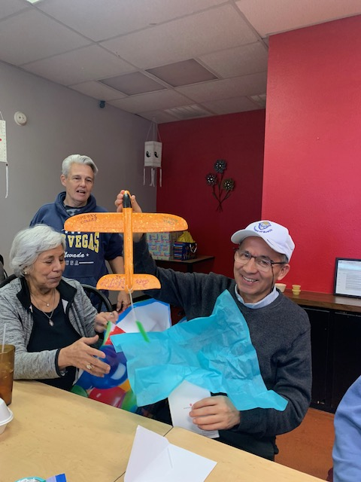

Slide 2
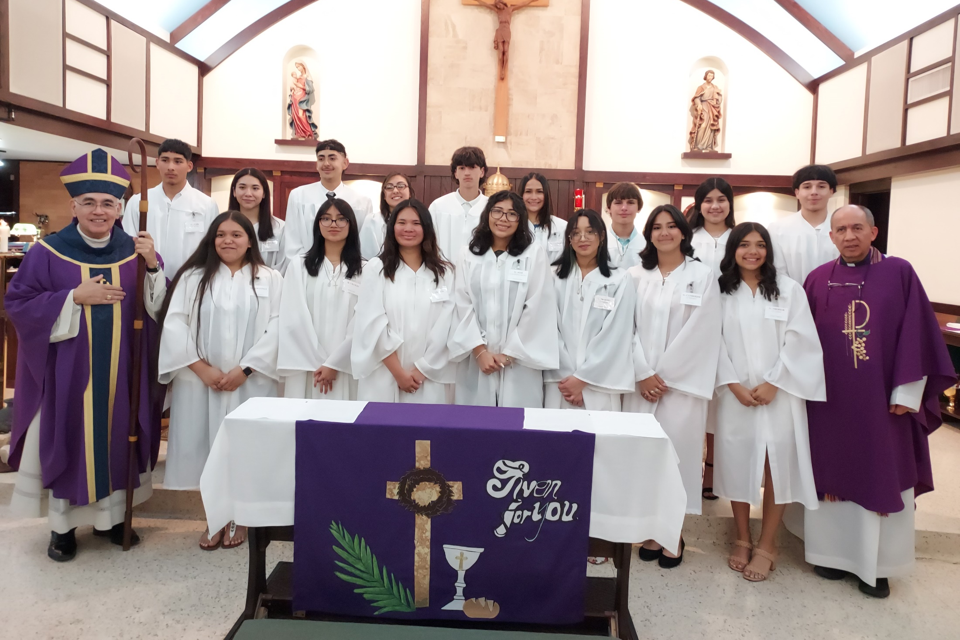
Confirmation – March 2023

Slide 3
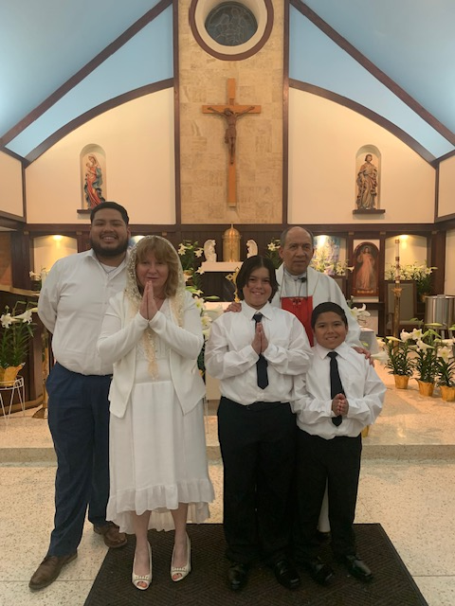
Easter Vigil – April 2023
Oscar Moran,
Donna Barker,
Jamden & Jayden Garcia

Slide 4
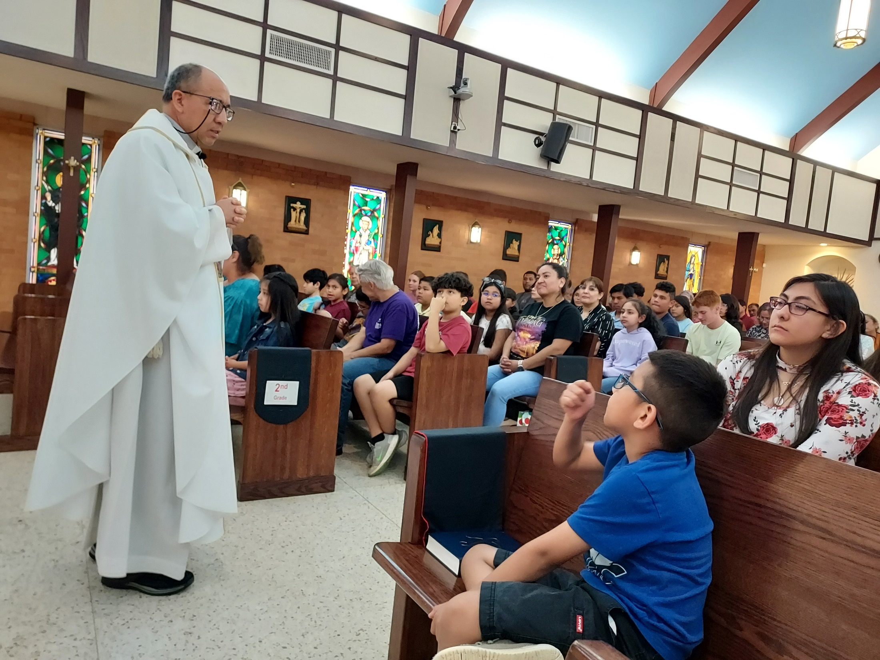
RE Closing Mass - May 2023

Slide 5
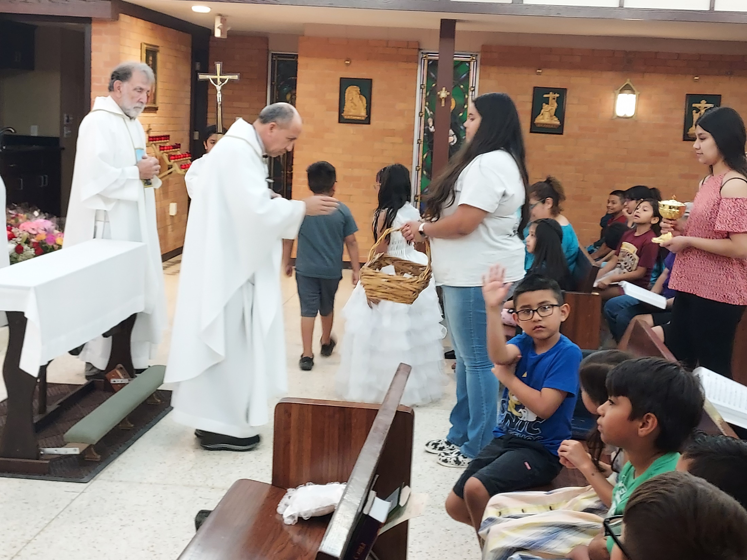

Slide 6
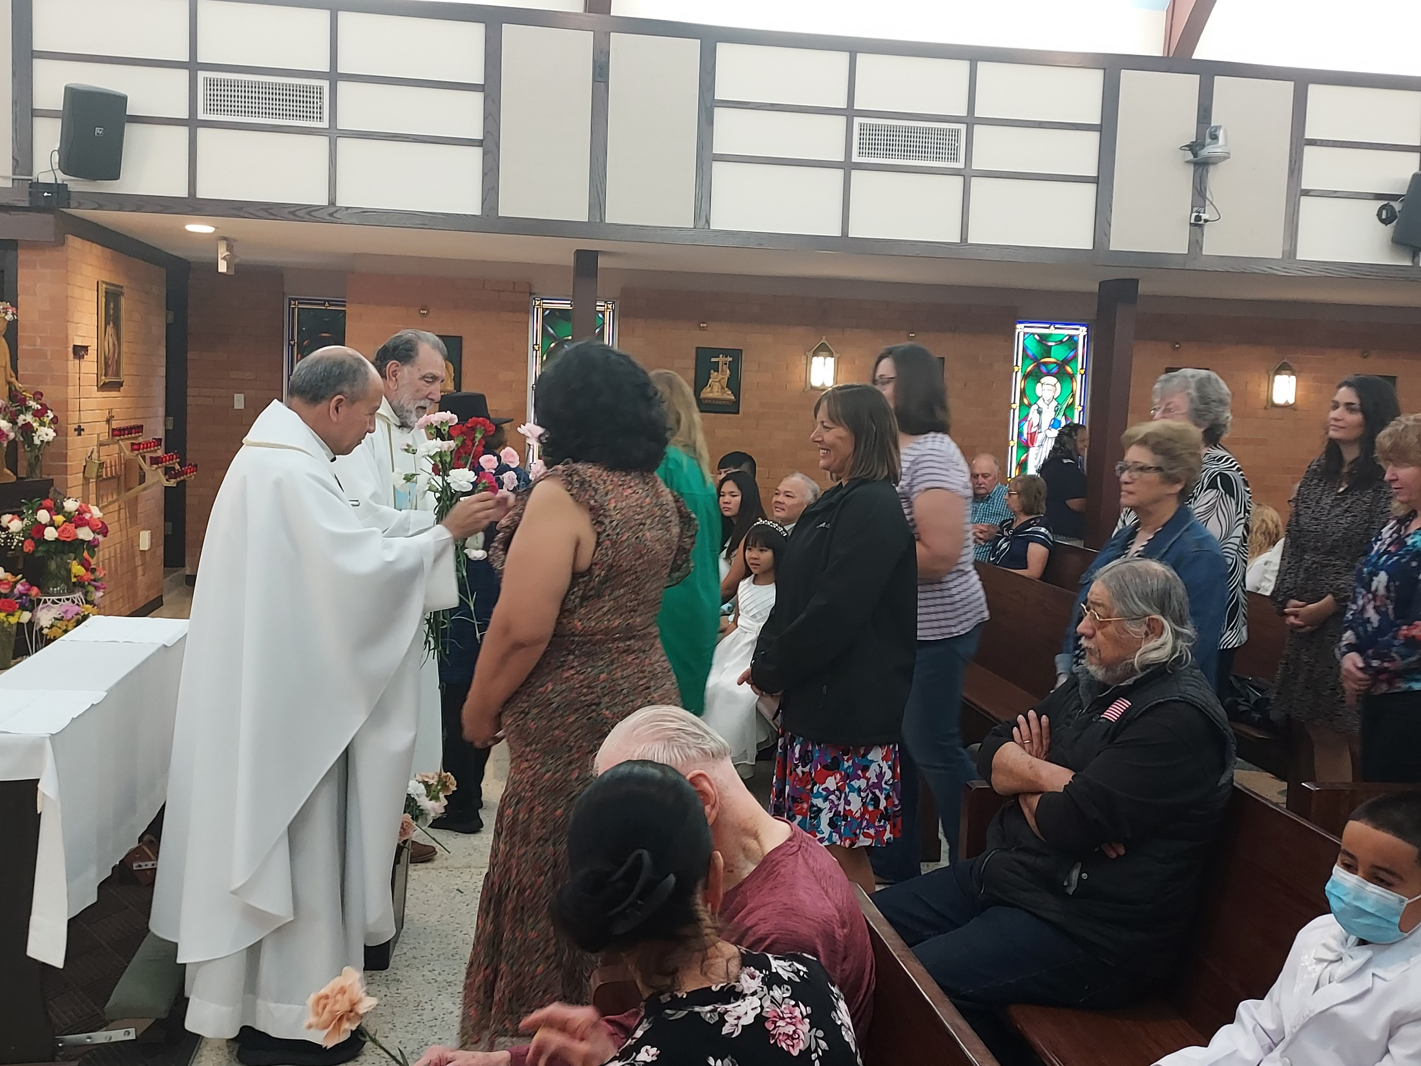

Slide 7
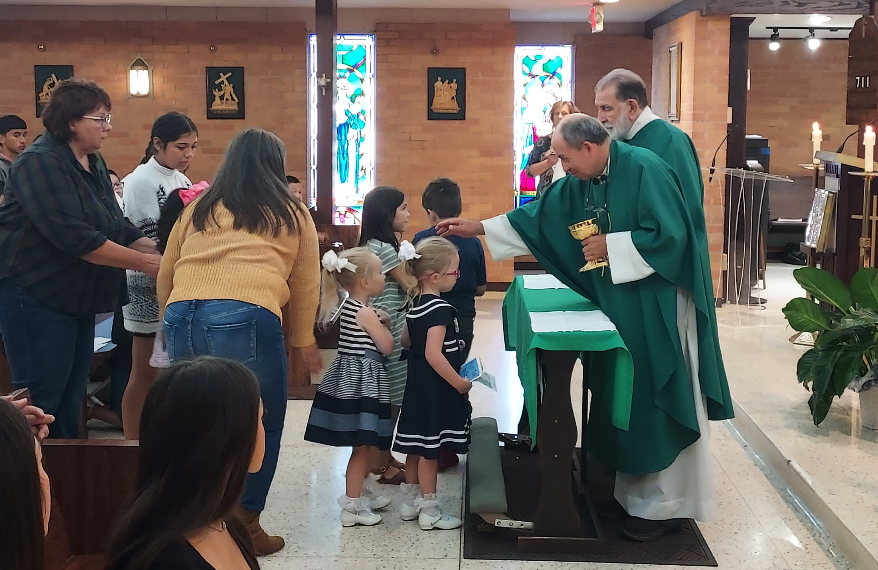

Slide 8
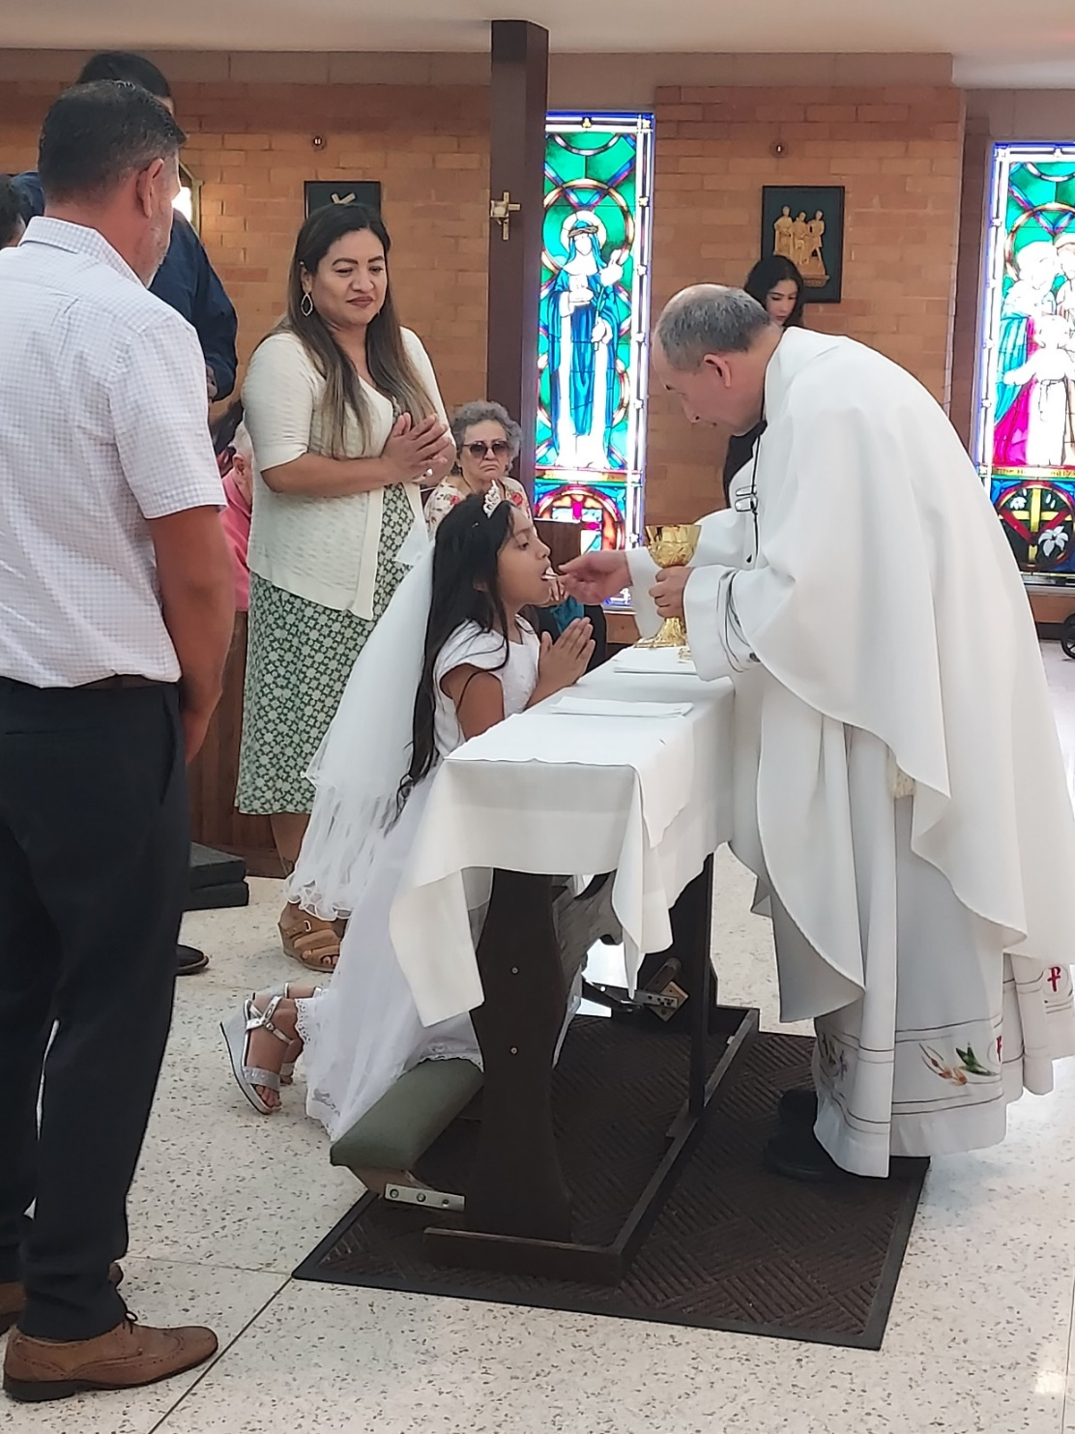
1st Communions – May 2023
Abigail Chavez

Slide 9
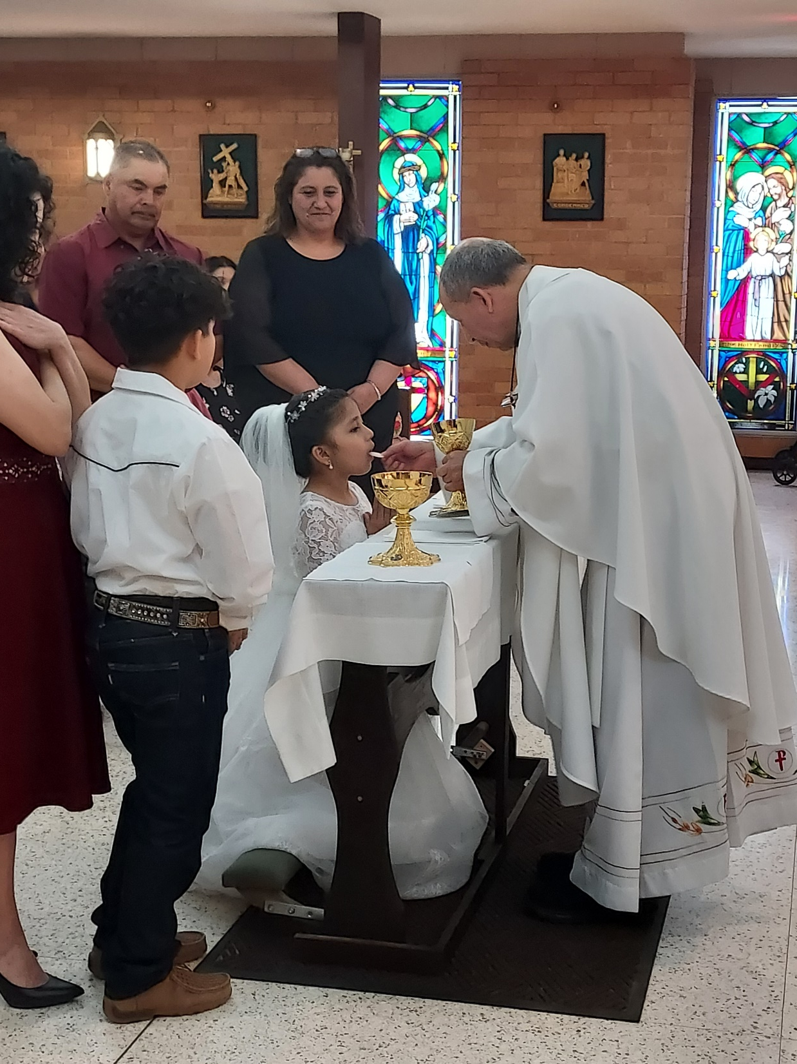
Jimena Lara

Slide 10
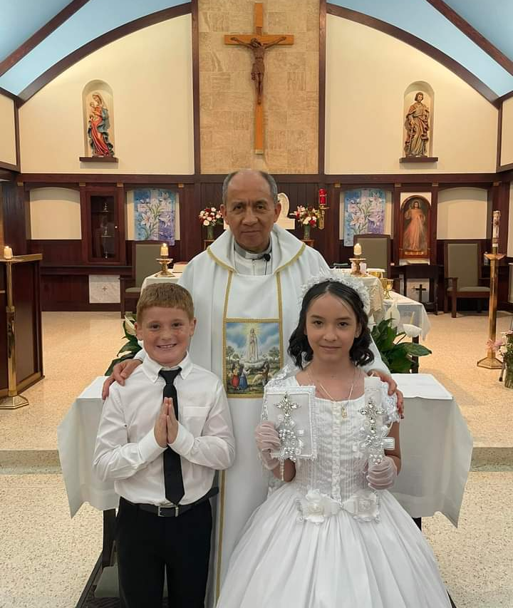
Jack Williams,
Diacyneli Salcedo

Slide 11
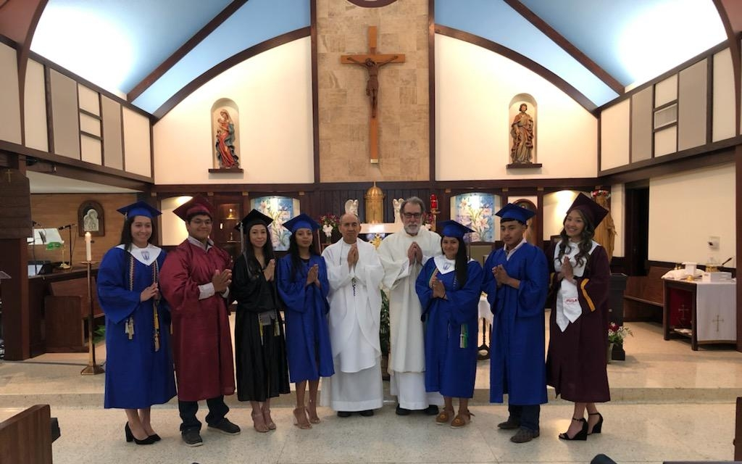
Graduation Sunday – May 2023

Slide 12
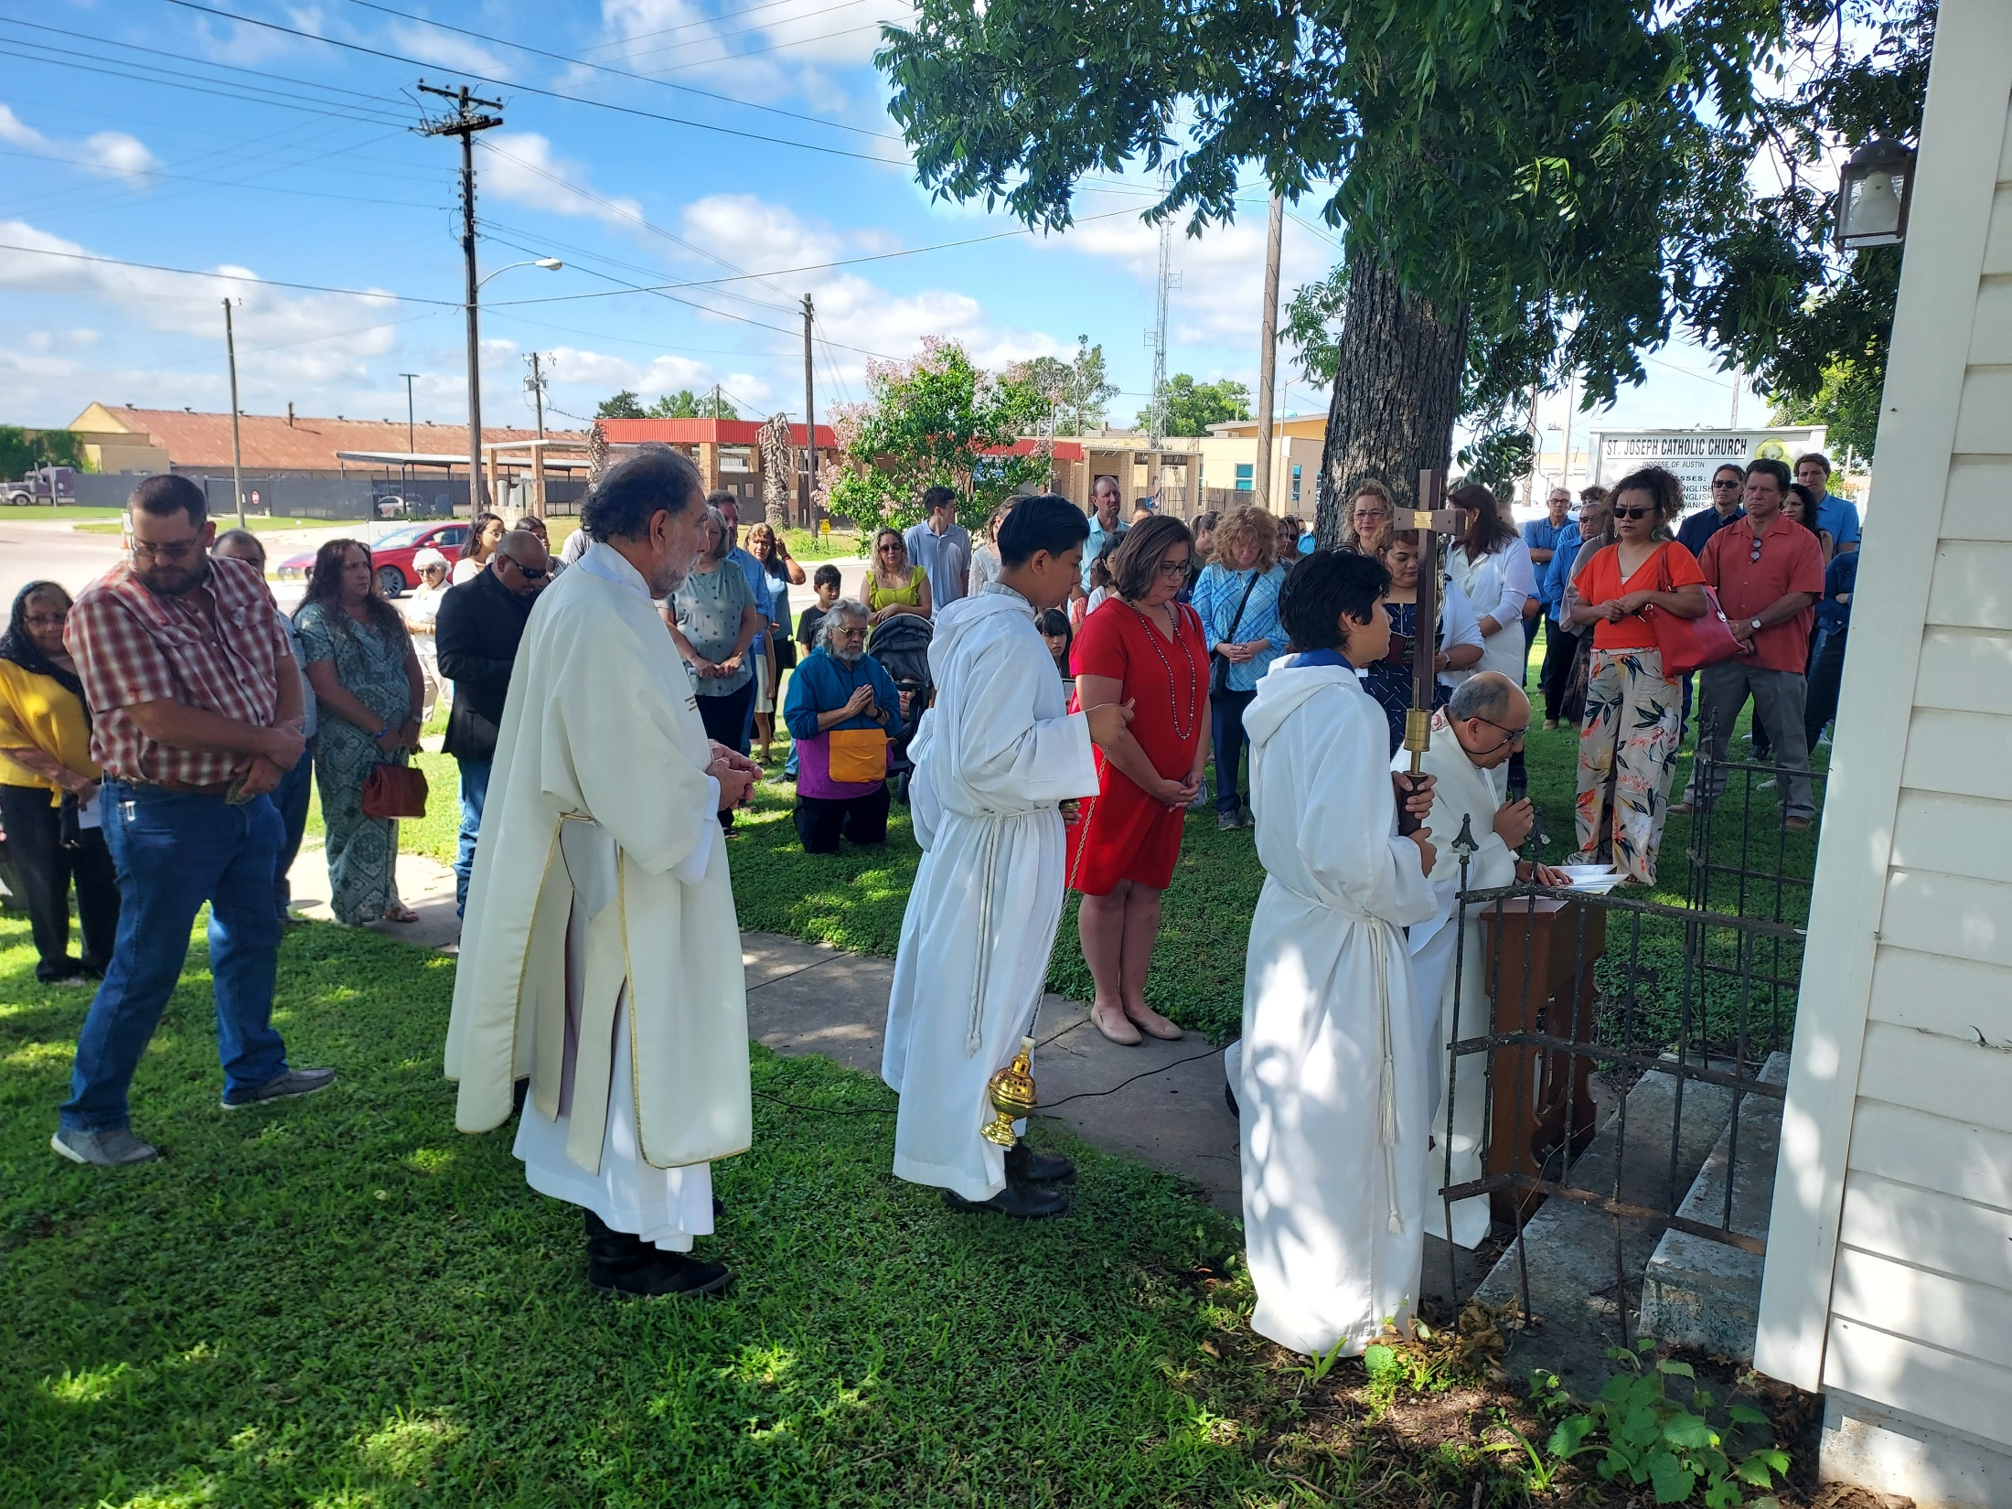
Corpus Christi – June 2023

Slide 13
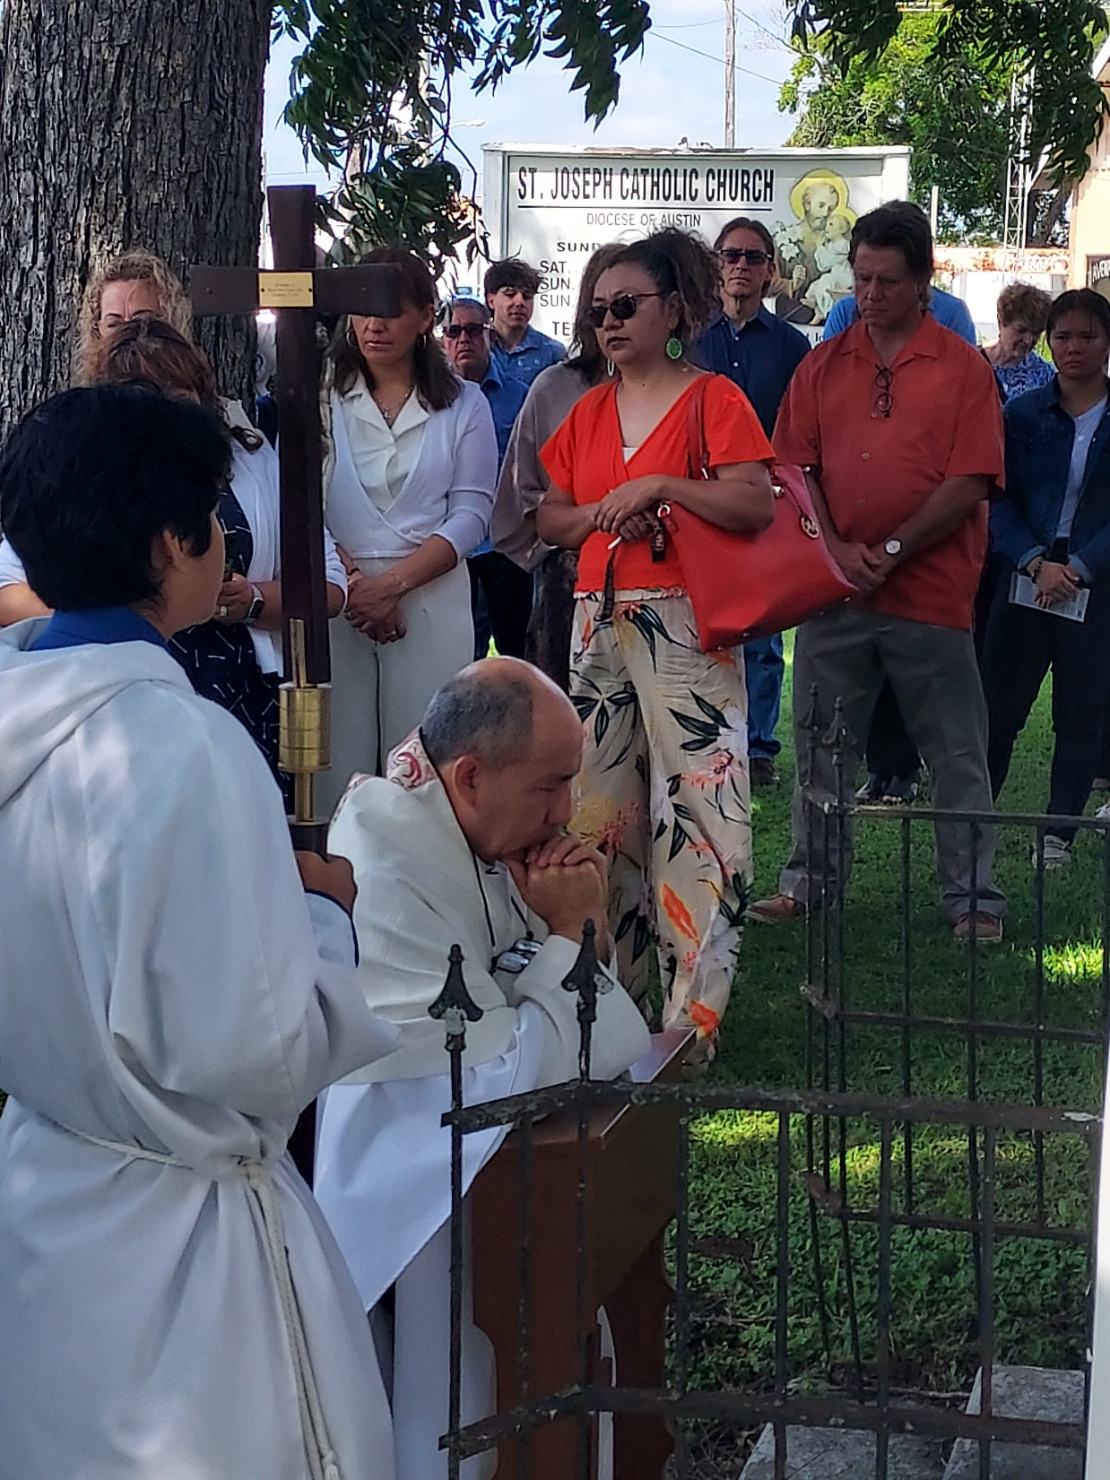

Slide 14
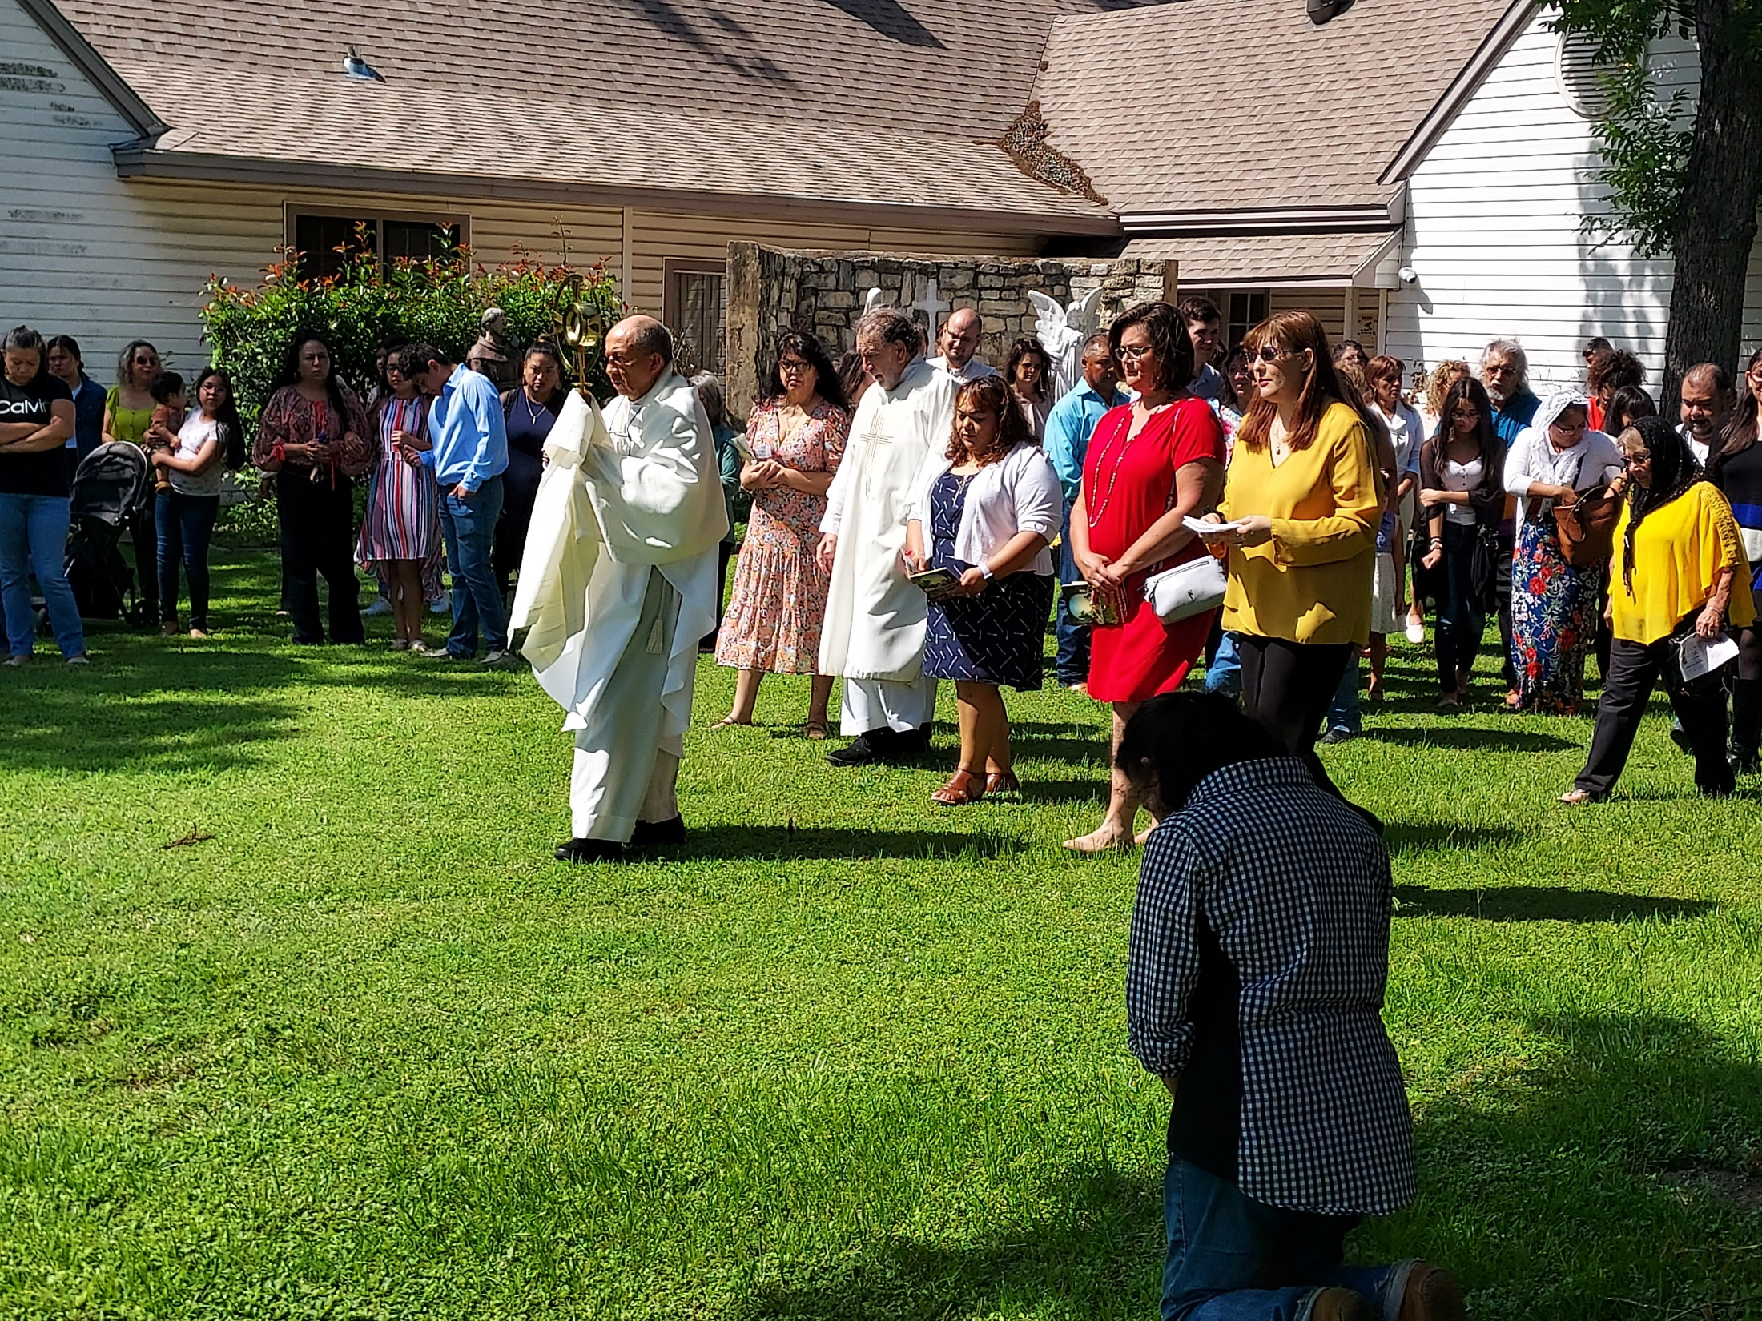

Slide 15
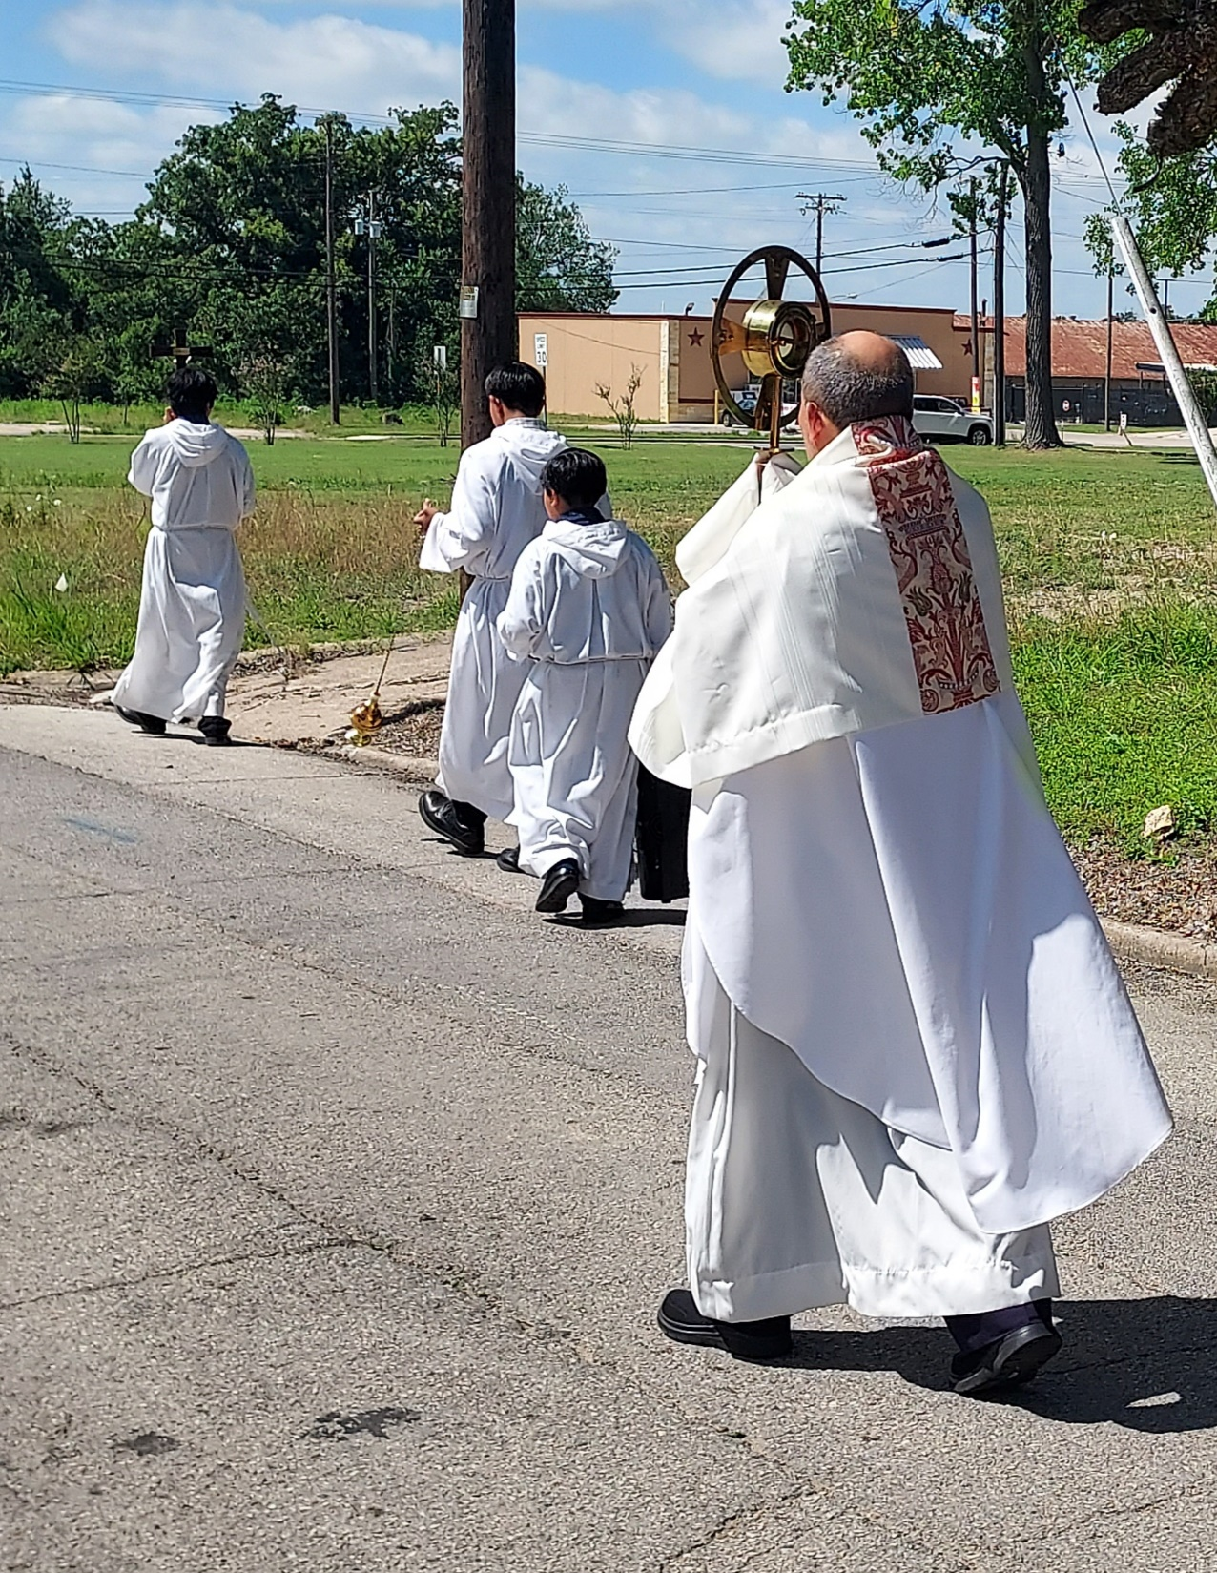

Slide 16
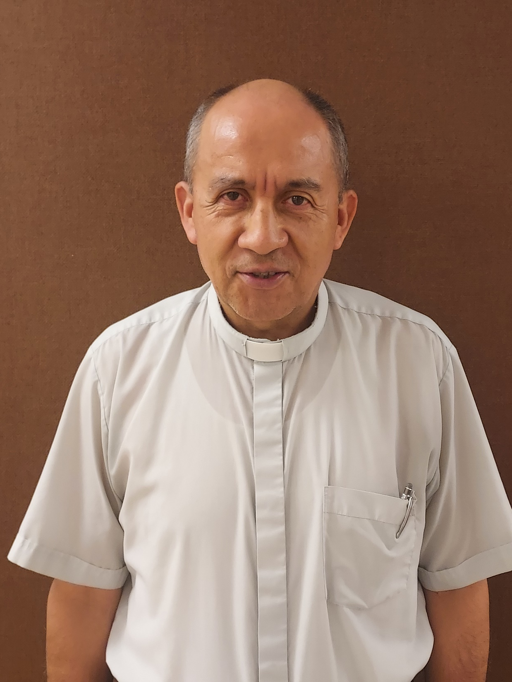

Slide 17
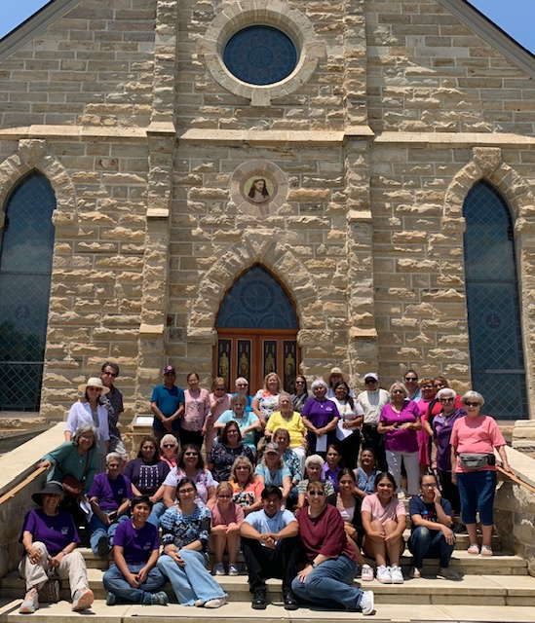
Painted
Churches trip
June 12, 2023

Slide 18
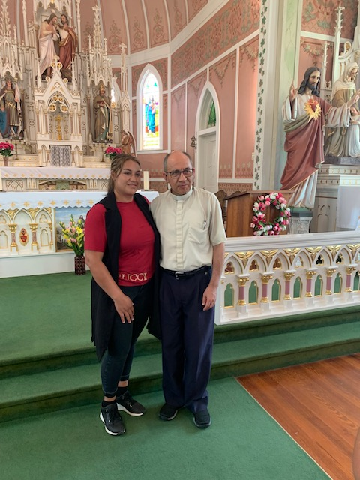
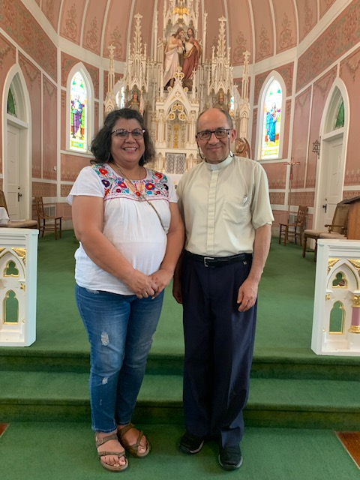
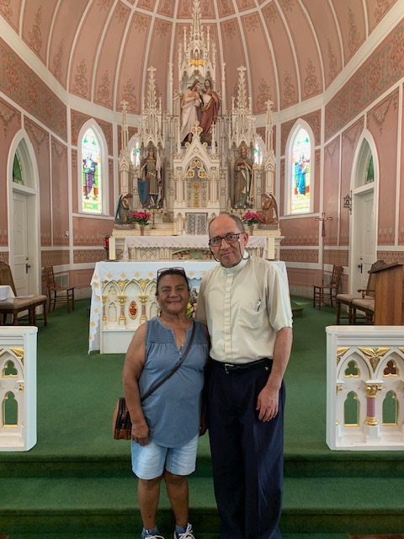

Slide 19
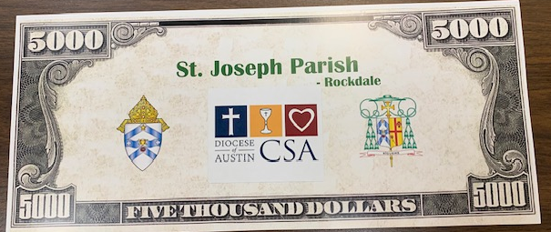
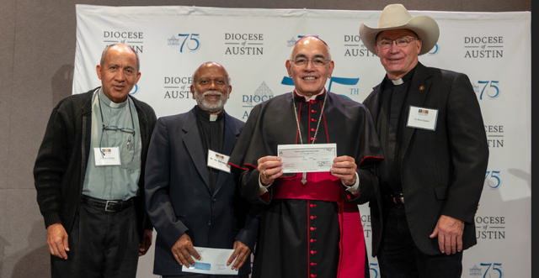
CSA Winner! – October 2023

Slide 20
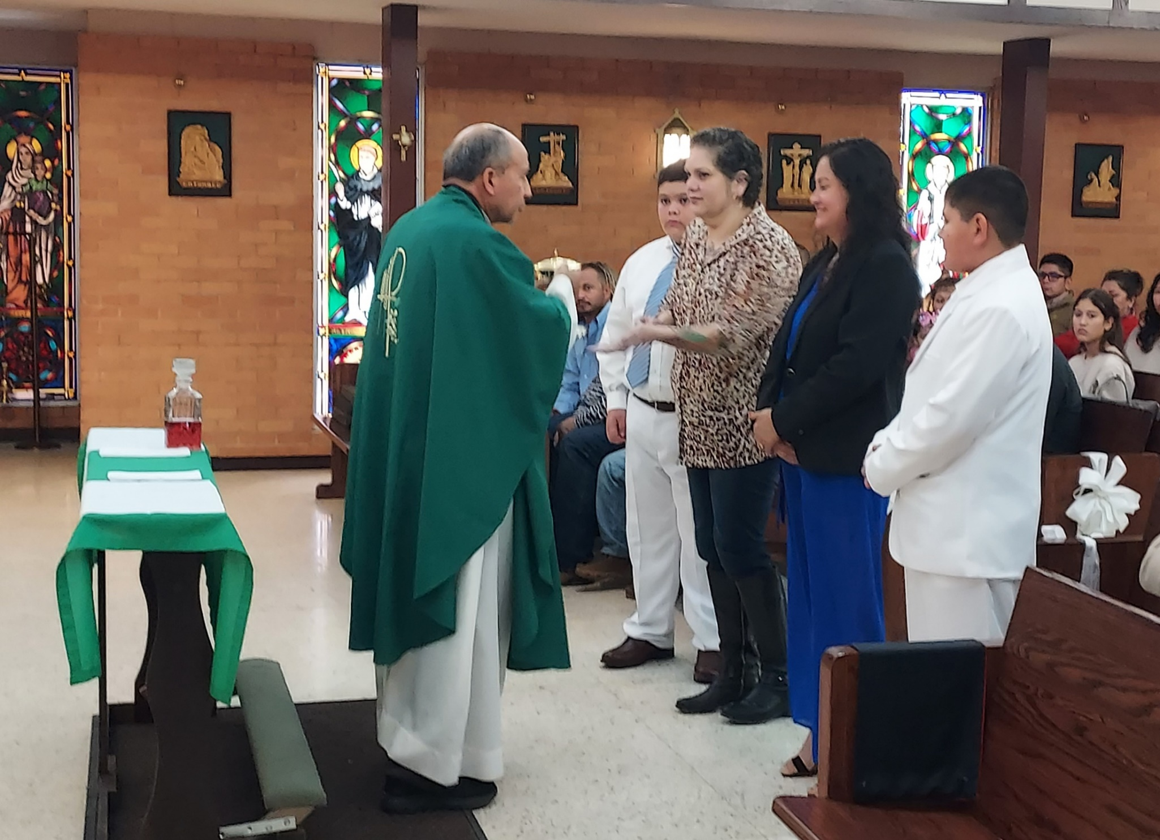
1st Communions – November 2023
Miguel Maldonado;
Enrique Martinez

Slide 21
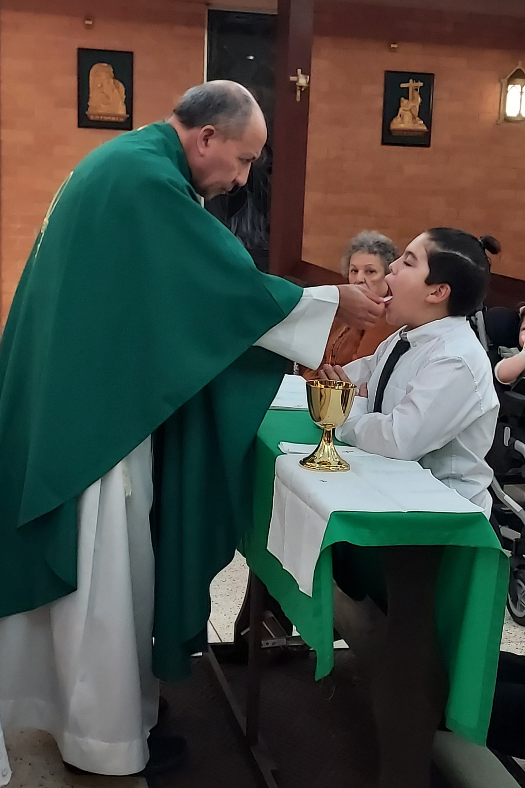
Kamden Garcia

Slide 22
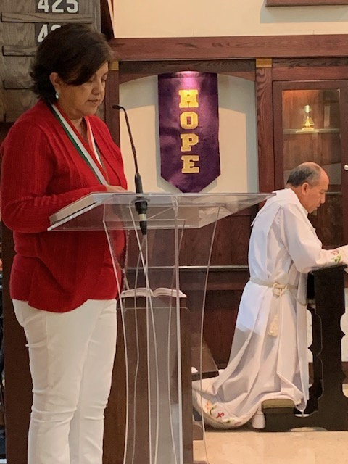
OLG celebration
December 2023

Slide 23
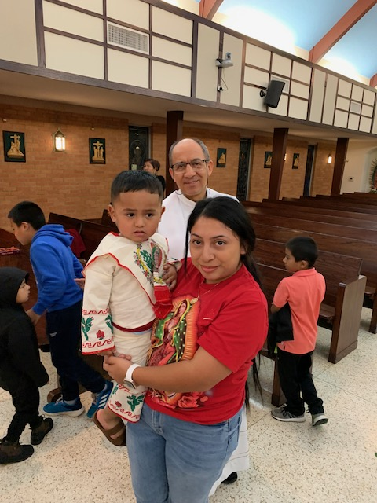

Slide 24
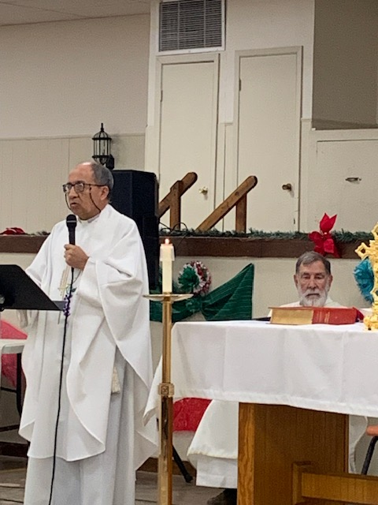

Slide 25
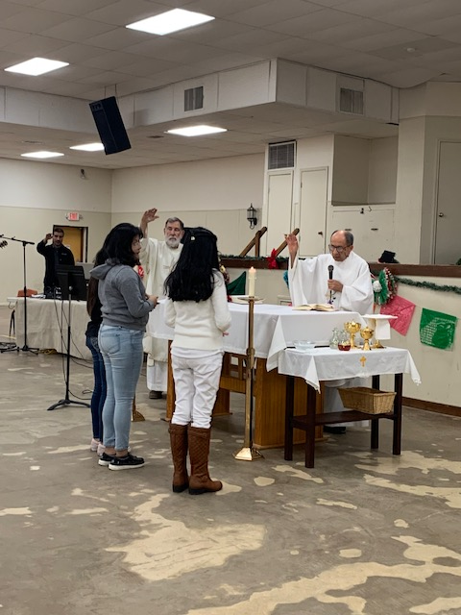

Slide 26
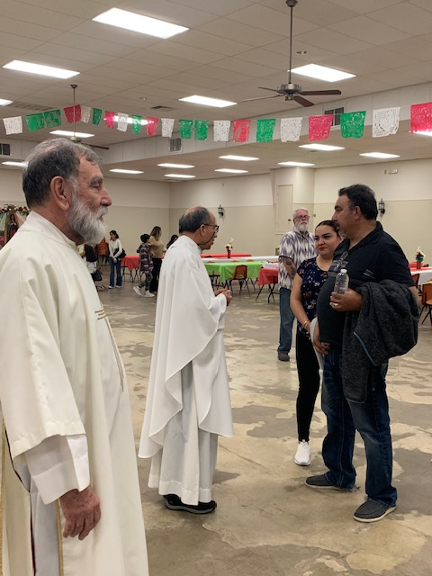

Slide 27
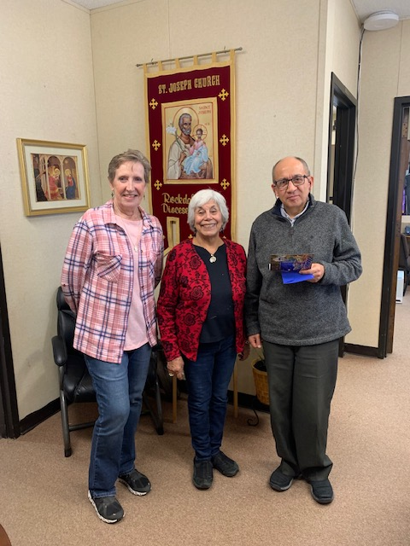
Pat Barcak,
Mary Helen Ortega

Slide 28
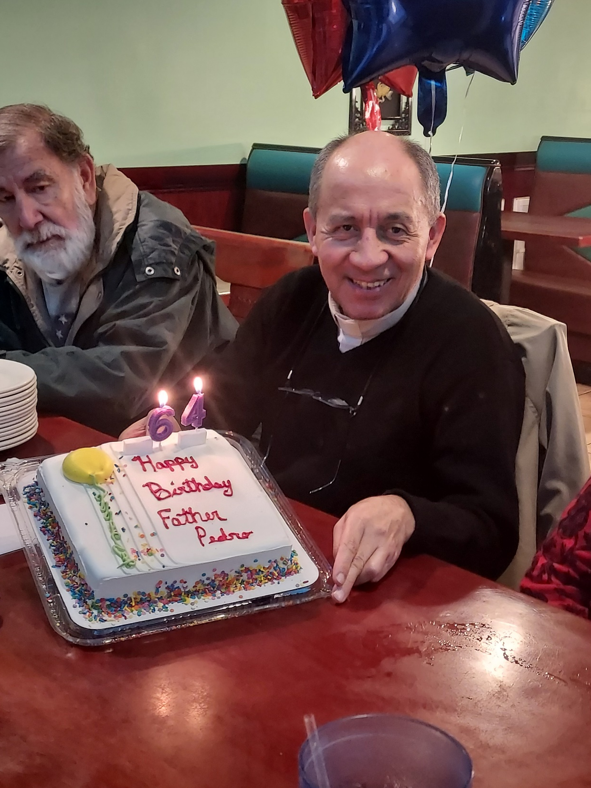
Fr.’s birthday
January 2024

Slide 29
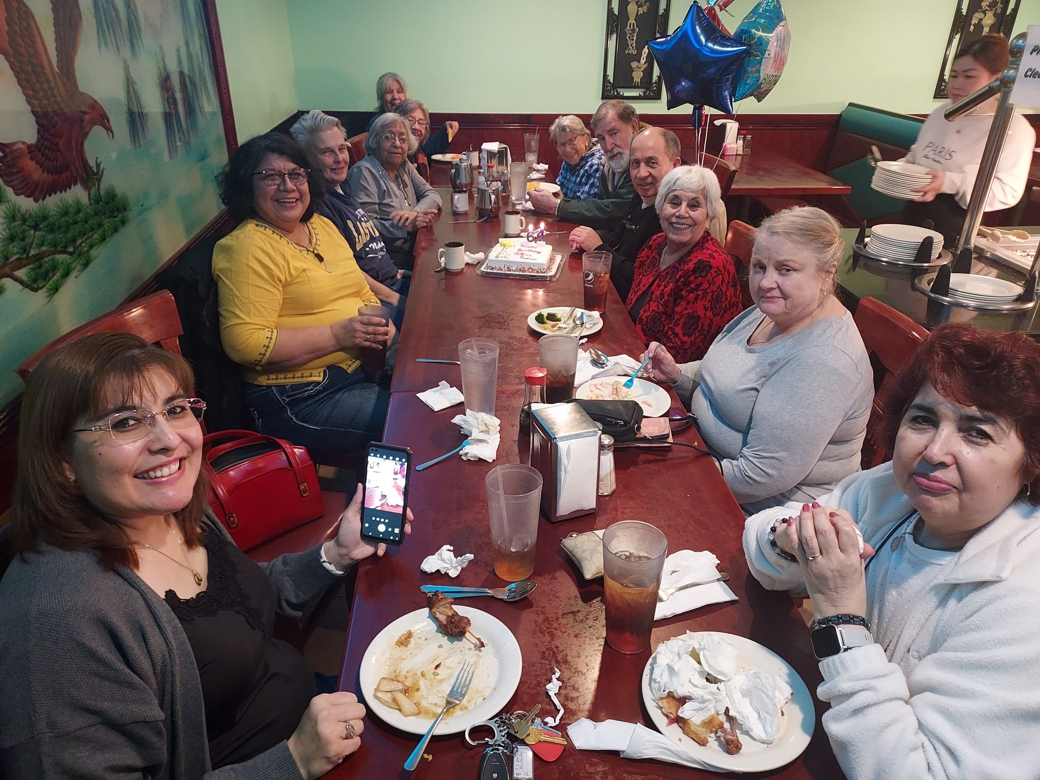

Slide 30
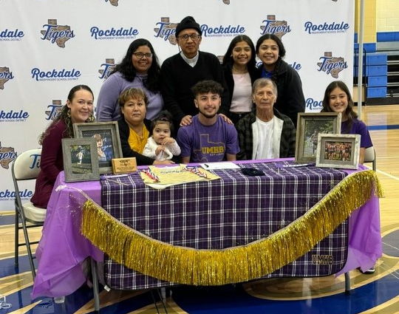
Jesus Bocanegra’s Scholarship Signing - February 2024

Slide 31
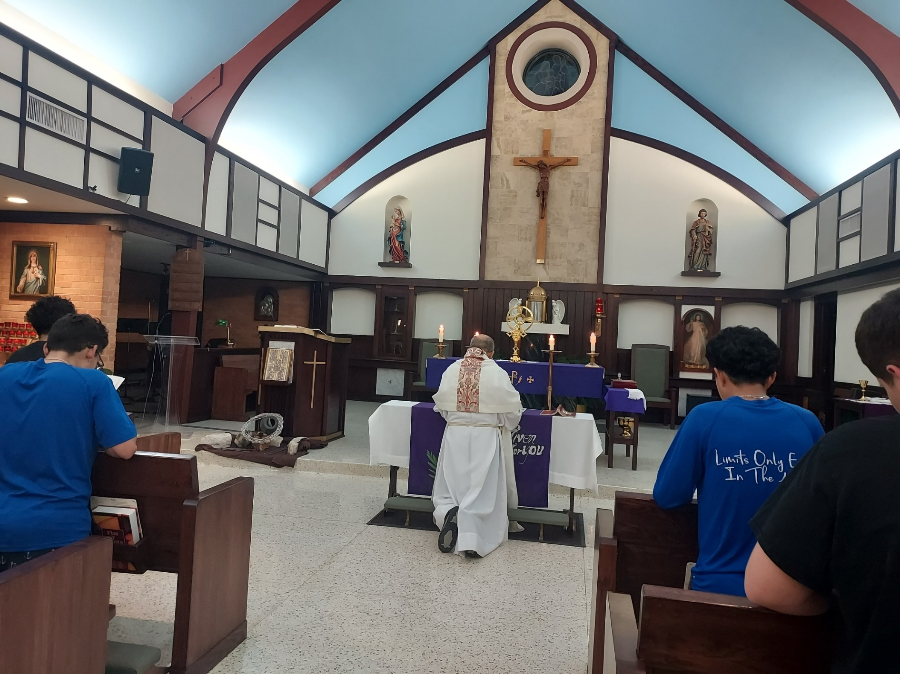
Adoration – February 2024

Slide 32
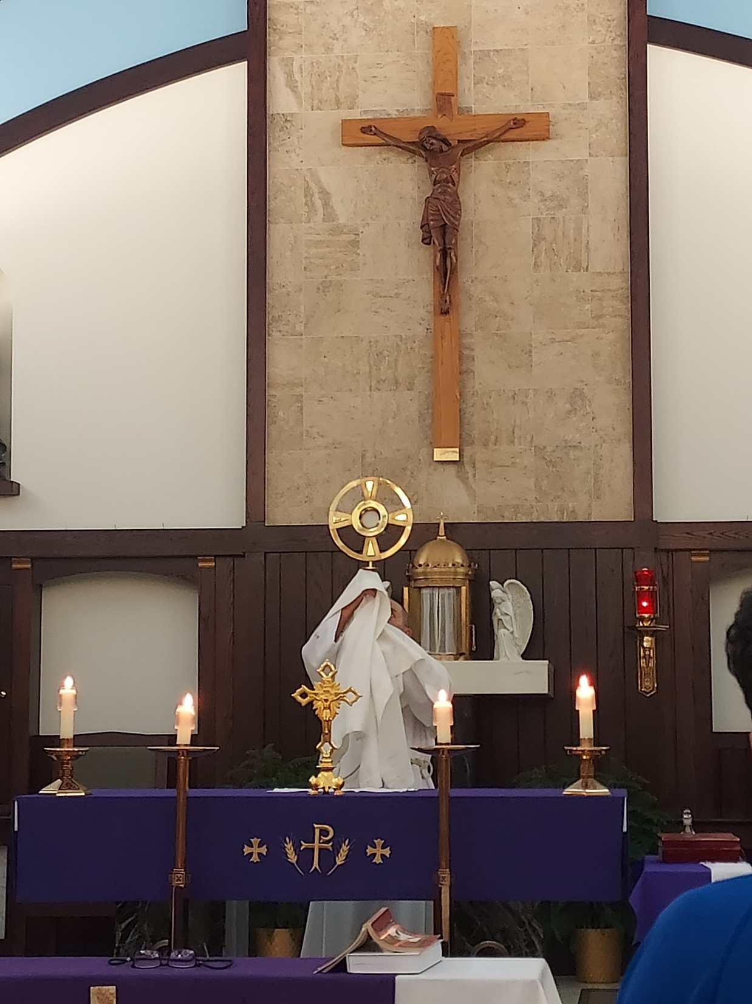

Slide 33
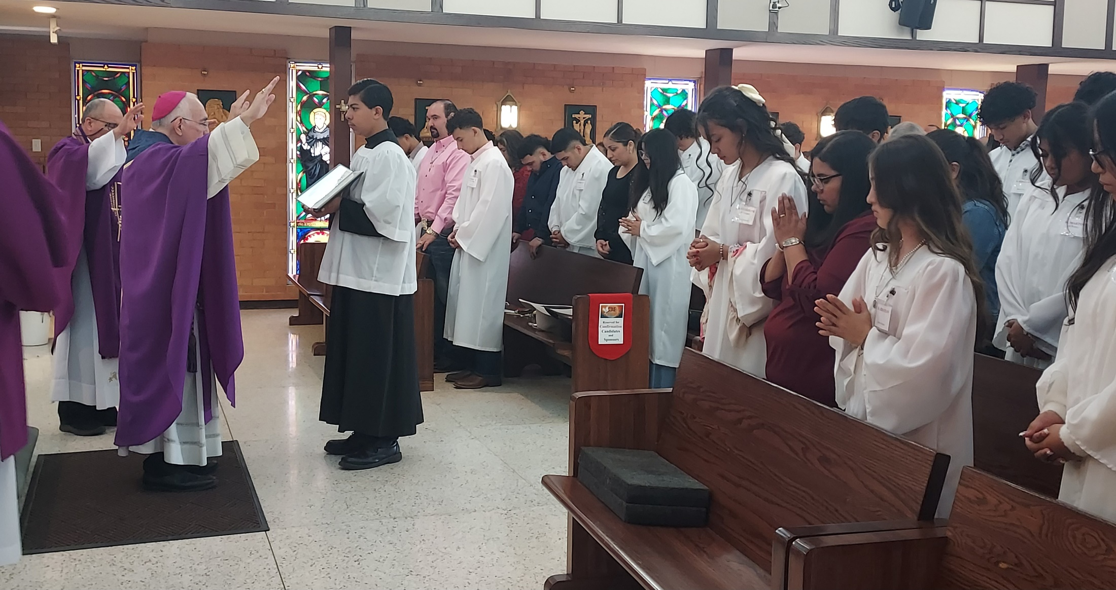
Confirmation – February 2024

Slide 34
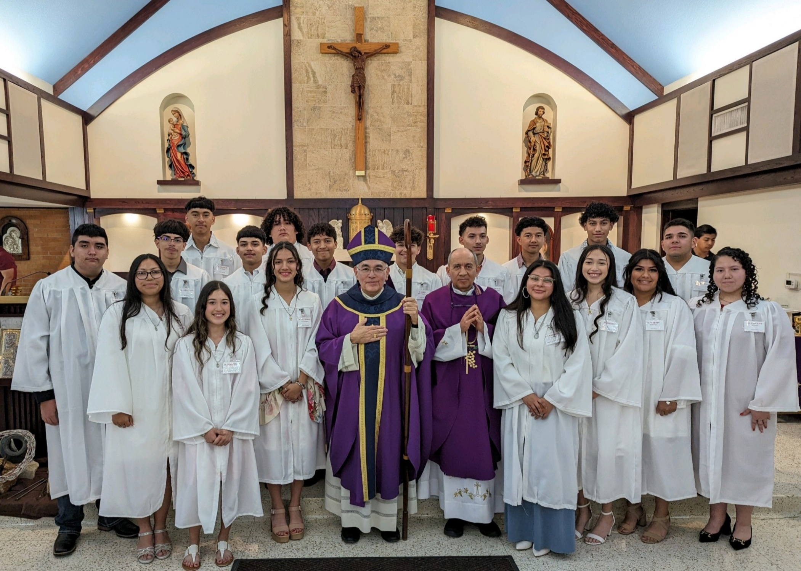

Slide 35
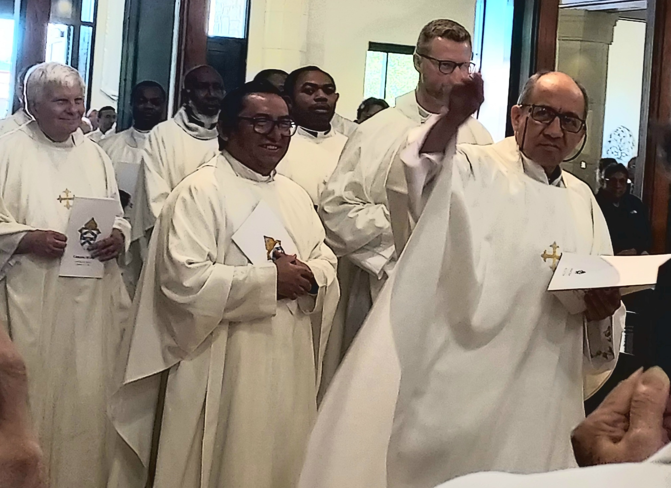
Chrism Mass - March 2024

Slide 36
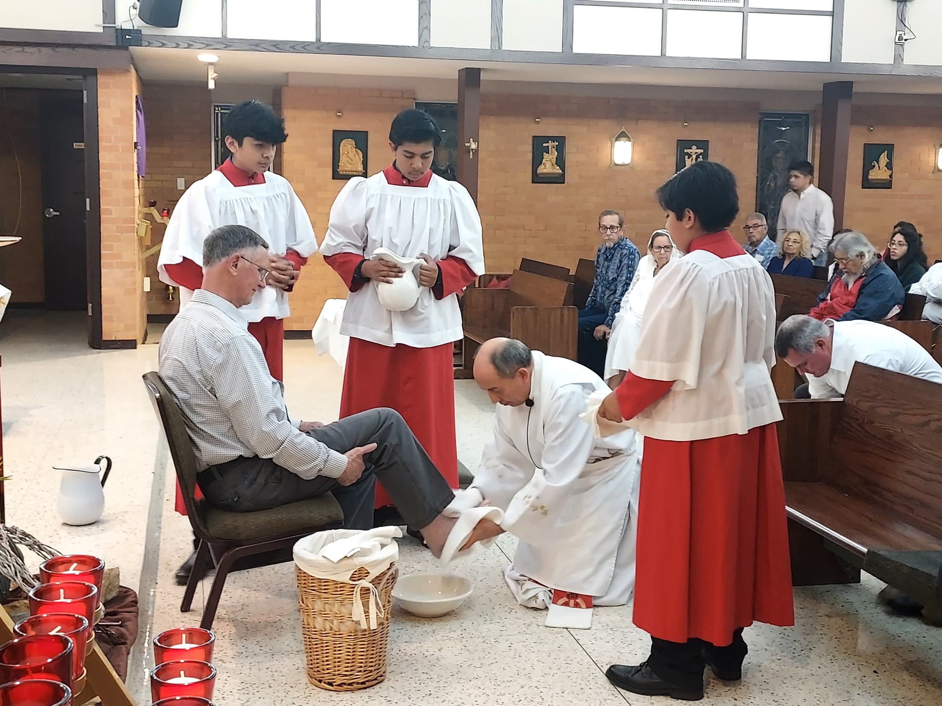
Holy Thursday – March 2024
Phil Konarik

Slide 37
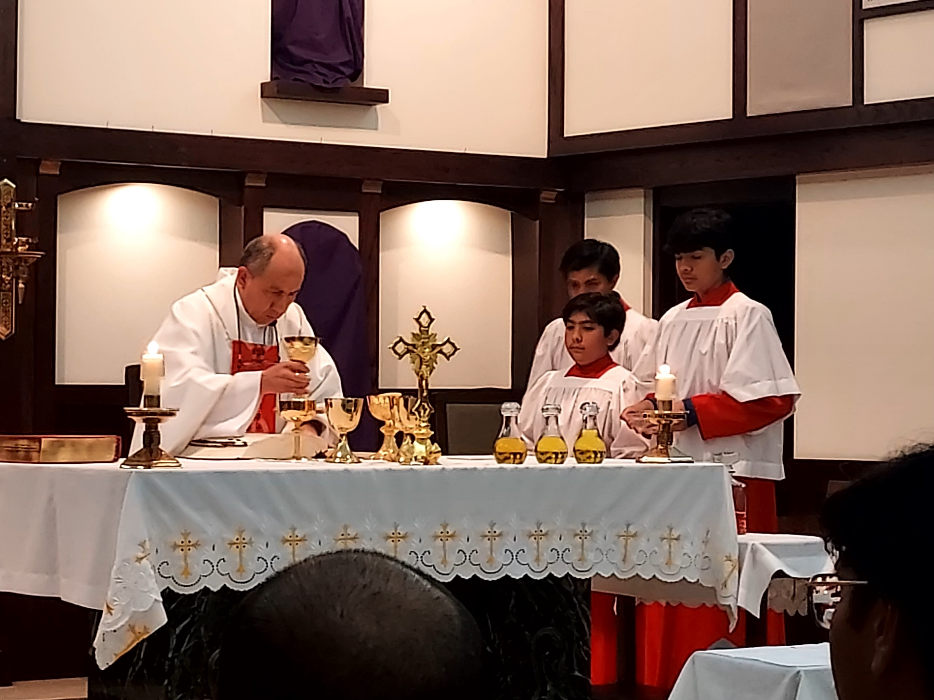

Slide 38
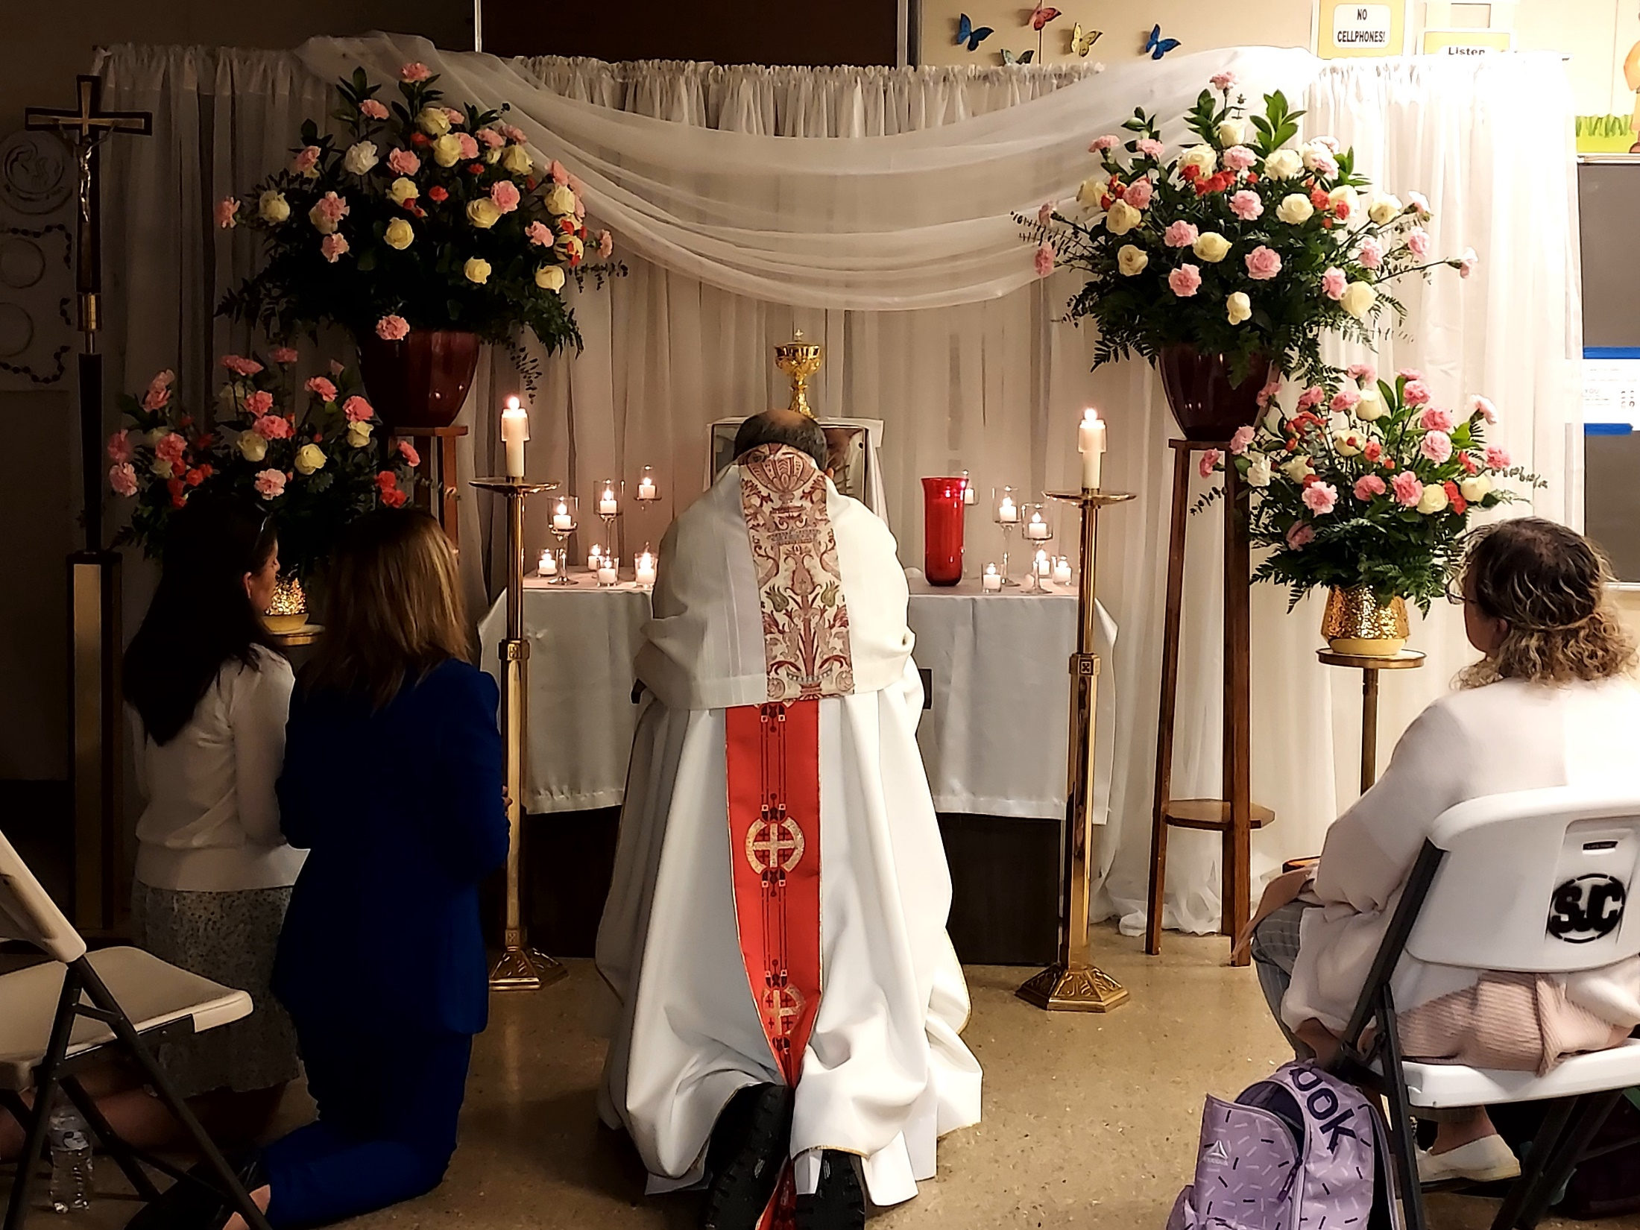

Slide 39
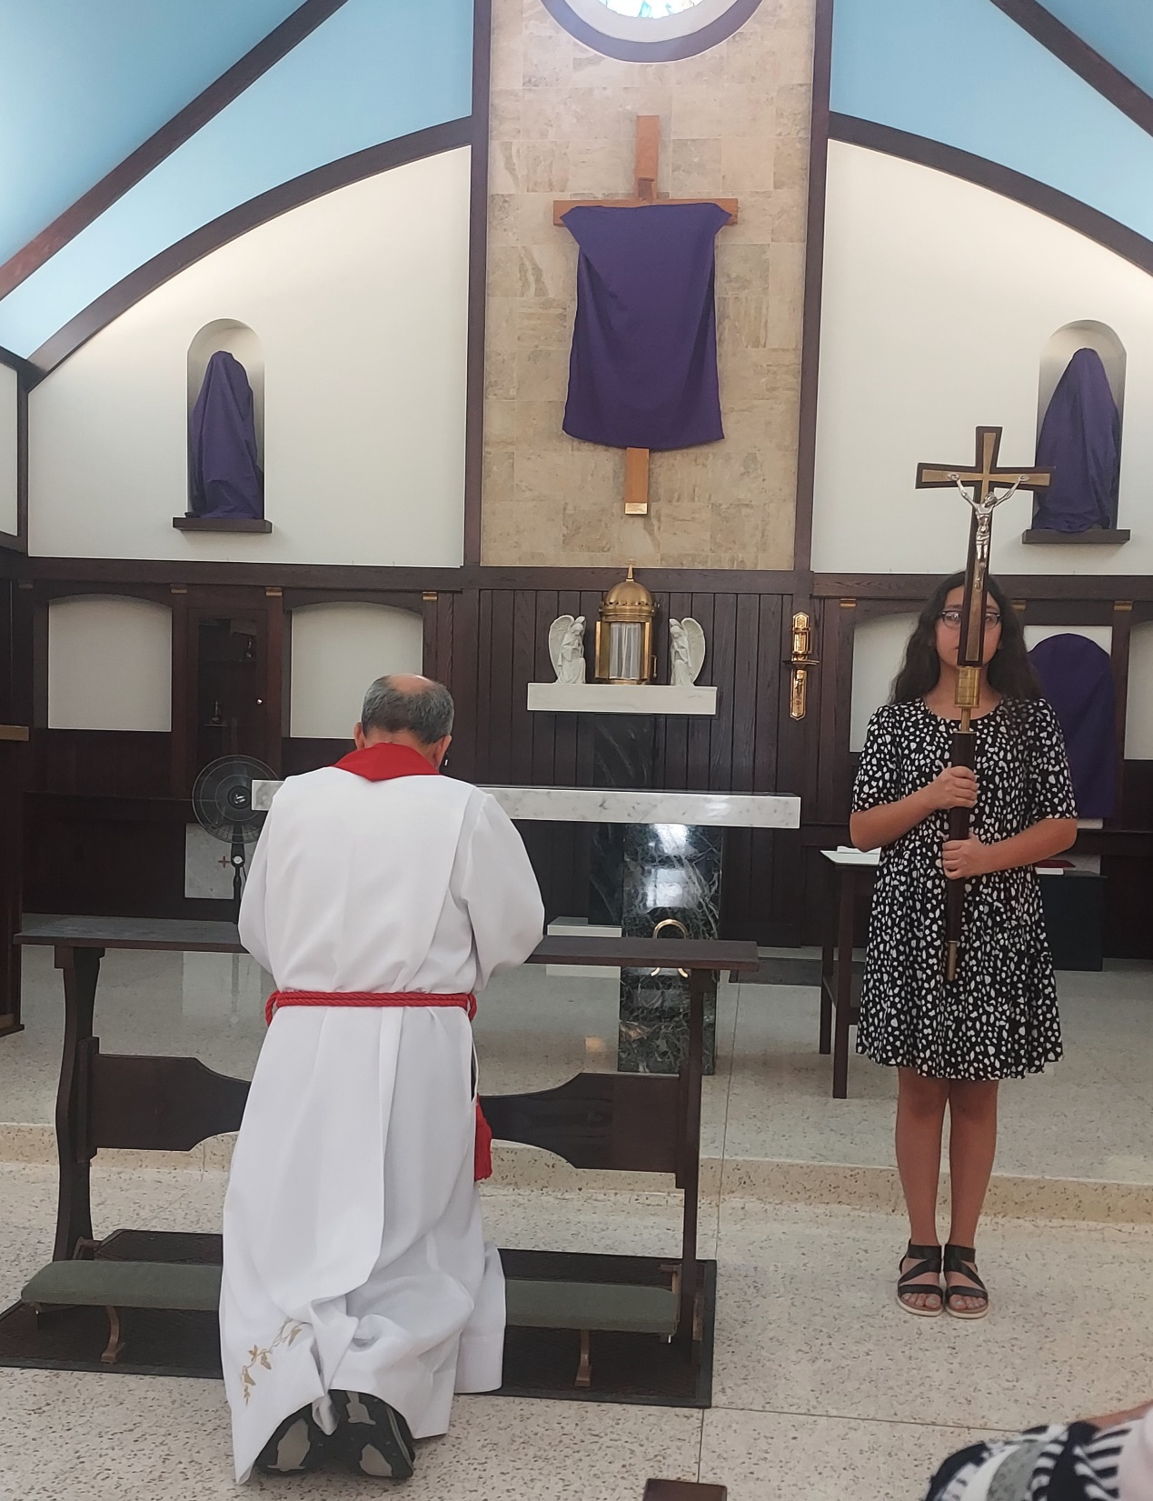
Good Friday
March 2024

Slide 41
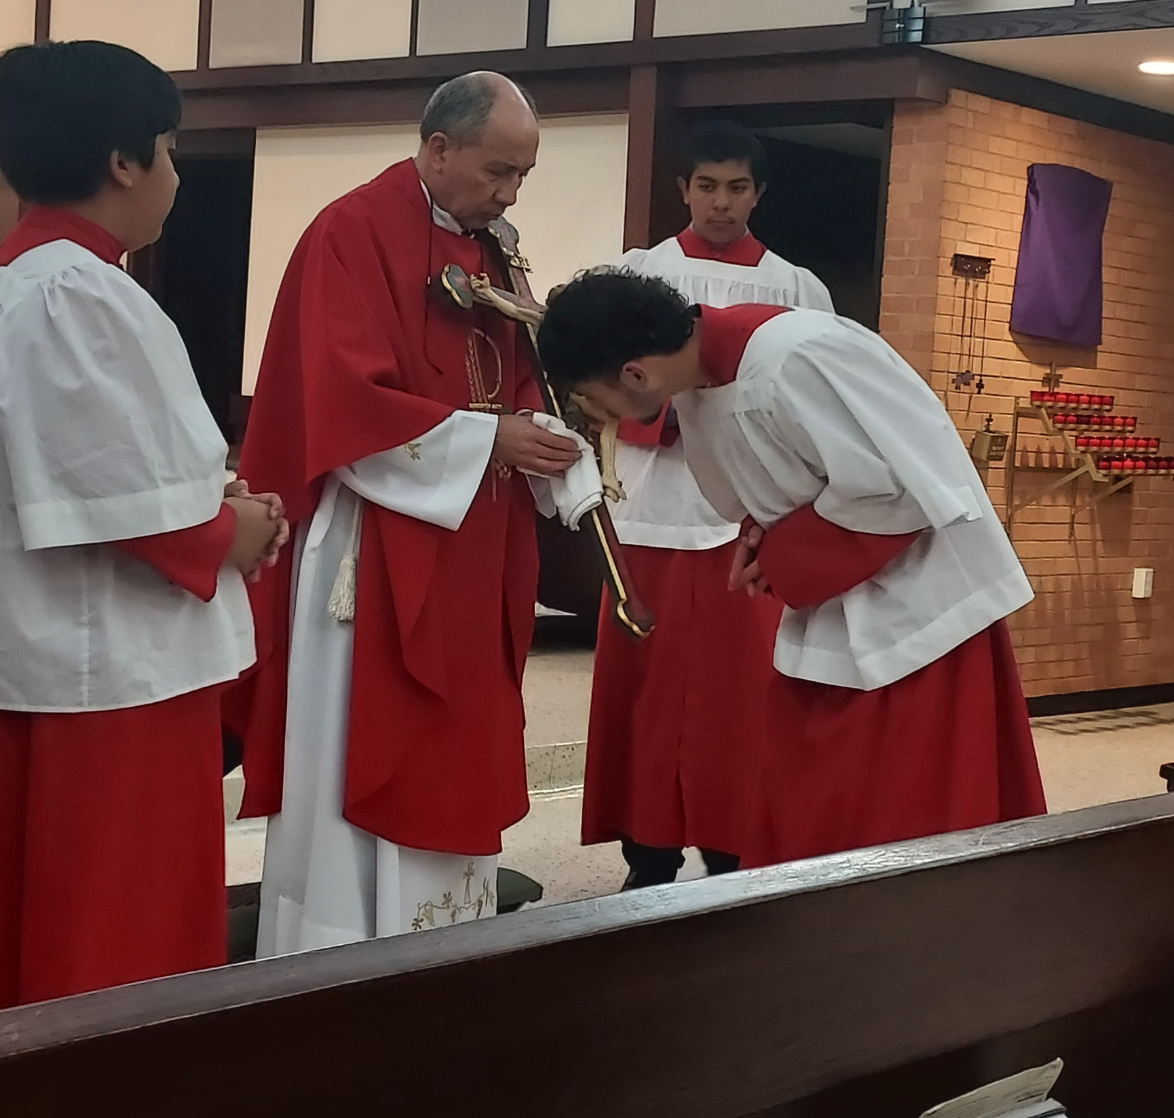

Slide 42
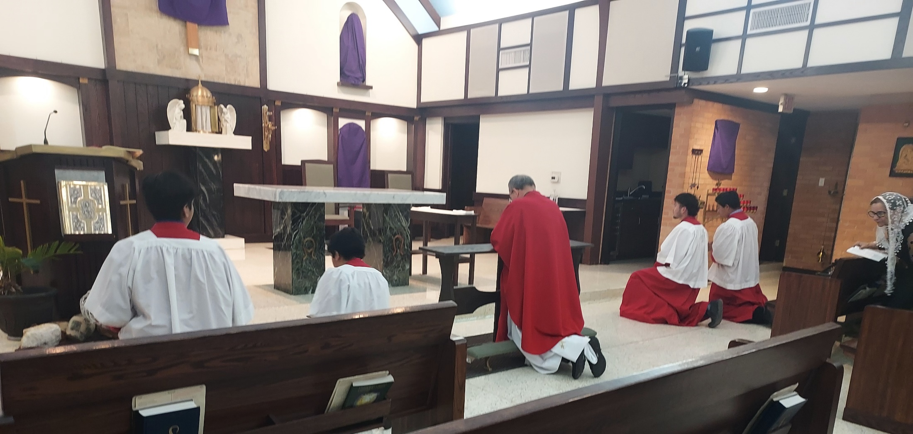

Slide 43
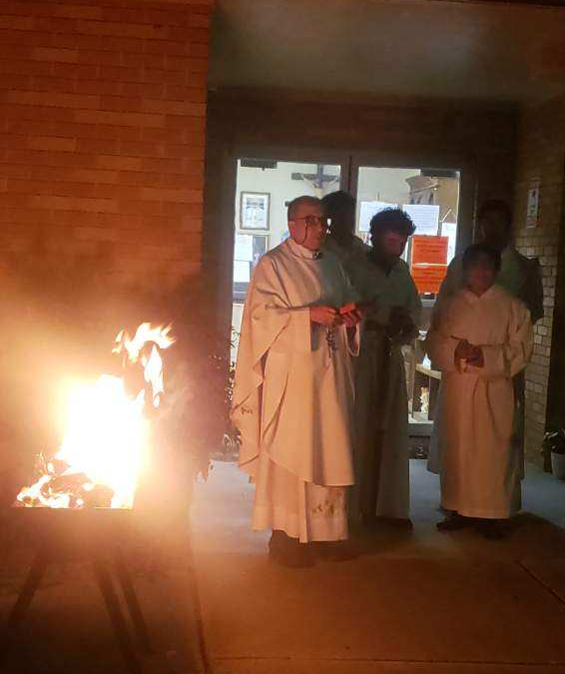
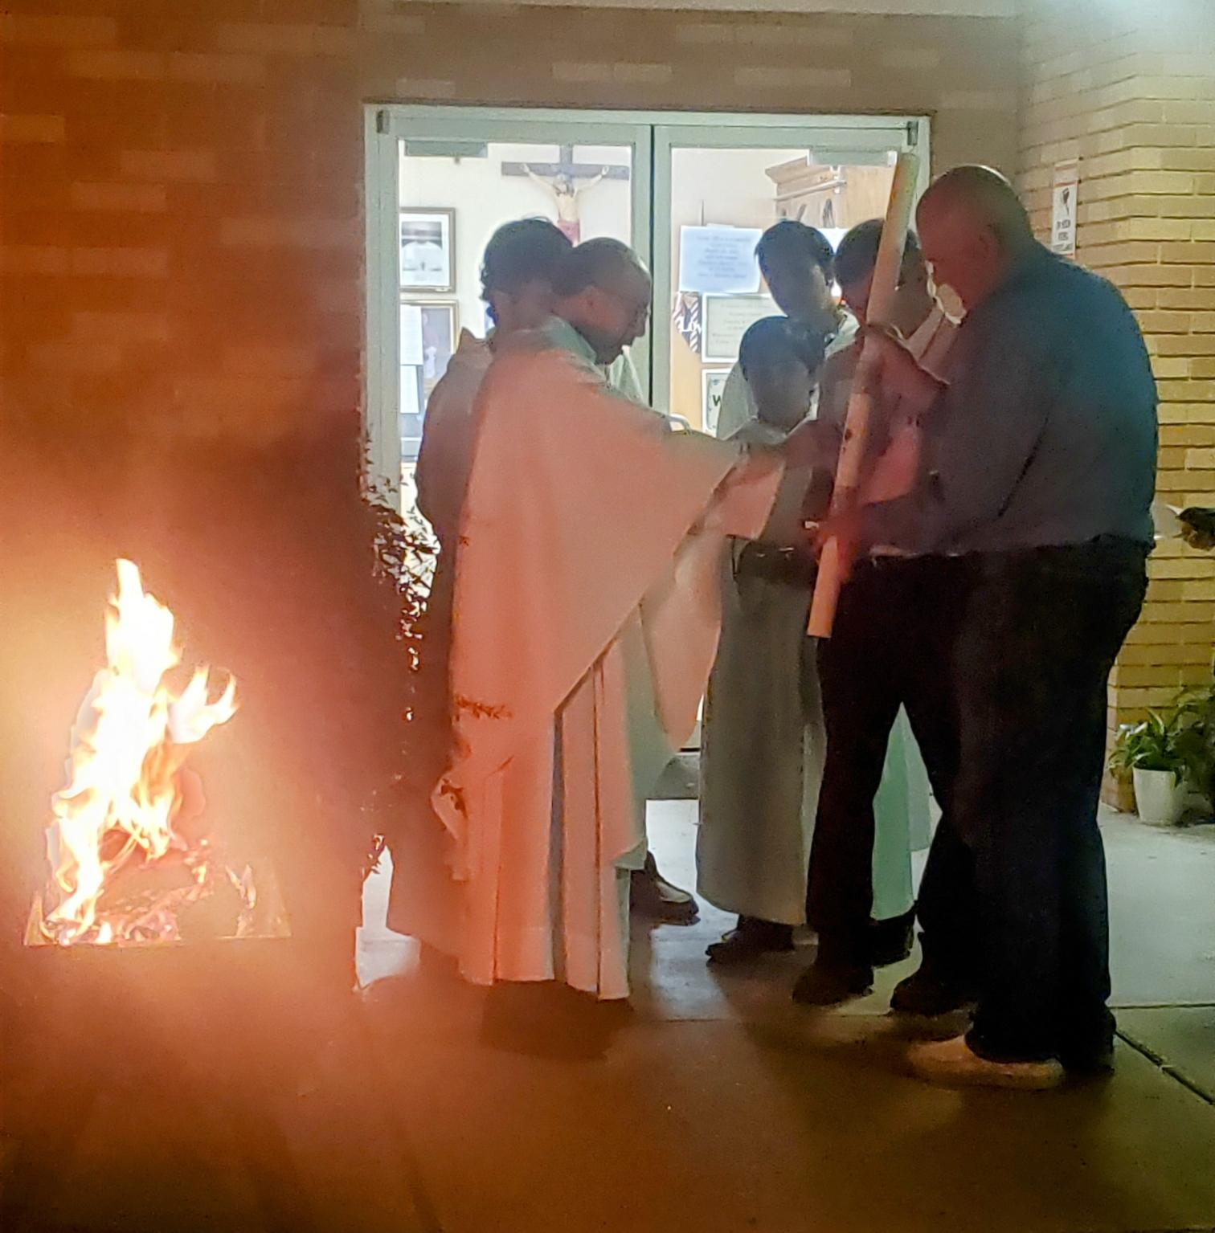
Easter Vigil – March 2024

Slide 44
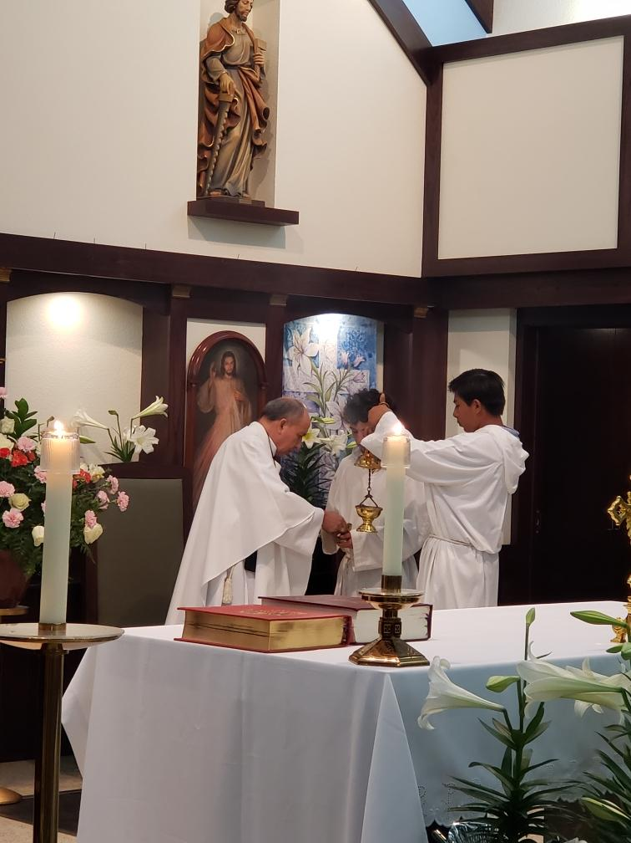

Slide 45
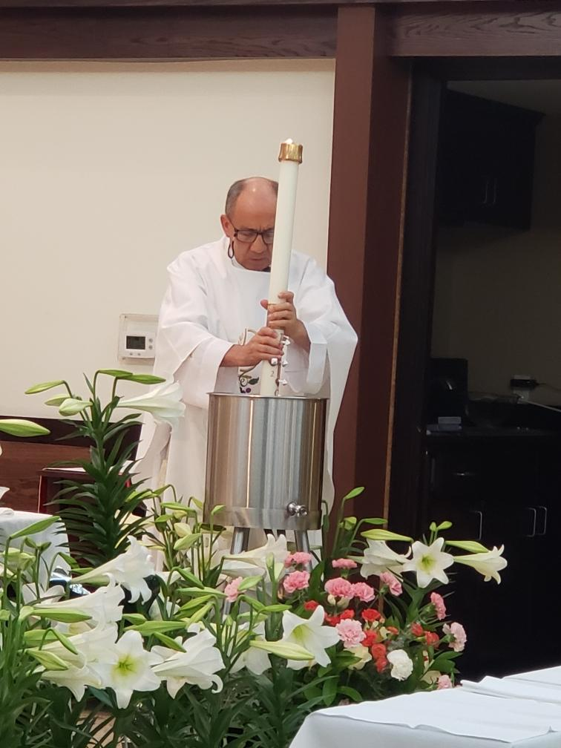
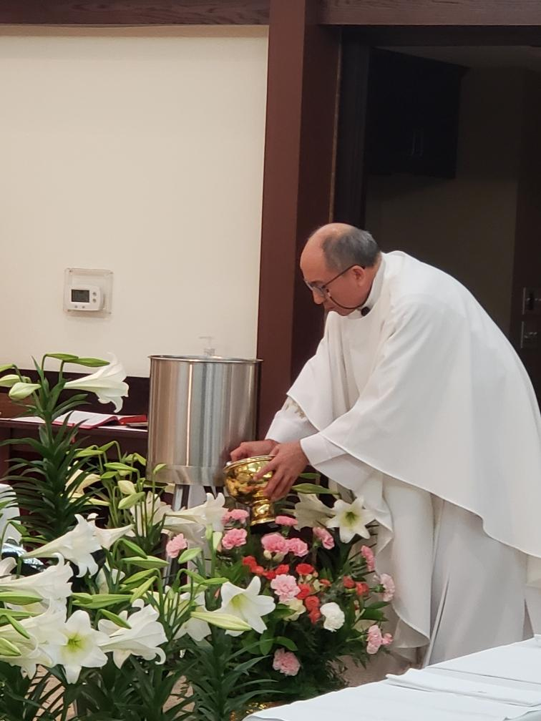

Slide 47
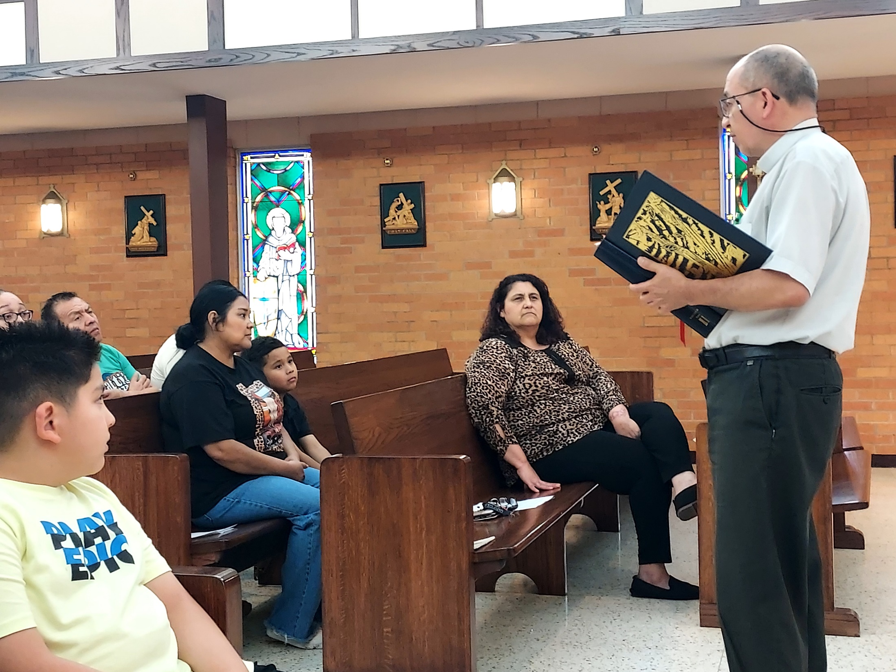
1st Communion practice - April 2024

Slide 48
EMOHC commissioning
April 2024

Slide 50
Good Shepherd Sunday letters to Fr. - April 2024

Slide 55
Volunteer Appreciation Dinner
April 2024

Slide 59
Altar Server Training - May 2024

Slide 62
Mentoring The Daughters of Mary
May 2024

Slide 65
Children’s collection
May 2024

Slide 68
Baptisms - May 2024

Slide 69
Grant Damian Twining

Slide 70
Juan Pablo Robles

Slide 71
1st Communions
May 2024

Slide 72
Brantley Konarik

Slide 73
Domingo Llanas III

Slide 74
Fr. Pedro’s Going Away Celebration - May 2024
Nancy Phillips

Slide 76
Nancy & Pete Zenner

Slide 77
Dolores Masiel

Slide 78
Martha Bocanegra

Slide 80
Molly Marquez

Slide 83
Eddy & Tina Bui; Gina, Gretchen

Slide 84
Sylvia & Manuel Ramos

Slide 85
Juan & Maria Chavez; Abigail & Omar

Slide 86
Luis & Betty Esquievel; Adrian

Slide 87
Moises & Maria Ruelas; Marcos, Andres

Slide 89
Luis & Azucena Lepe; Sebastian, Katherine

Slide 90
Javier & Bianey Rivera family

Slide 91
Benito Costilla & Marina Costilla

Slide 92
Gabriel & Erika Obiedo; Everlee, Ella, Emilia

Slide 93
Maria Tristan; Samuel, Fatima, Isabella, Ana

Slide 94
Leo & Maria Dubey

Slide 95
Martha Bocanegra family

Slide 96
Jose & Lucia Acosta; Julian, Lizbeth

Slide 98
Mark & Maria Santellano; Mariana, Mario, Marcos

Slide 100
Eugene & Bonnie Holub

Slide 101
Amalia Hernandez

Slide 102
Gloria Pedroza

Slide 103
Martha Jeffcoat & Gloria Pedroza

Slide 104
Theresa Alvarez

Slide 107
Deacon Gus & Norma Coelho

Slide 108
Tom Hormuth

Slide 109
Kaely Lopez

Slide 110
RE Closing Mass
May 2024

Slide 111
Anointing of the Sick

Slide 114
We have truly been blessed to have you, Fr. Pedro, as our Good Shepherd.
May God continue to keep you in the palm of His hand.

