Slide 1
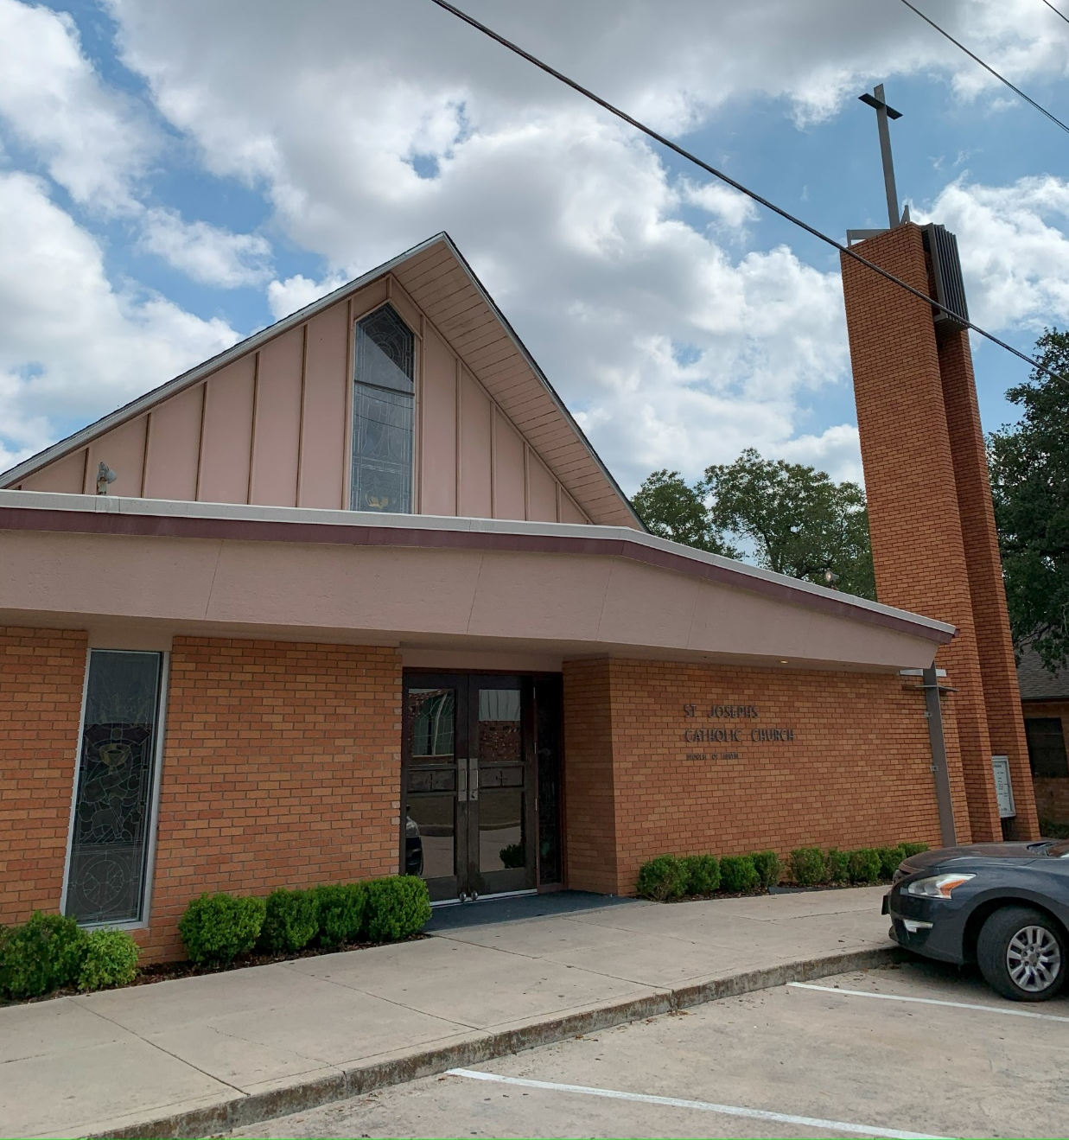
St. Joseph’s – Rockdale, Texas
July 6, 2017 …

Slide 2
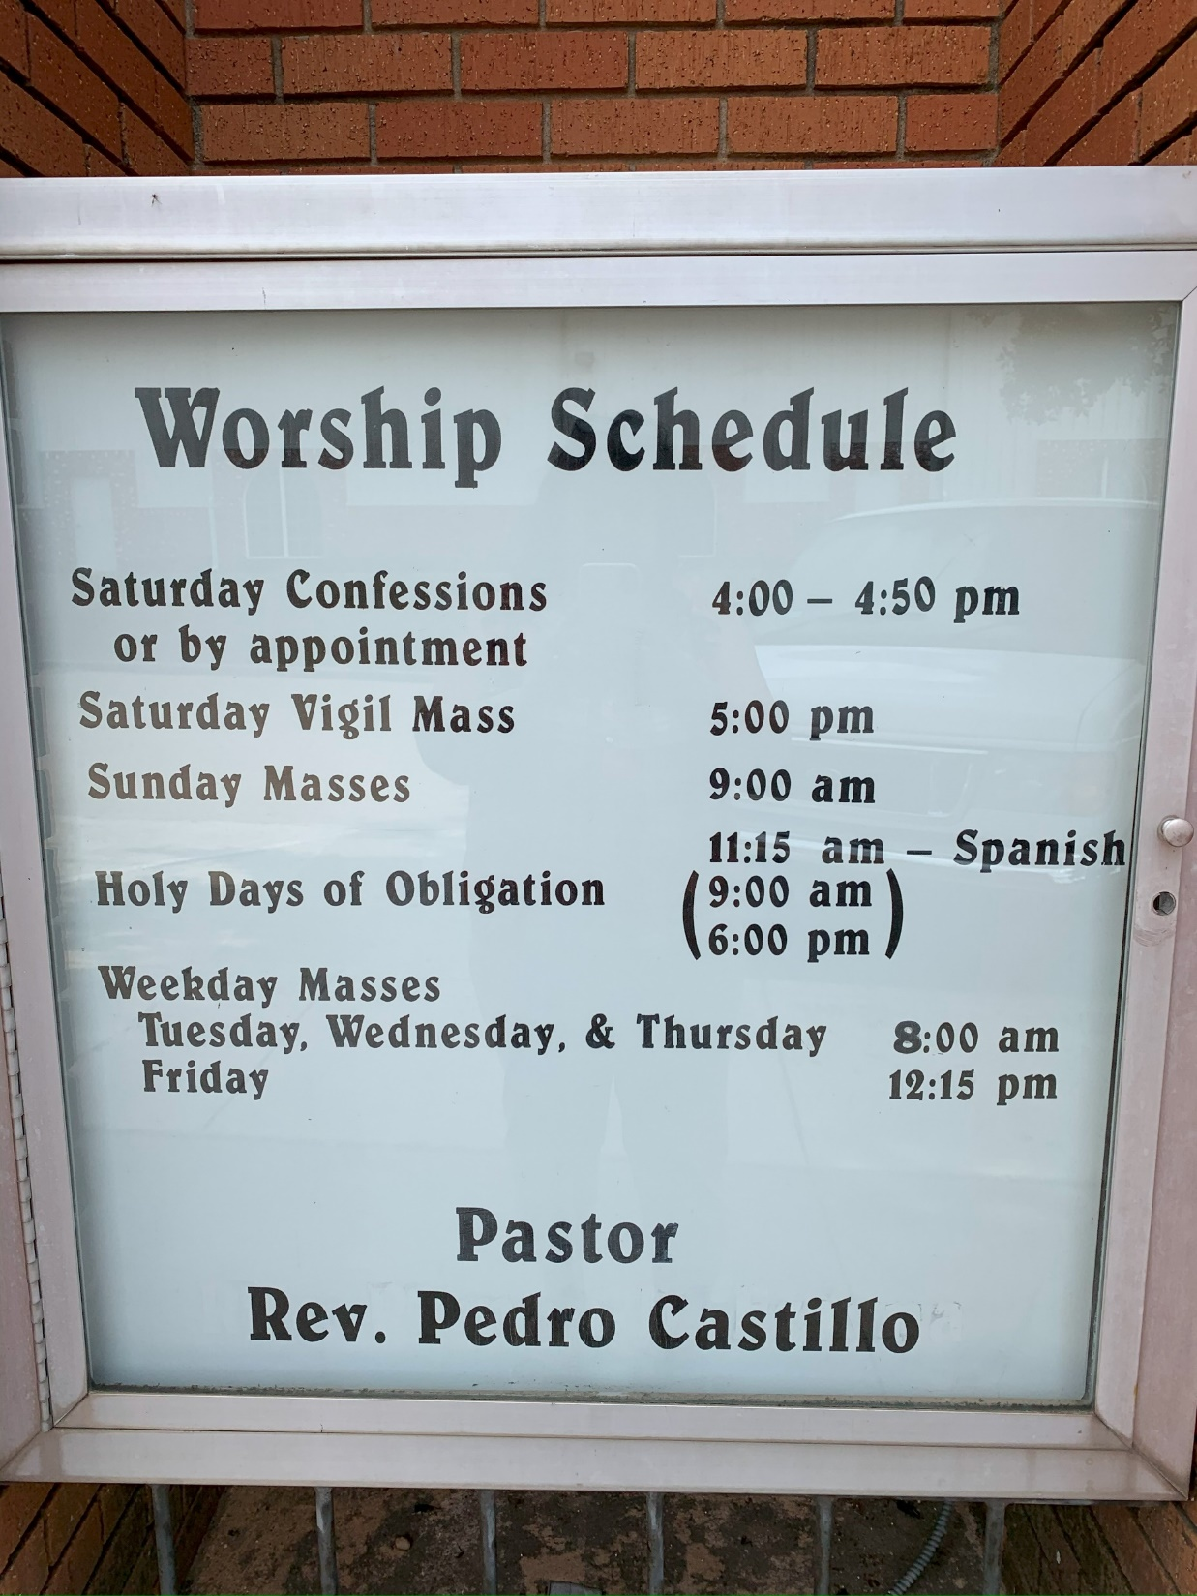

Slide 3
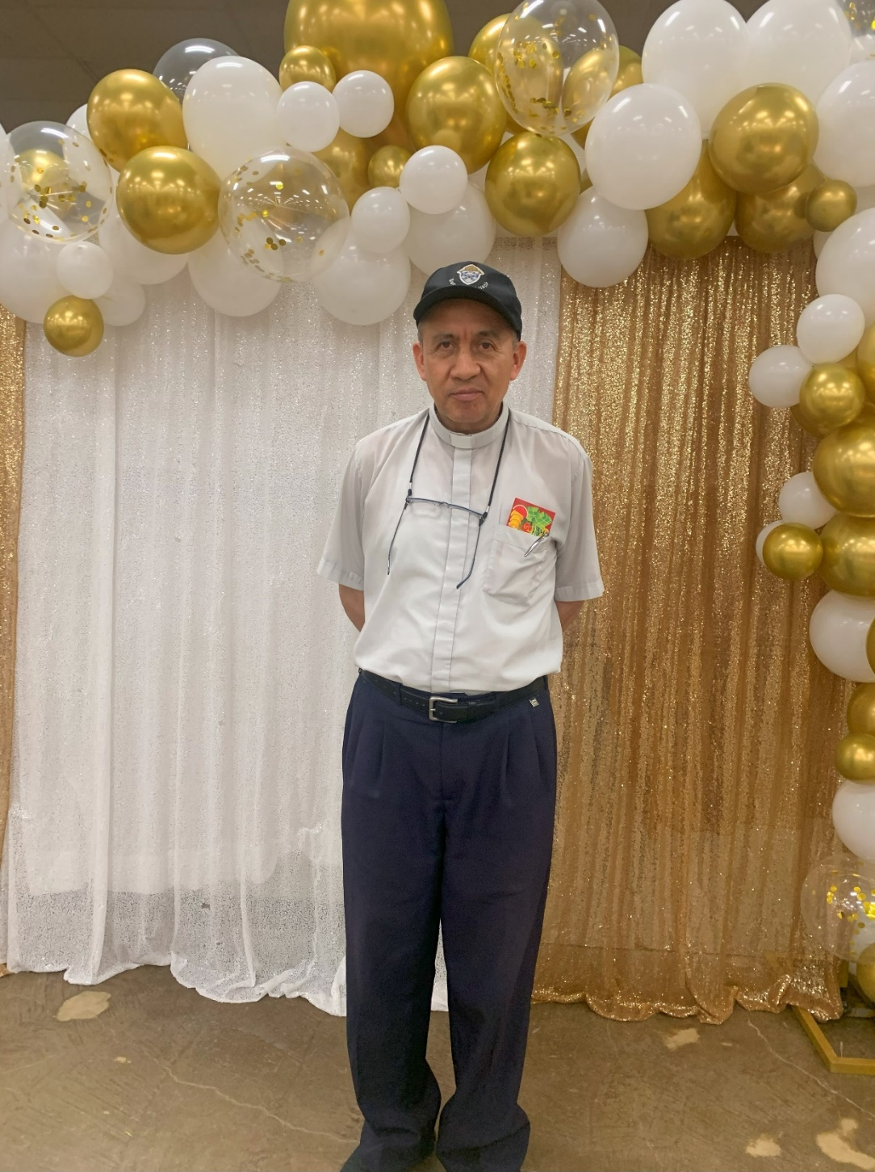
… May 13, 2024

Slide 4
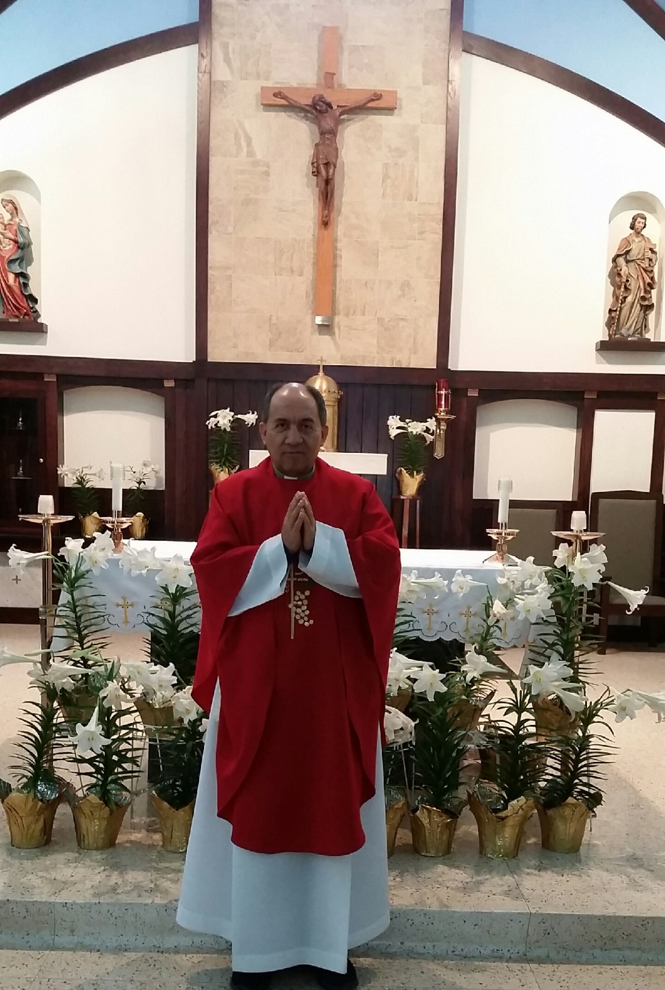

Slide 5
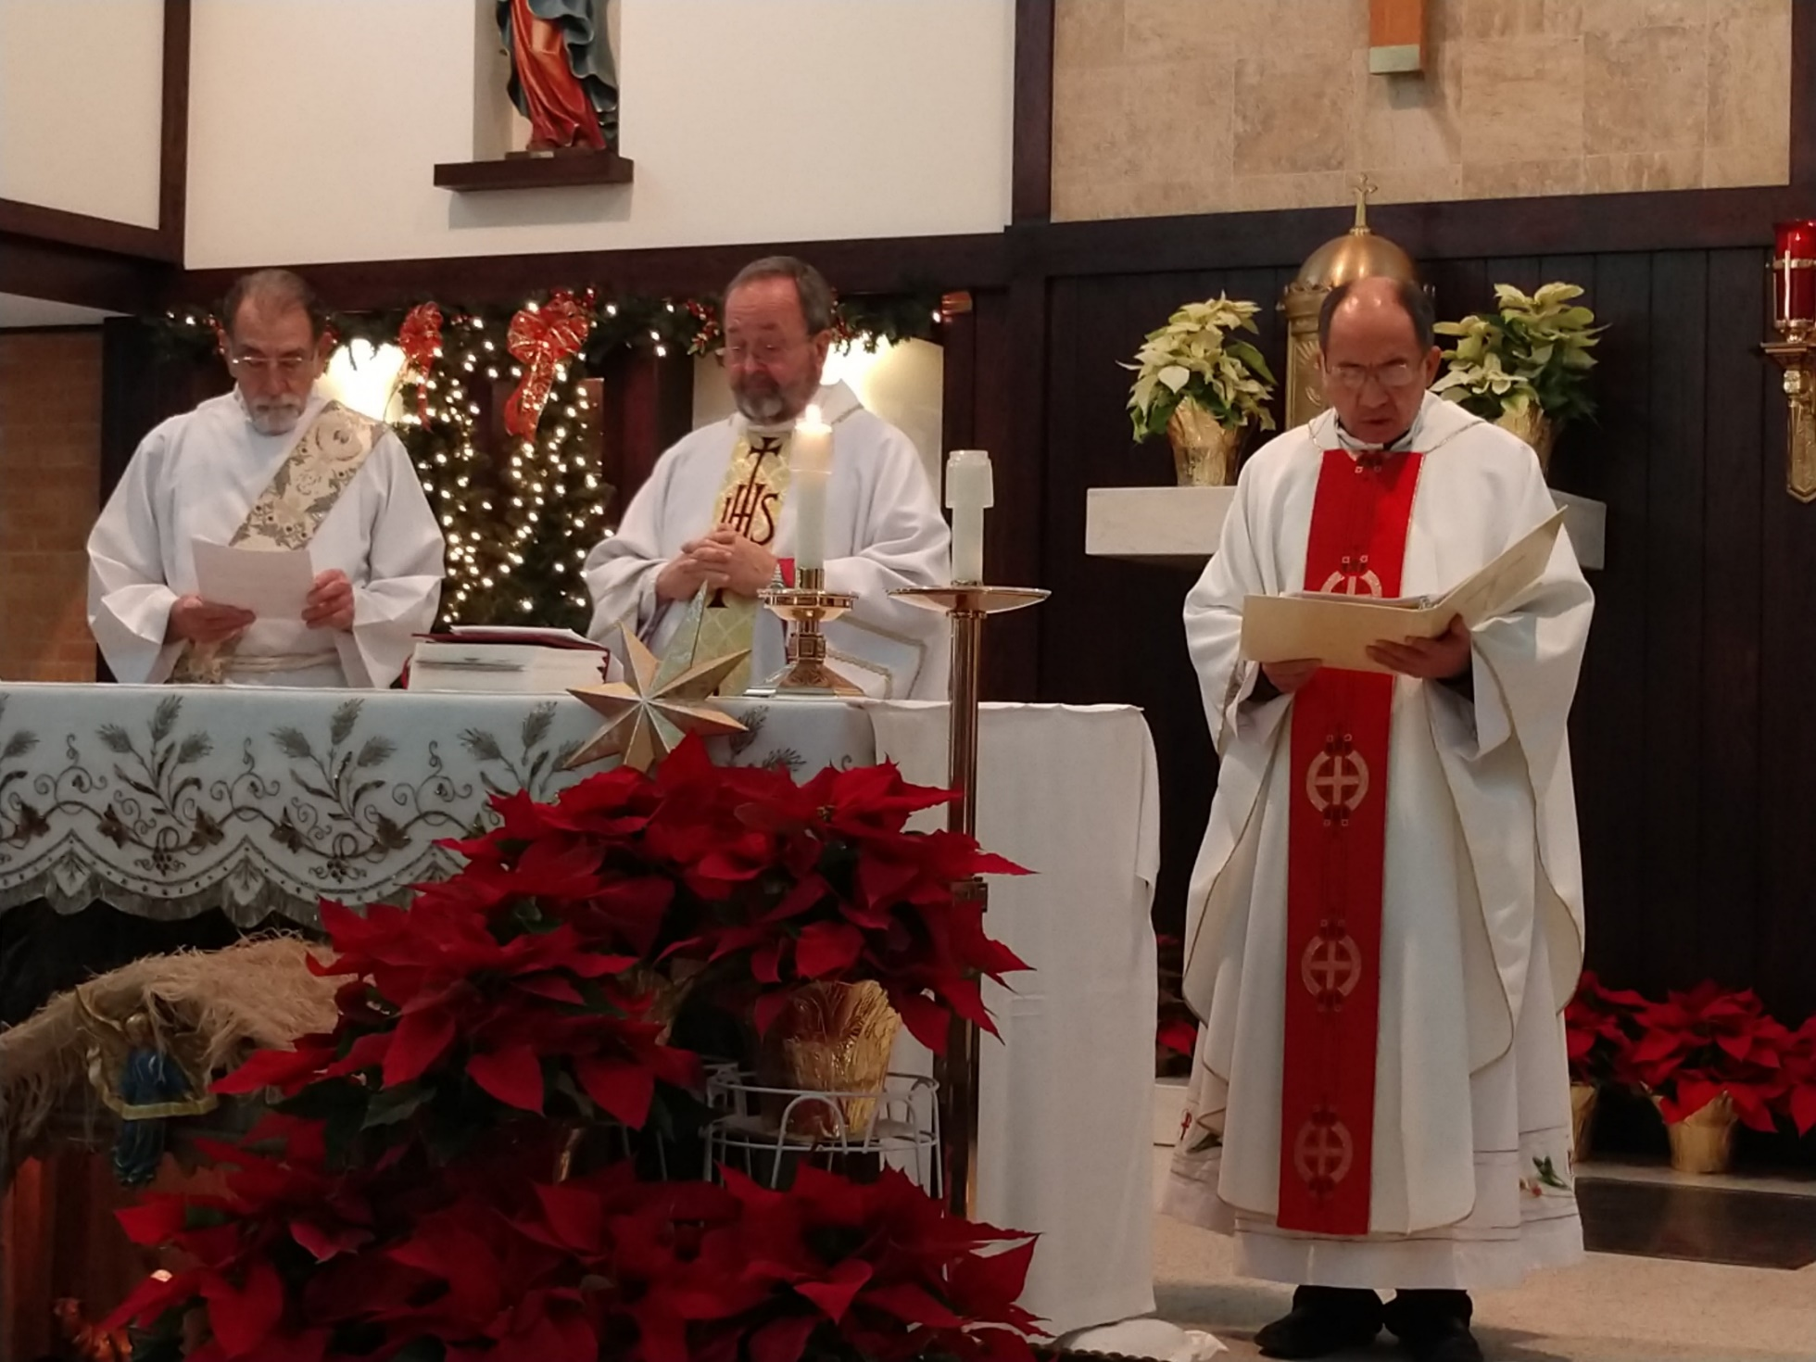
Fr.’s Installation to our parish – January 6, 2018

Slide 6
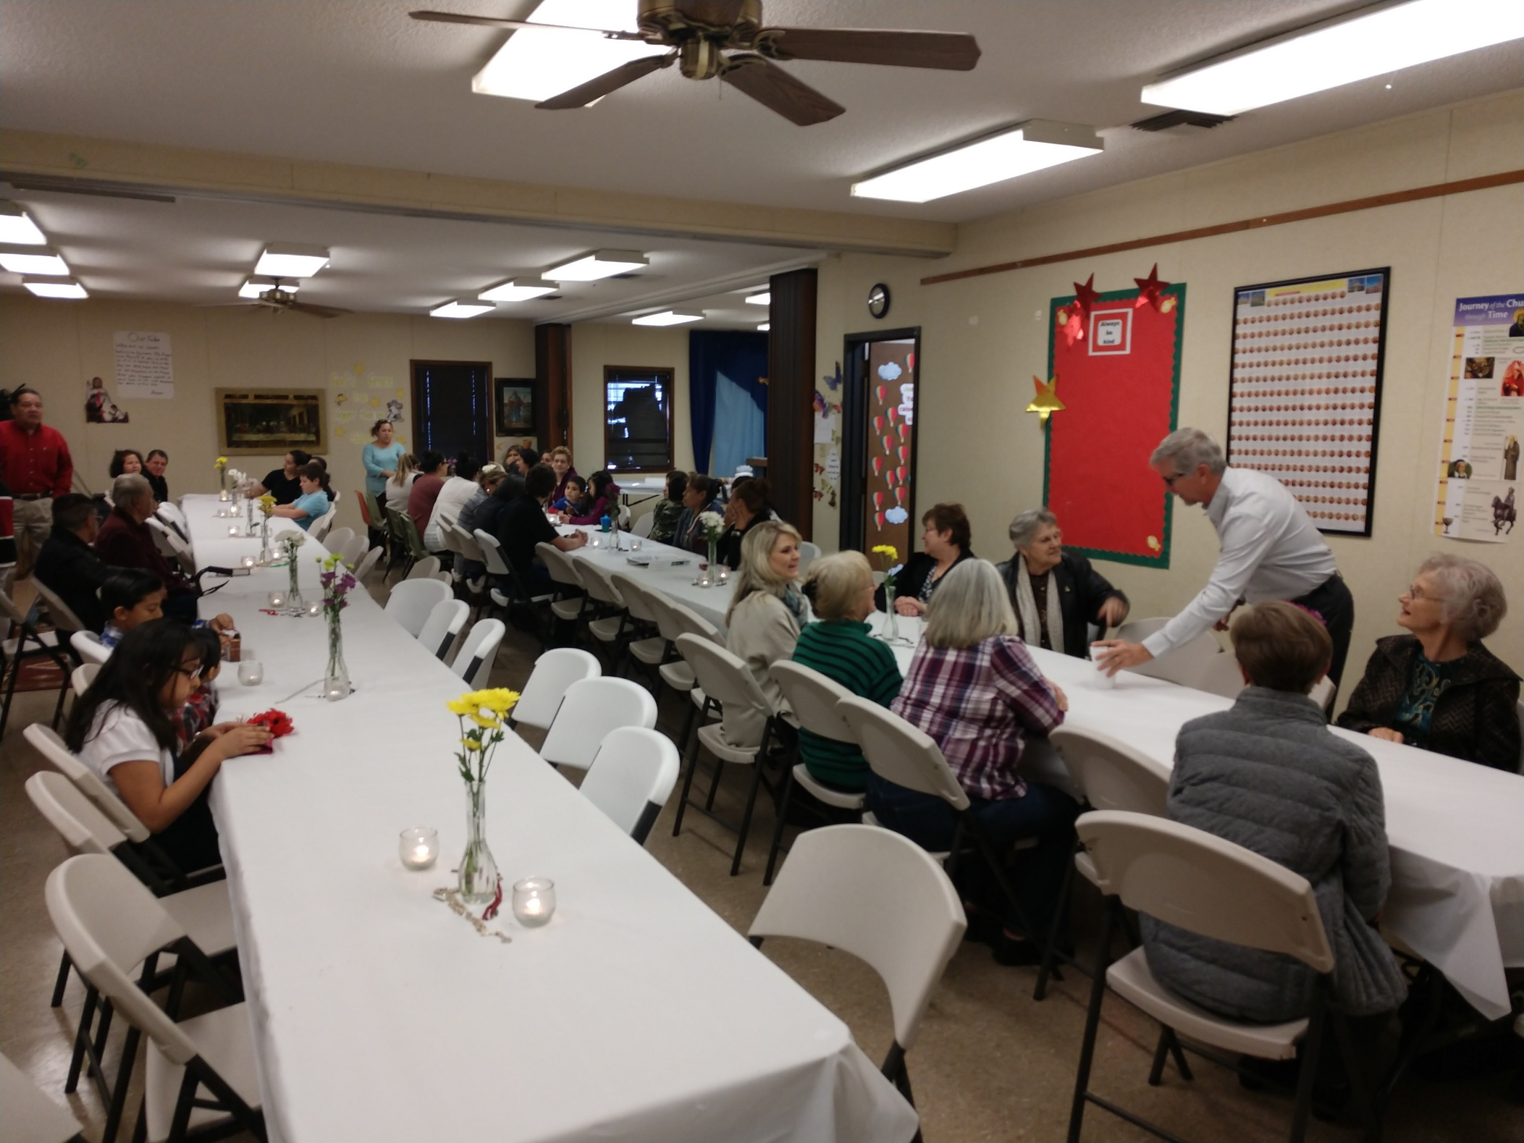

Slide 7
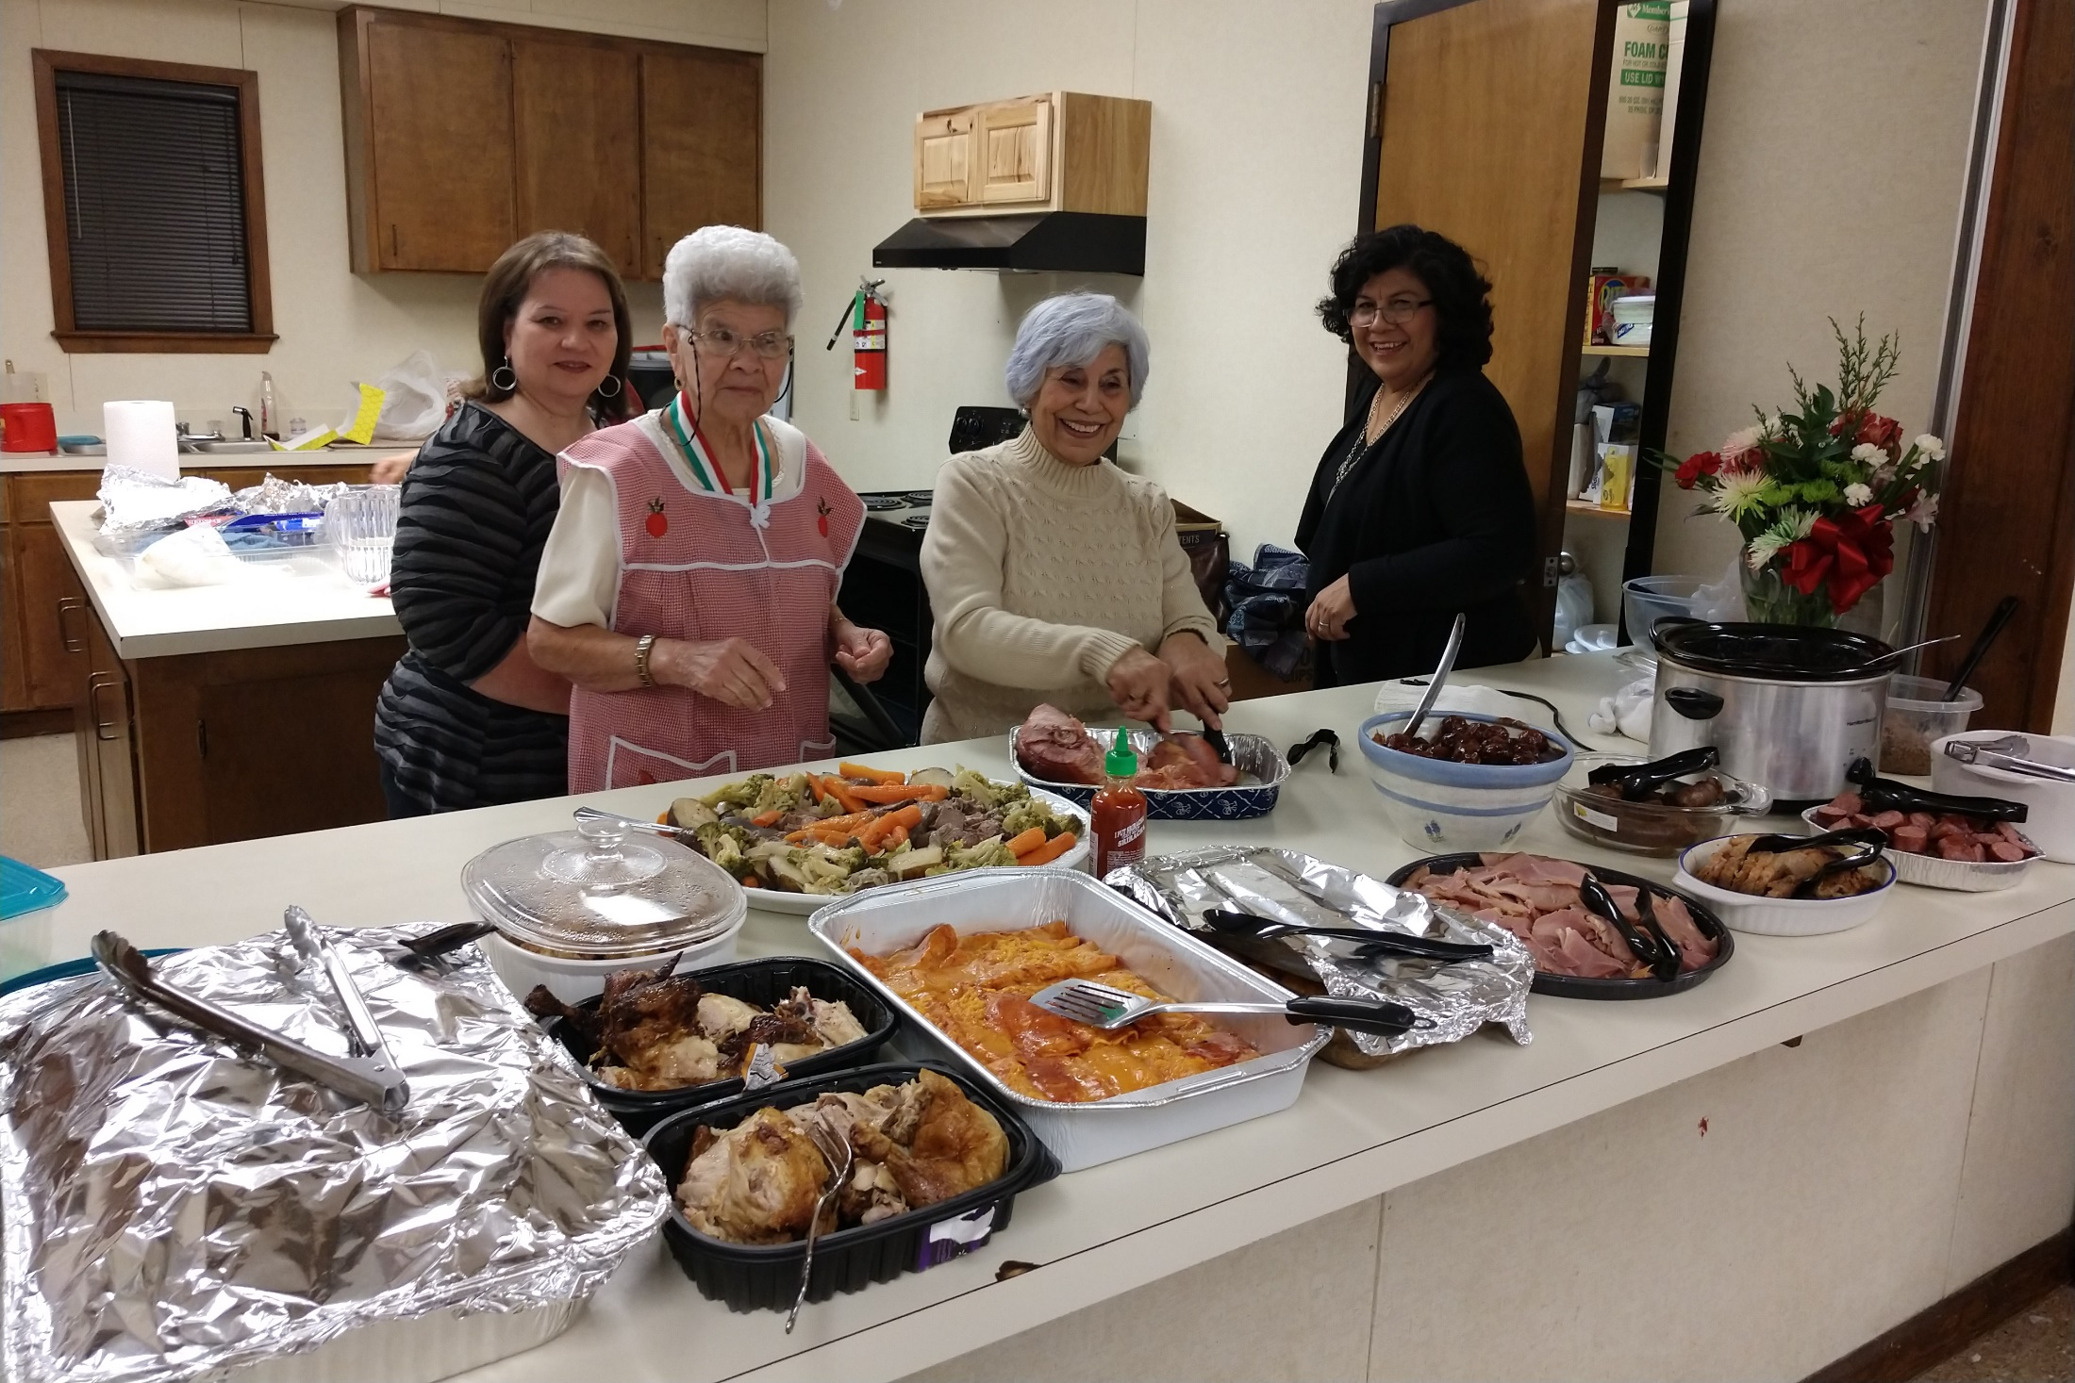

Slide 8
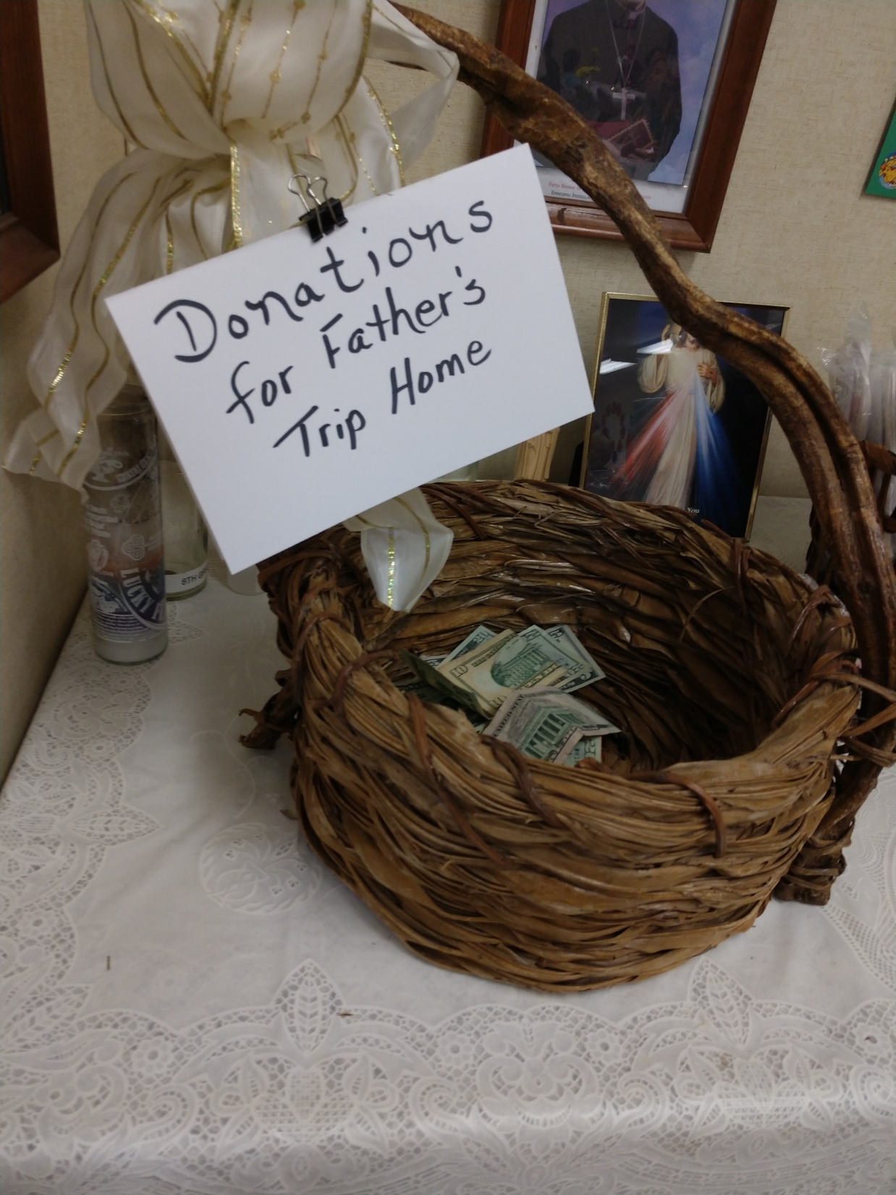

Slide 9
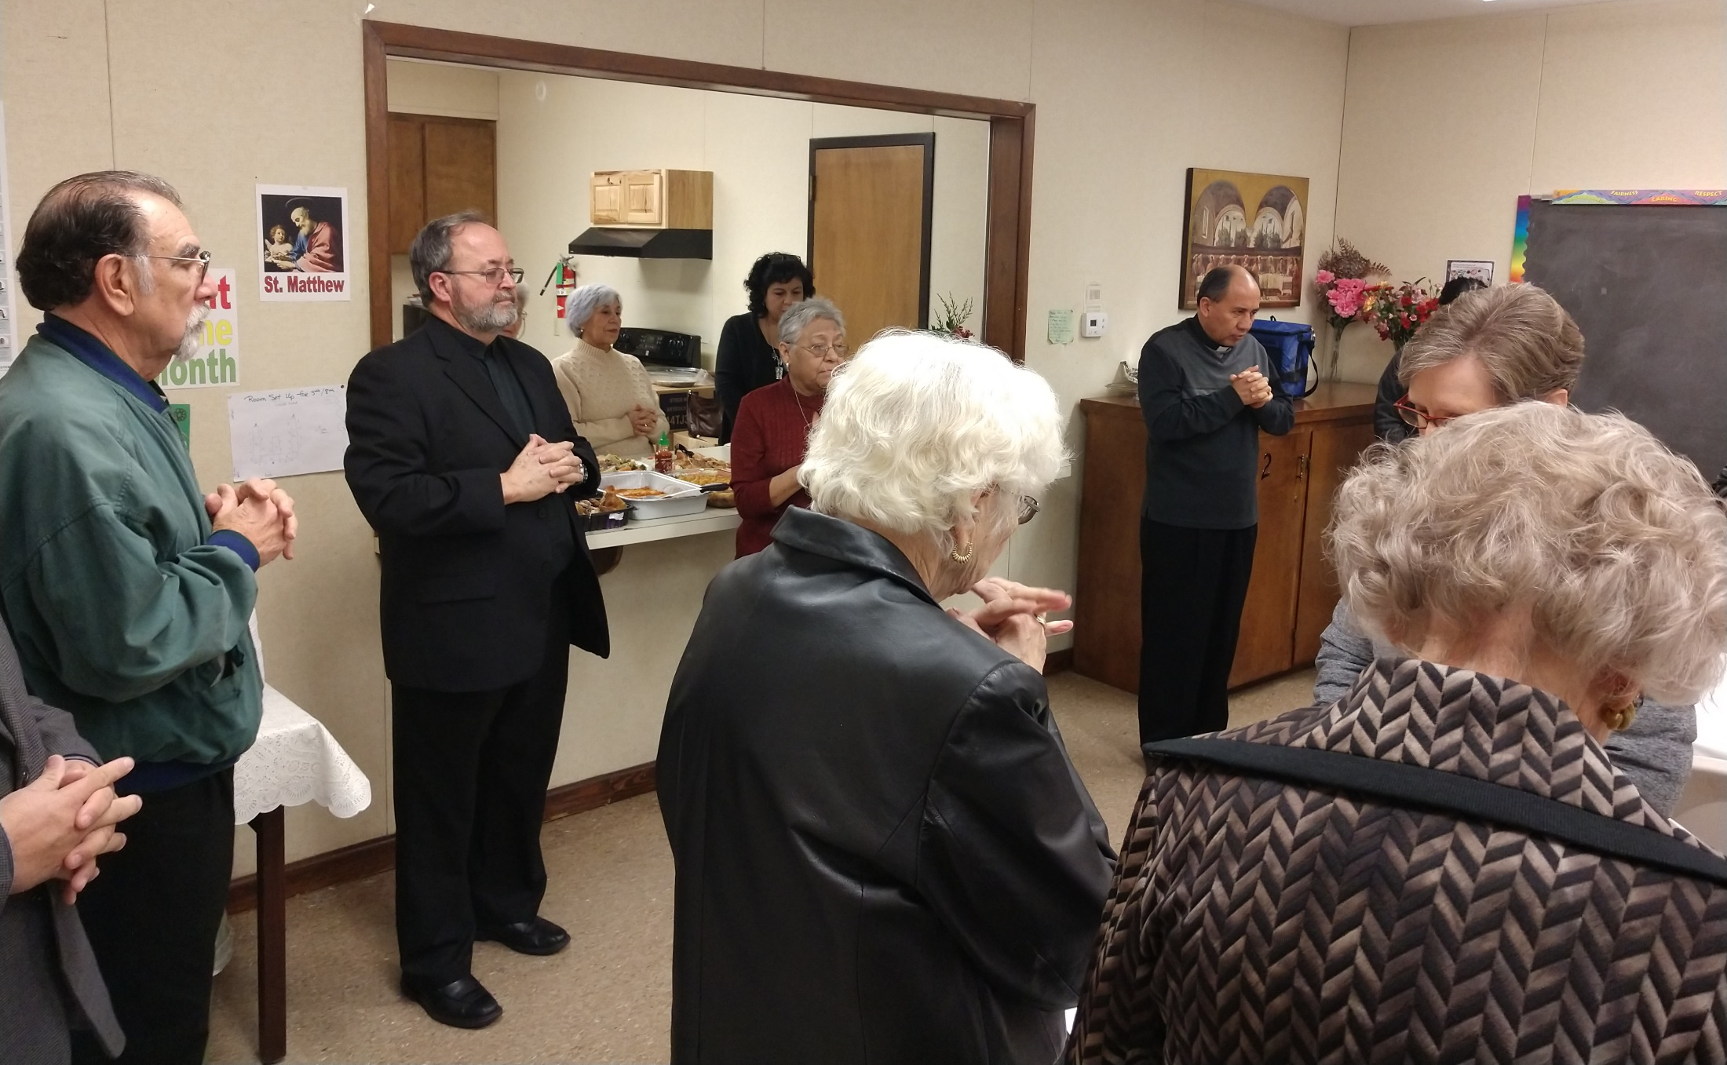

Slide 10
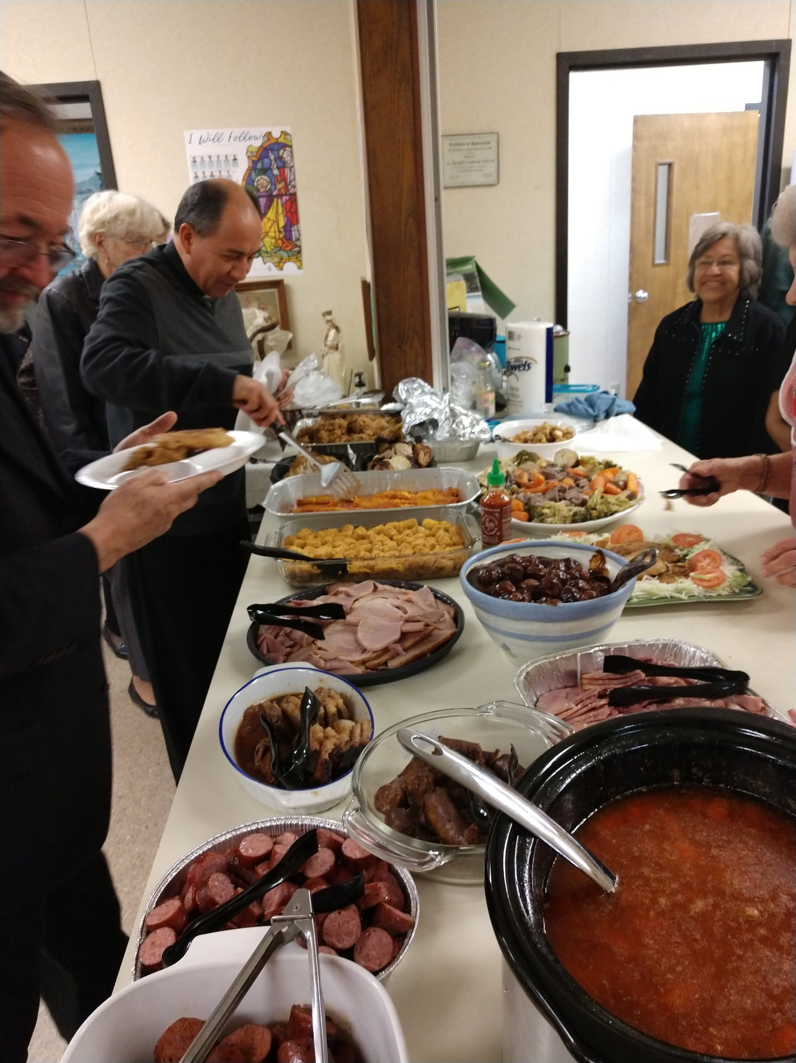

Slide 11
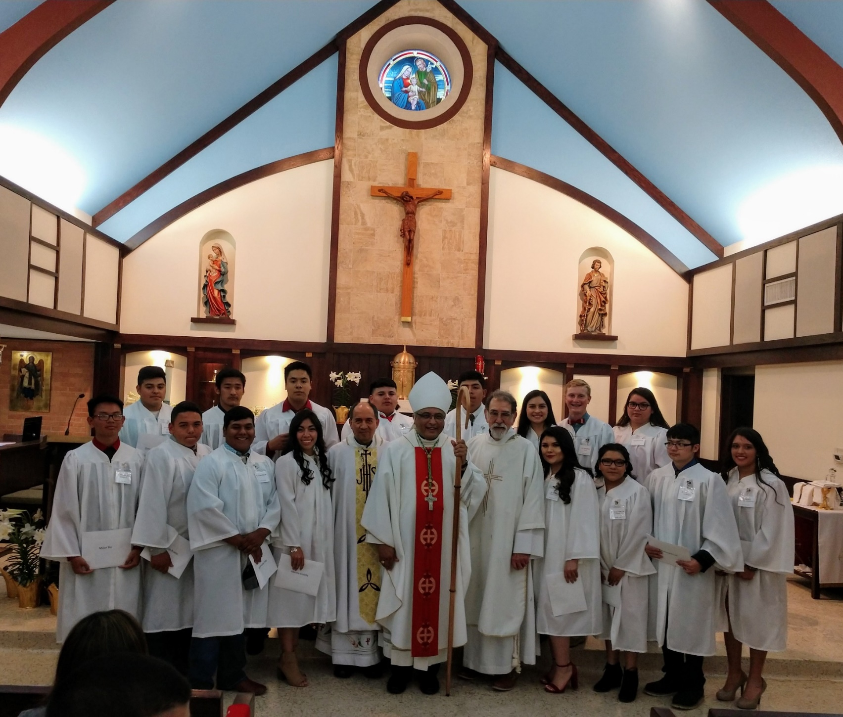
Confirmation – April 2018

Slide 12
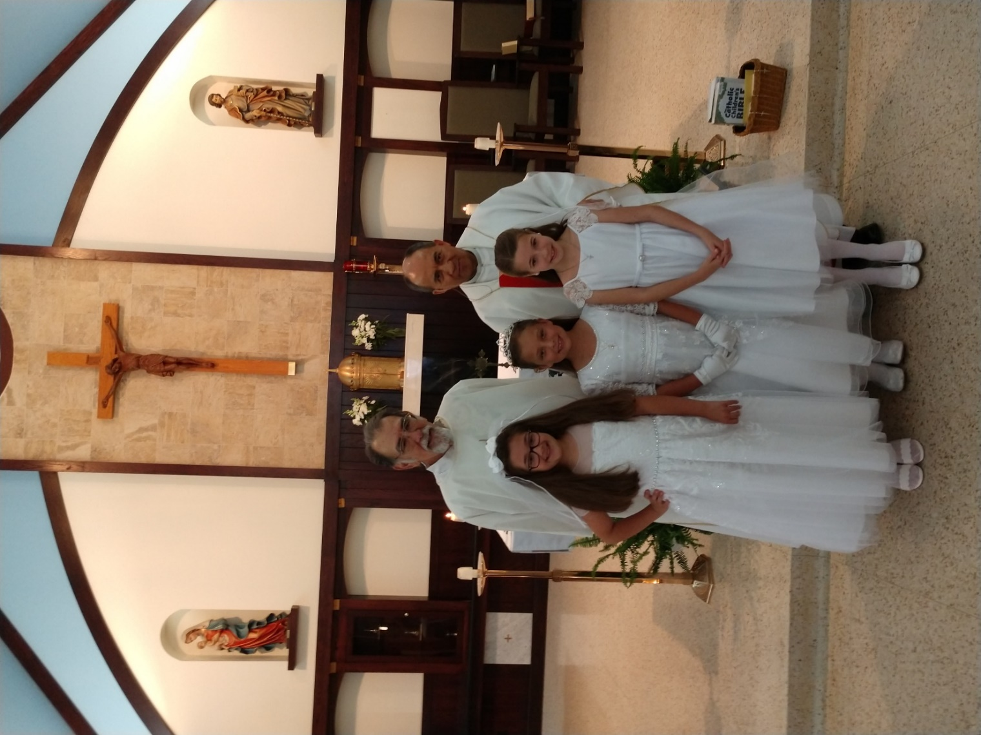
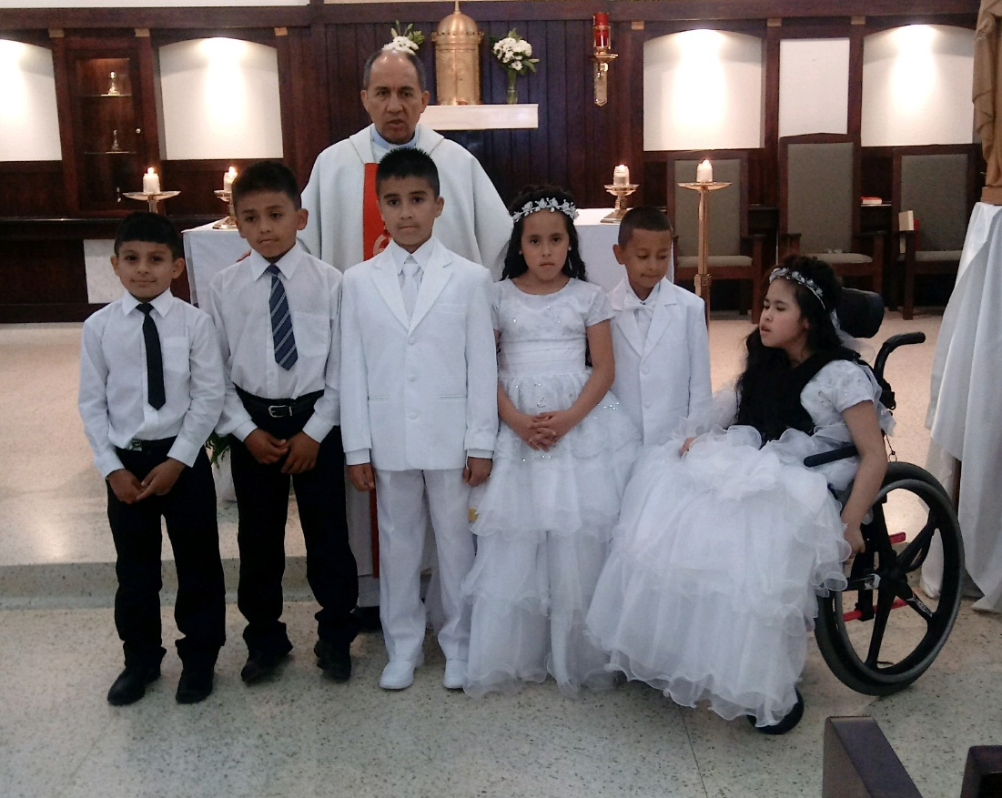
1st Communions – April & May 2018
Christian Reyes, Ivan Facundo, Lucio Reyes, Noeli Torres, Jorge Tenorio, Noemy Torres
Brooklyn Cates, Bella Alexander,
Bailey Neimann

Slide 13
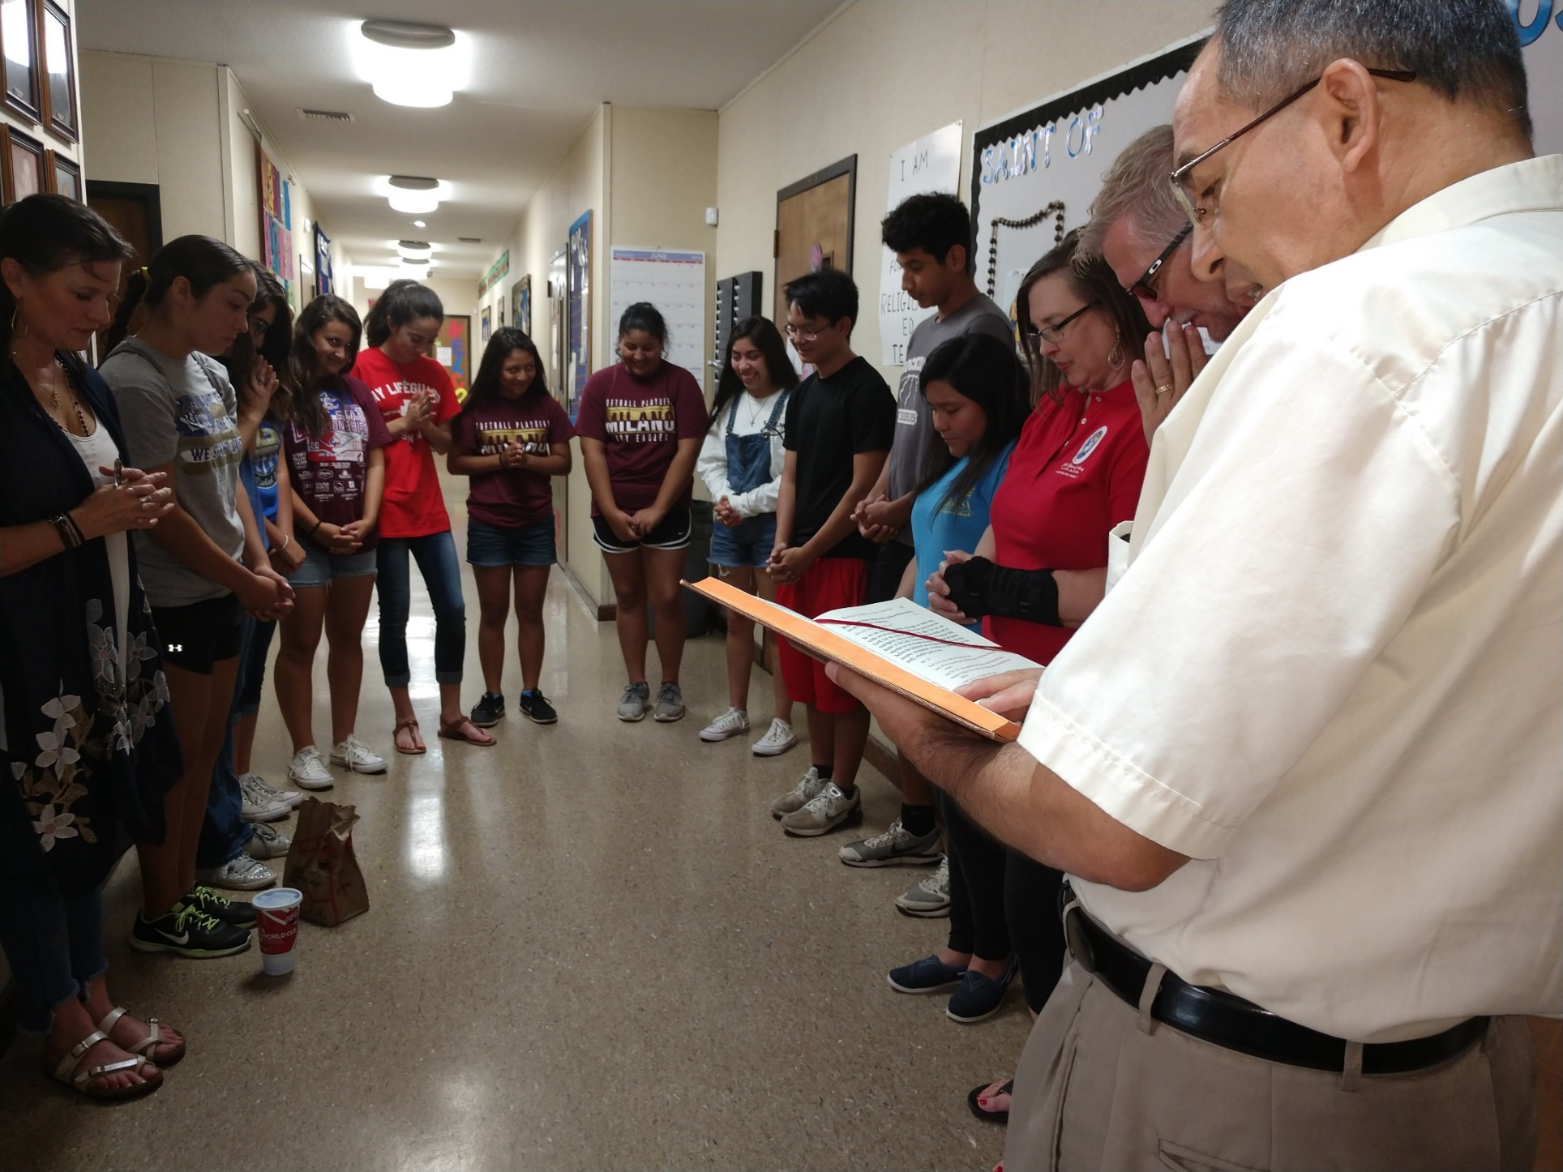
Praying over the youth before Steubenville – June 2018

Slide 14
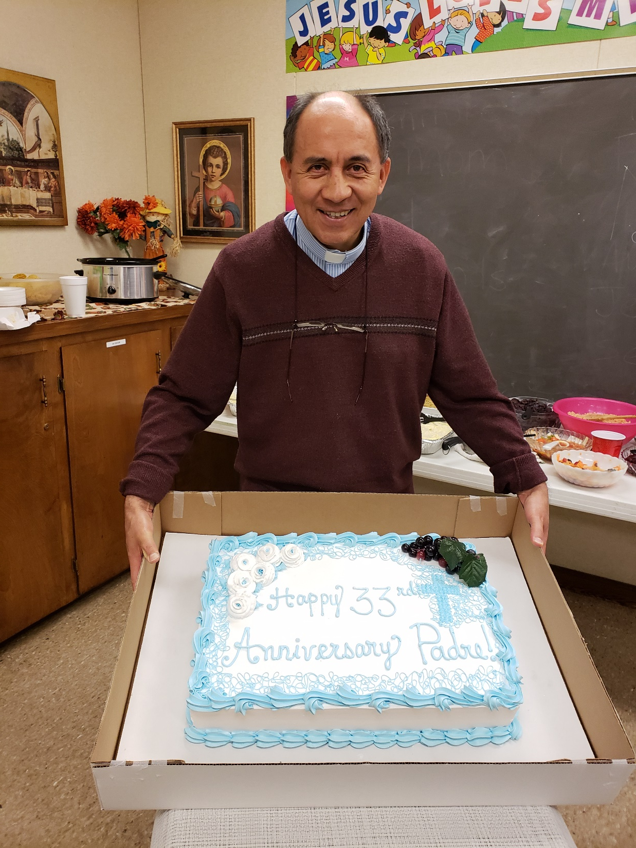
Fr.’s 33rd Anniversary
11/24/2018

Slide 15
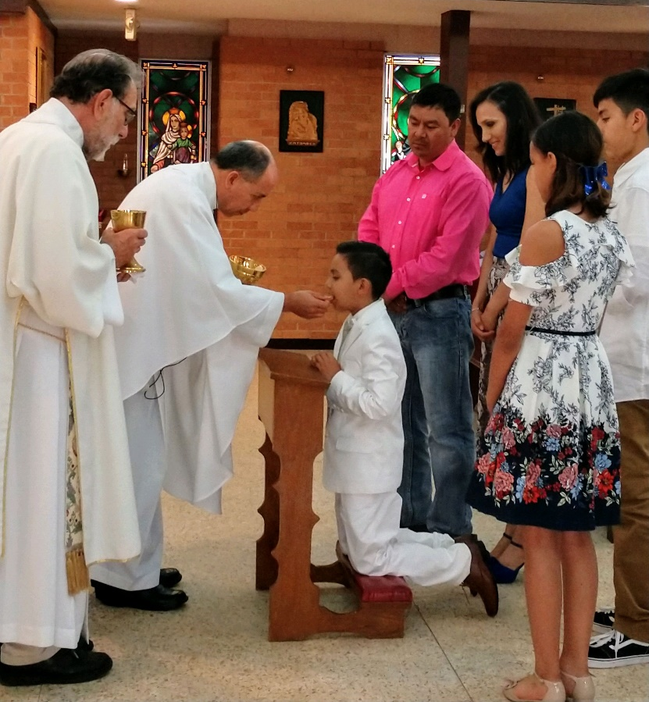
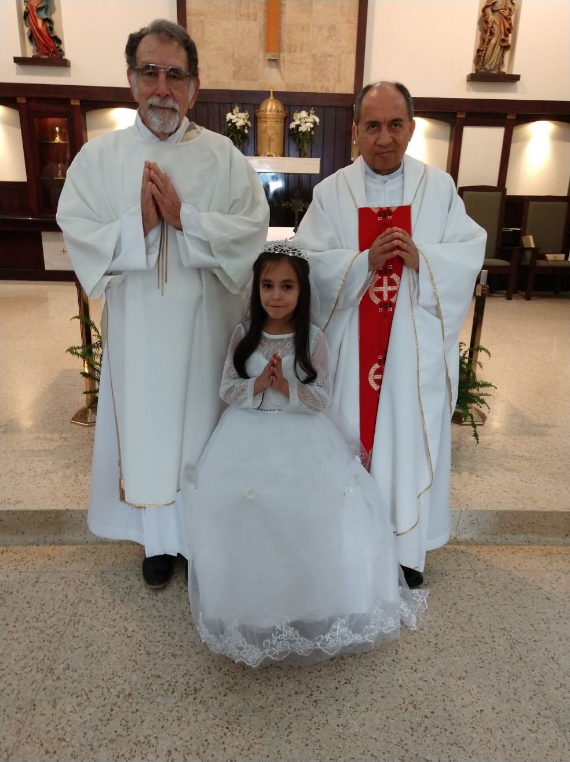
1st Communions – May 2019
Taiyari Hernandez
Megan

Slide 16
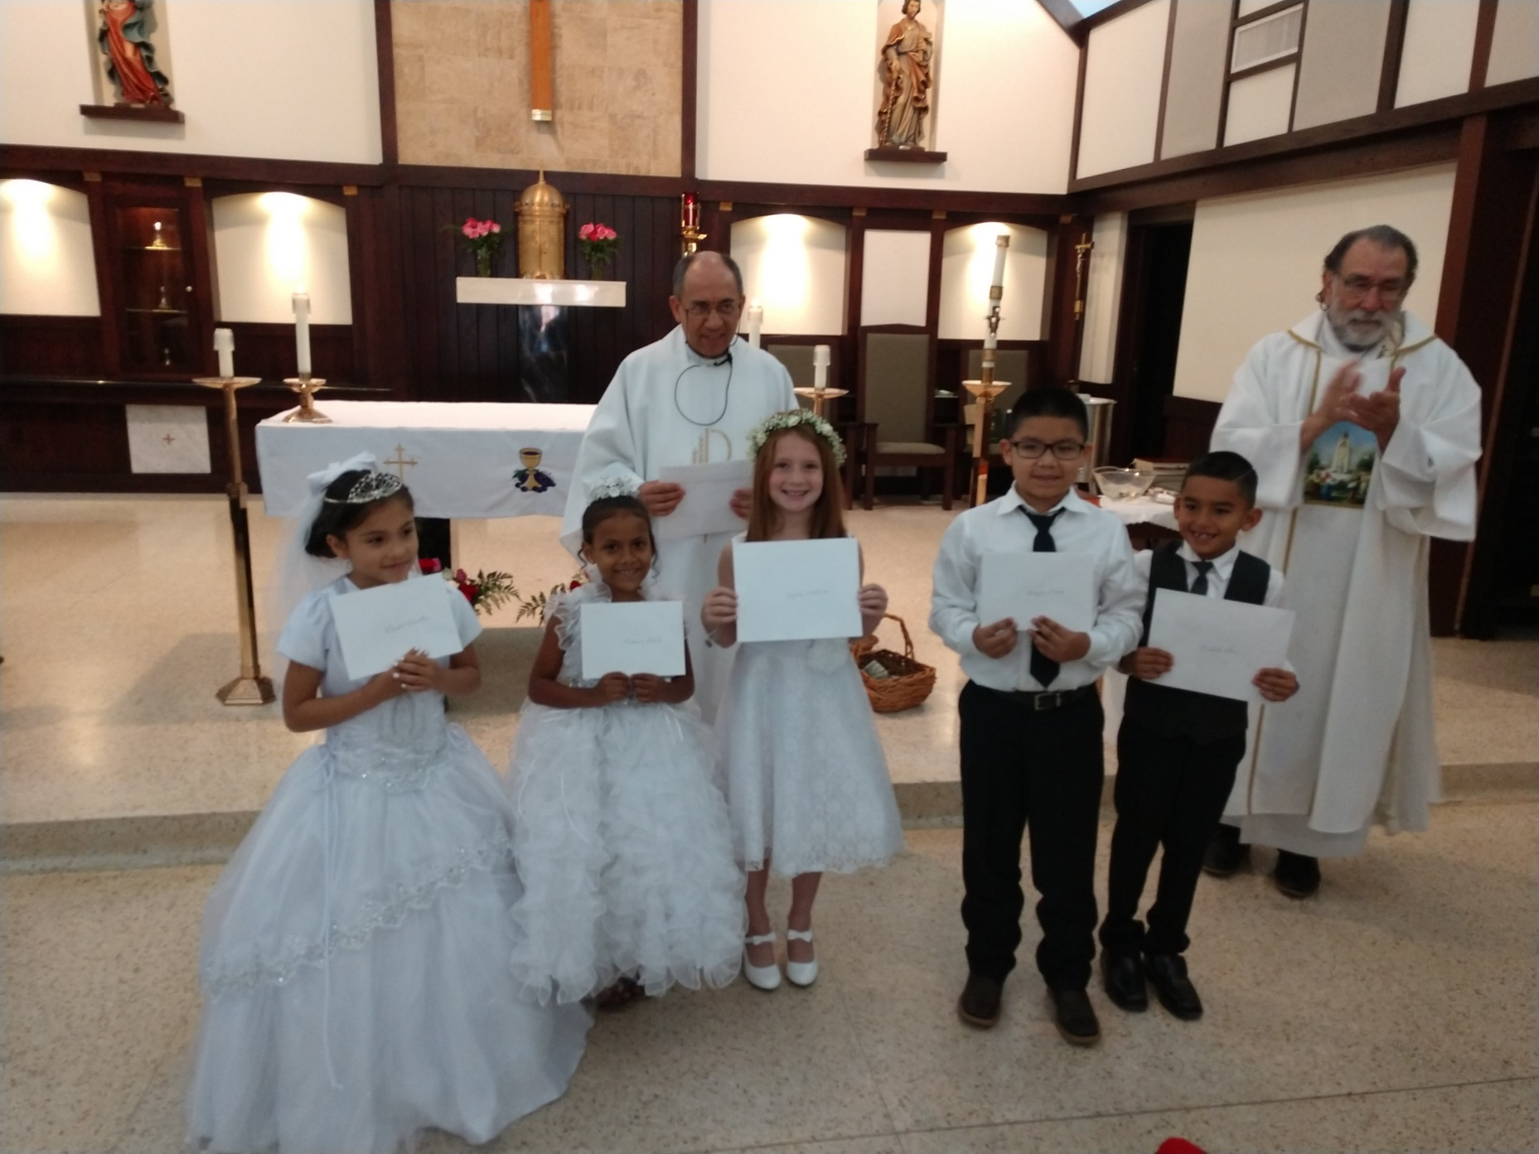
?, Madison Garcia, Brynlee Williams, Brayden Chaires, Humberto Lara

Slide 17
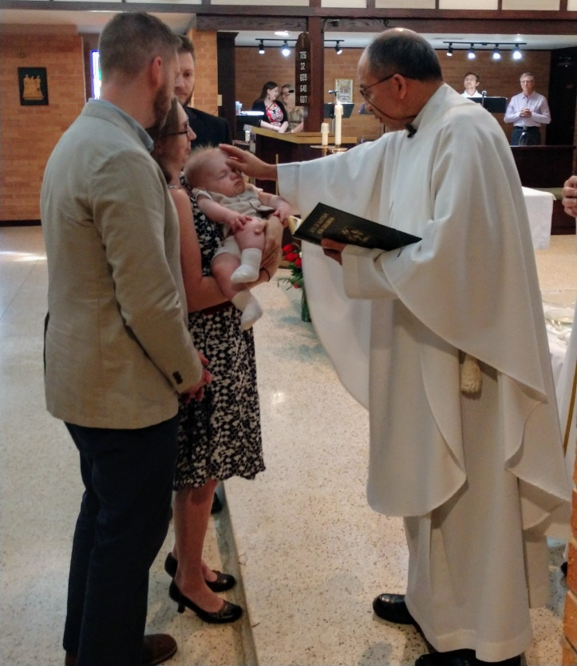
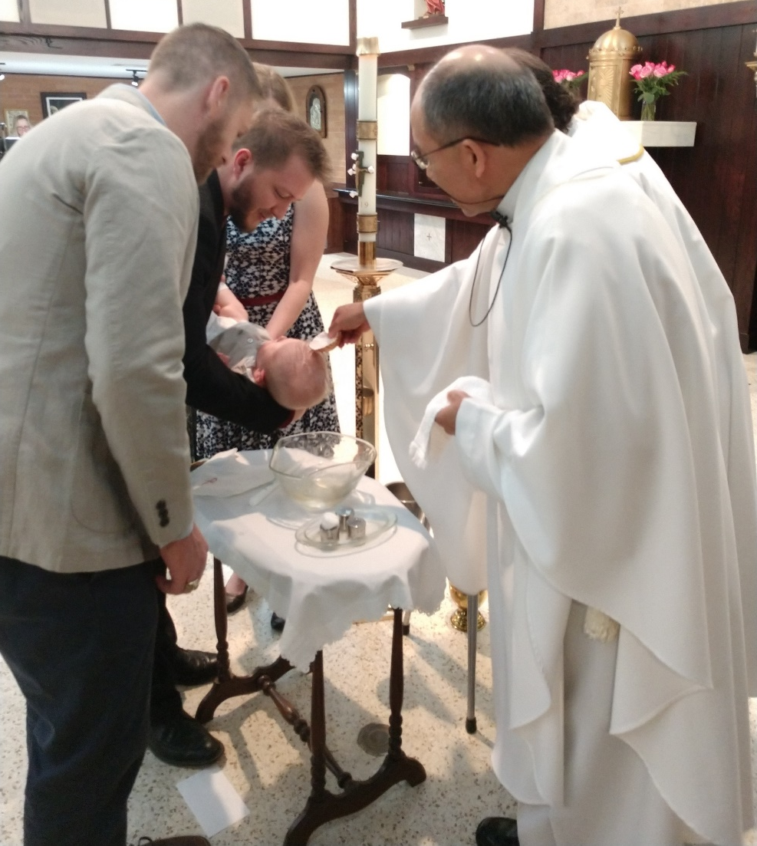
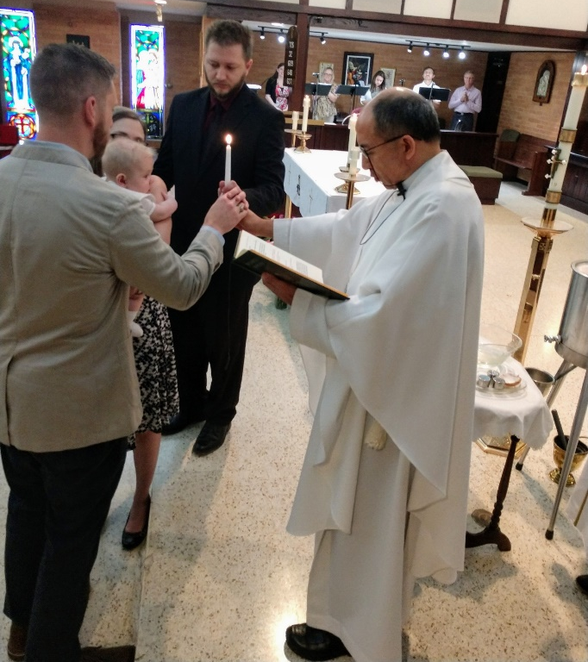
Baptism - June 2019
Gavin Charles Brown (Bonnie’s grandson)

Slide 18
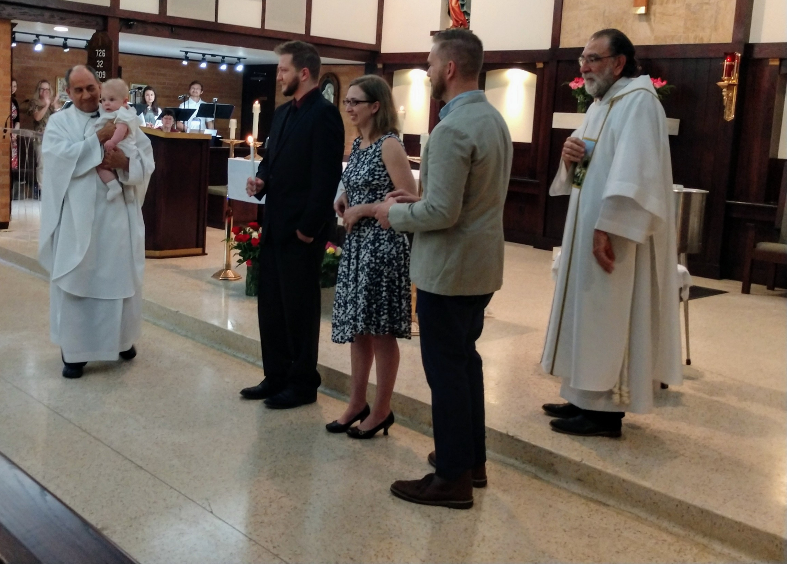

Slide 19
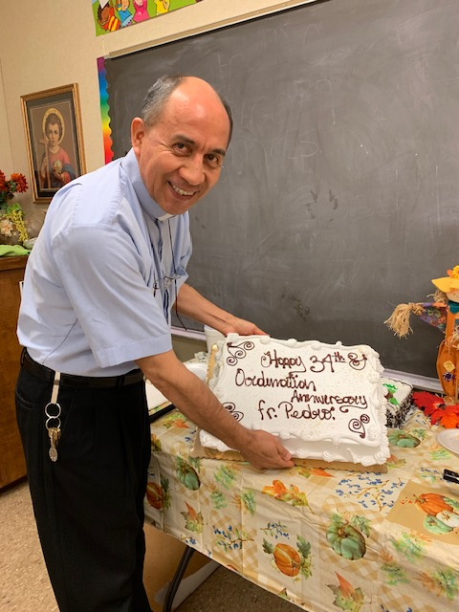
34th Anniversary of Ordination
11/24/2019

Slide 20
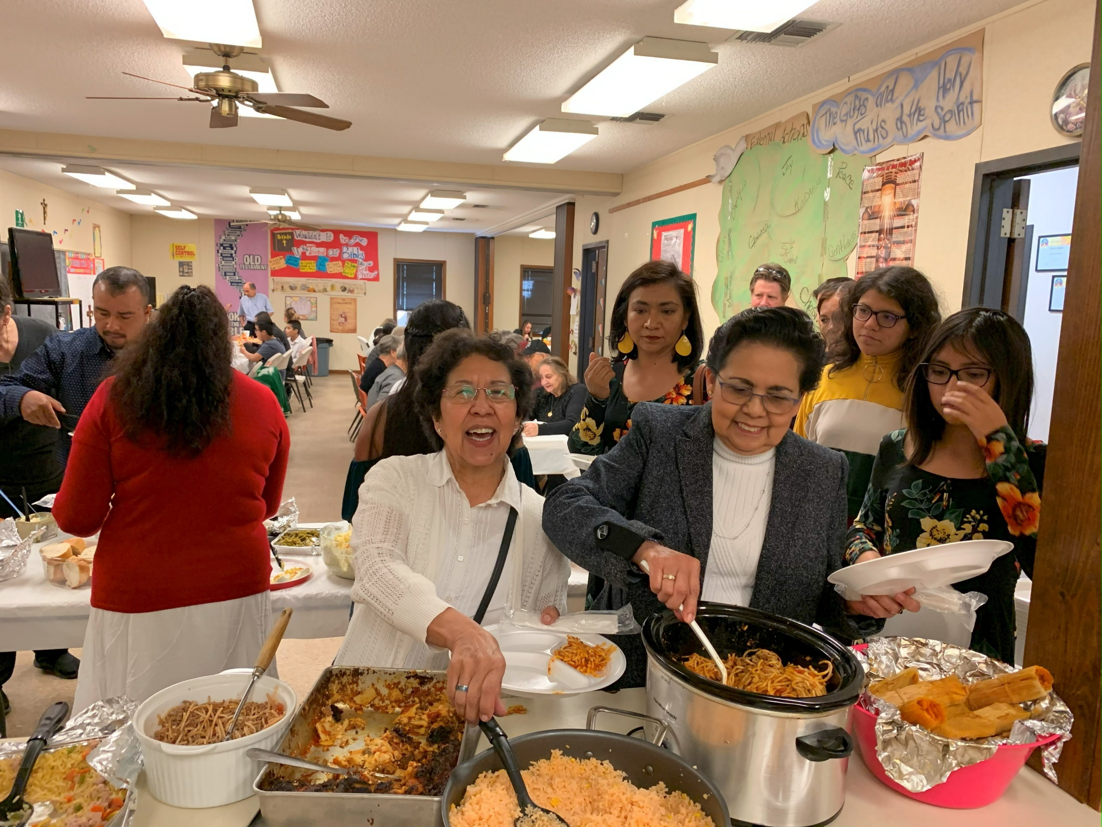

Slide 21
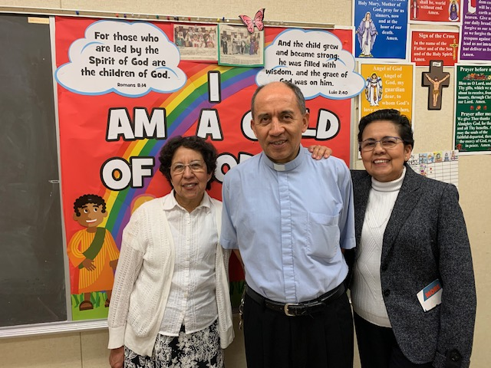

Slide 22
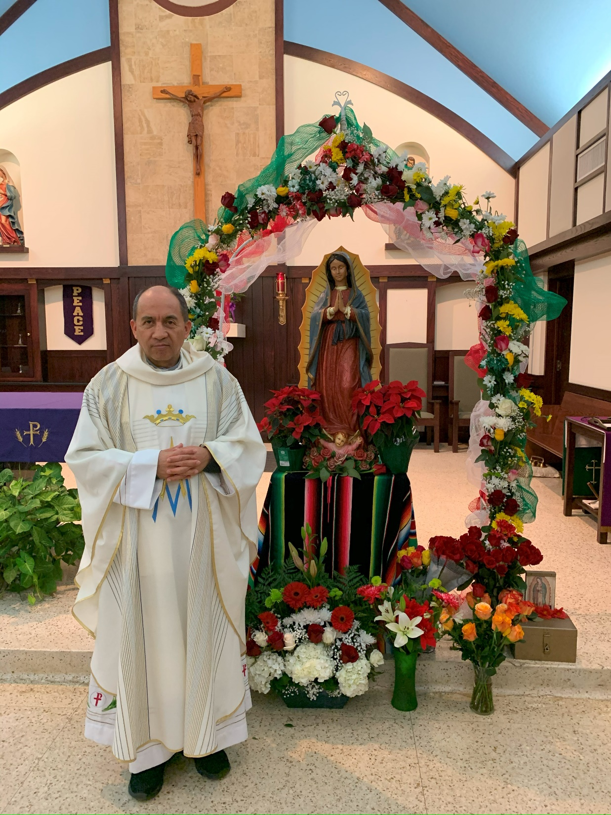

Slide 23
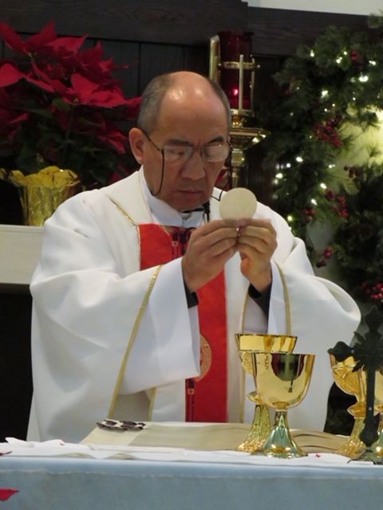
1/20/2020

Slide 24
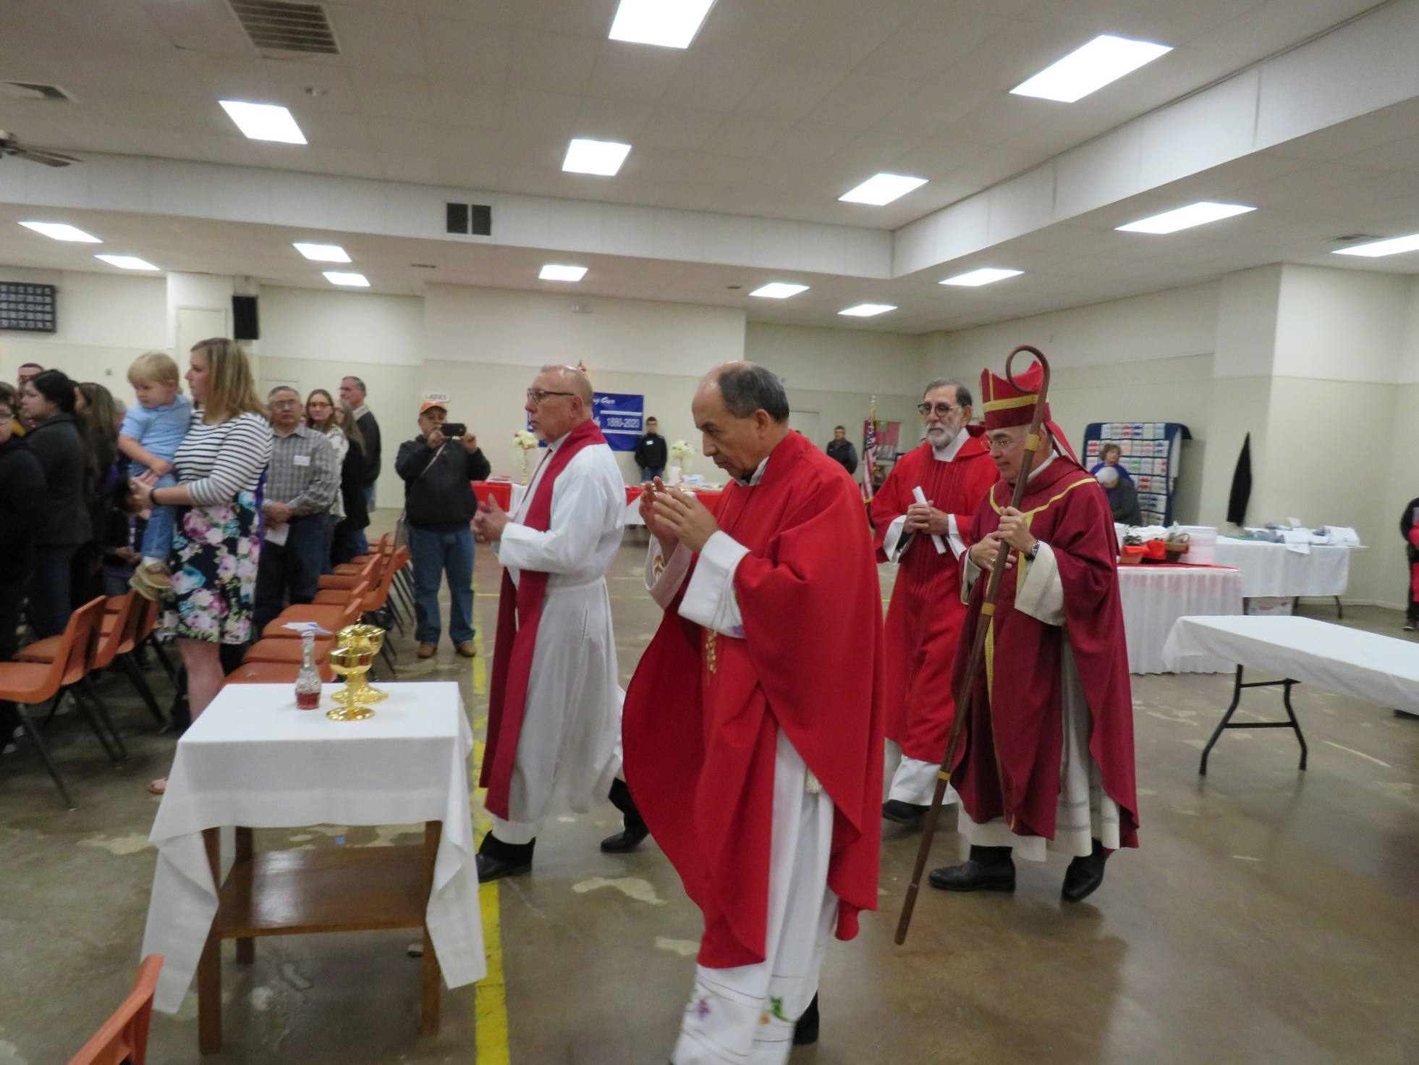
140th Anniversary & Adult Confirmation February 2020

Slide 25
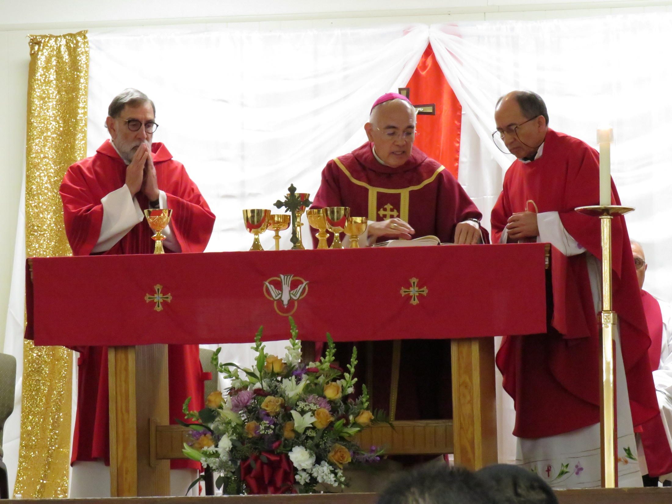

Slide 26
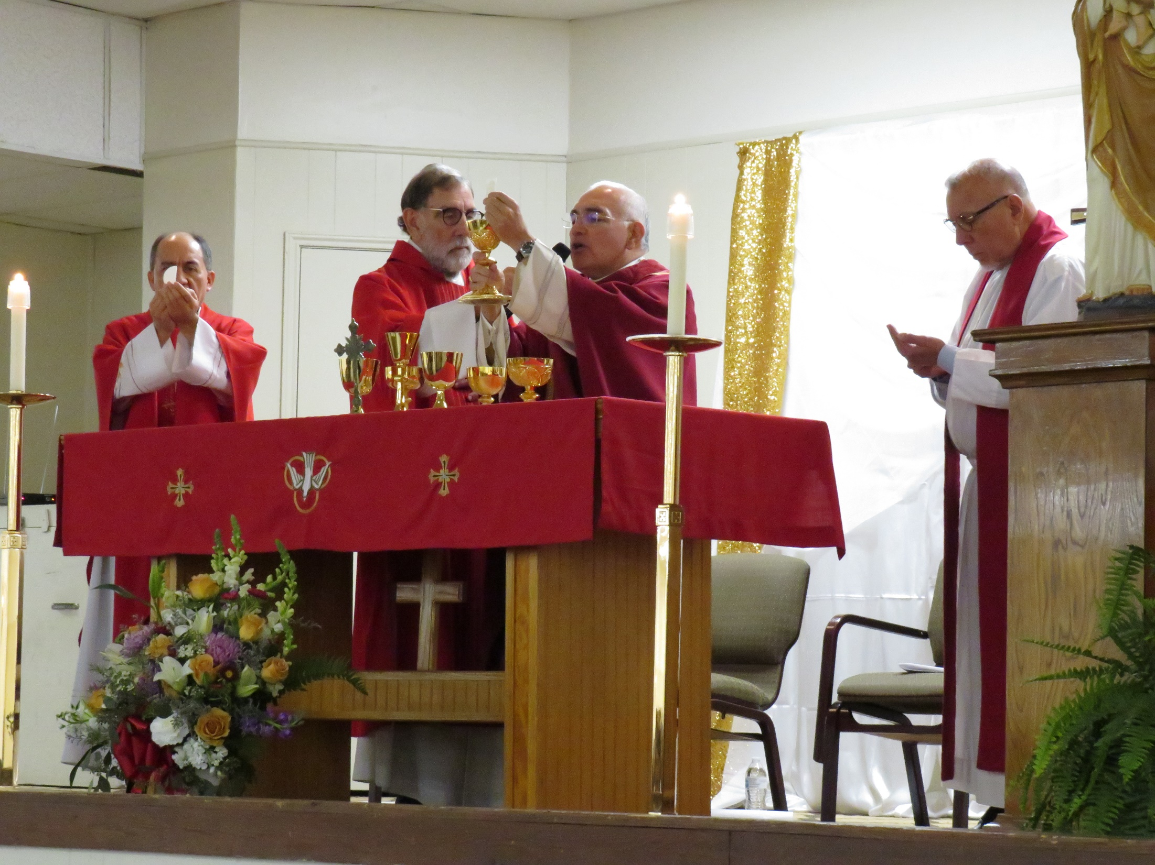

Slide 27
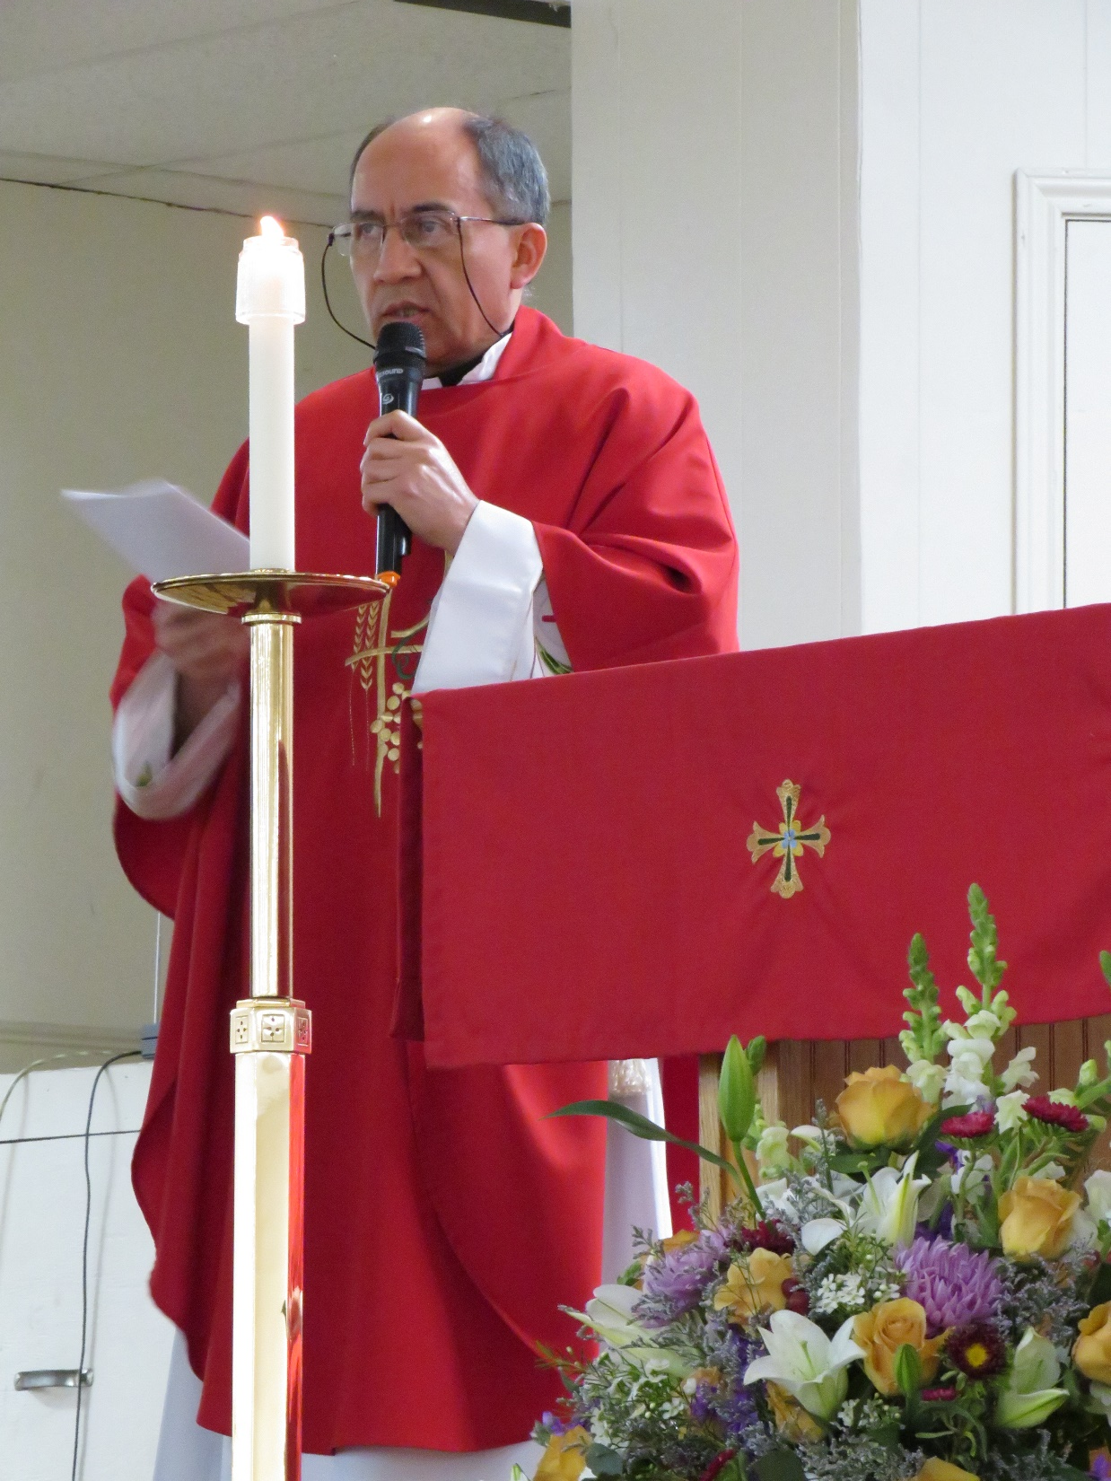

Slide 28
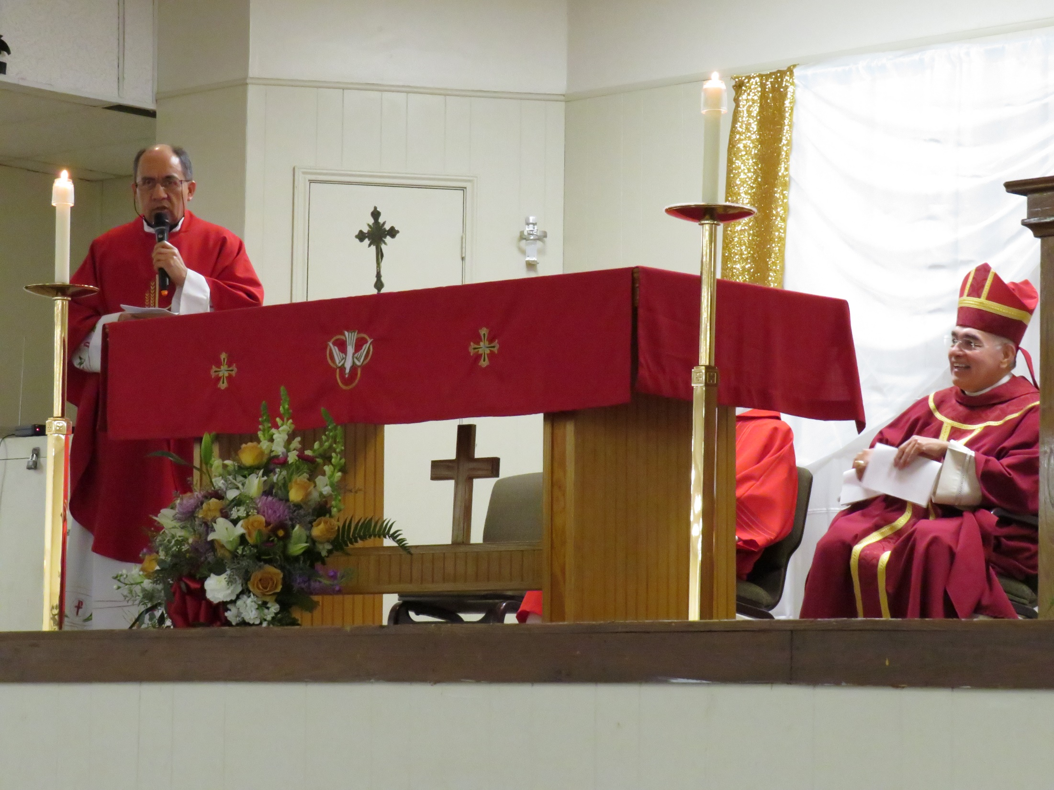

Slide 29
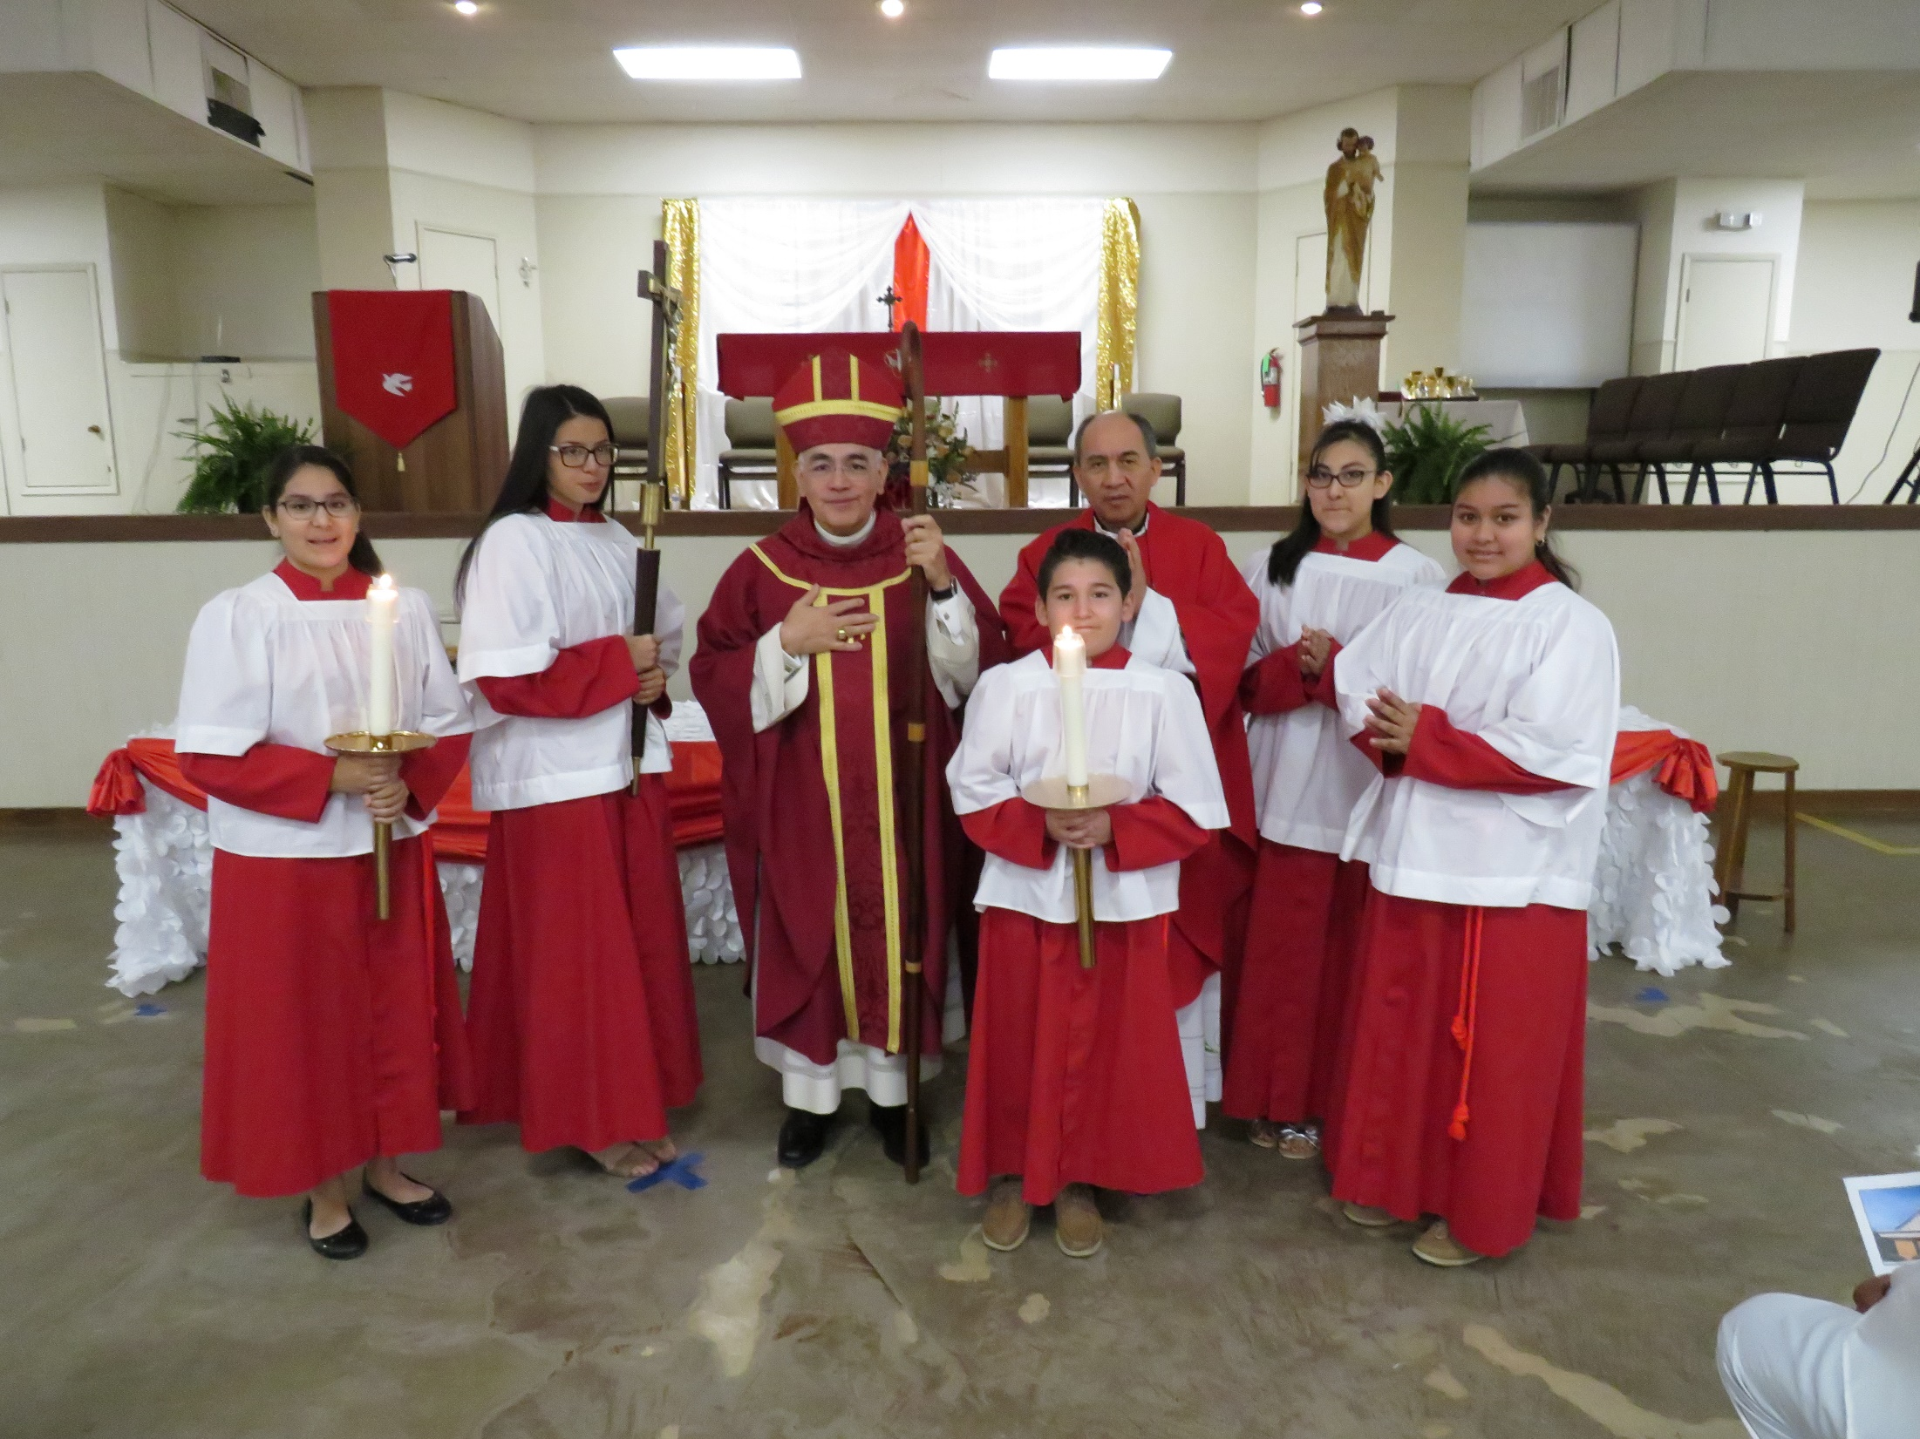

Slide 30
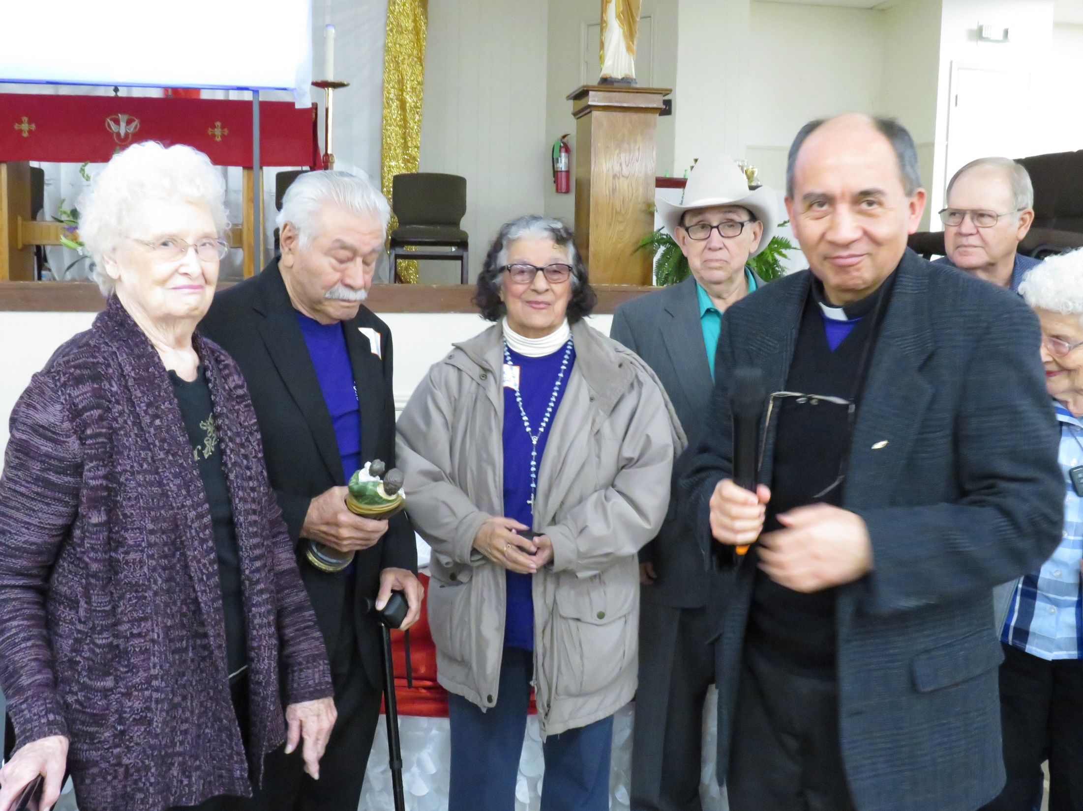

Slide 31
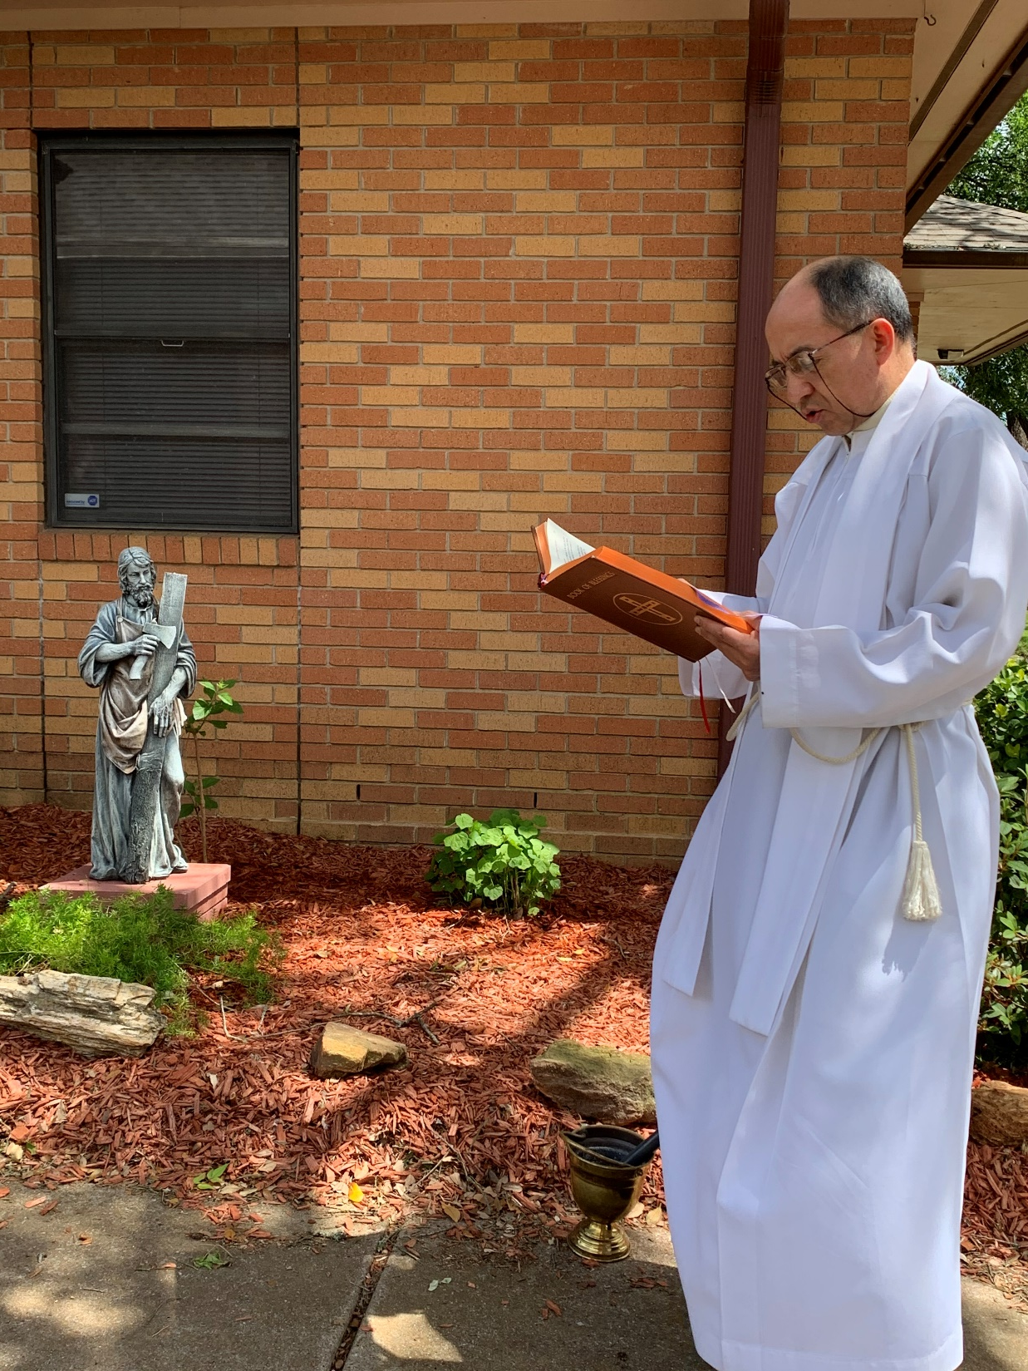
Blessing statue of
St. Joseph
5/1/2020

Slide 32
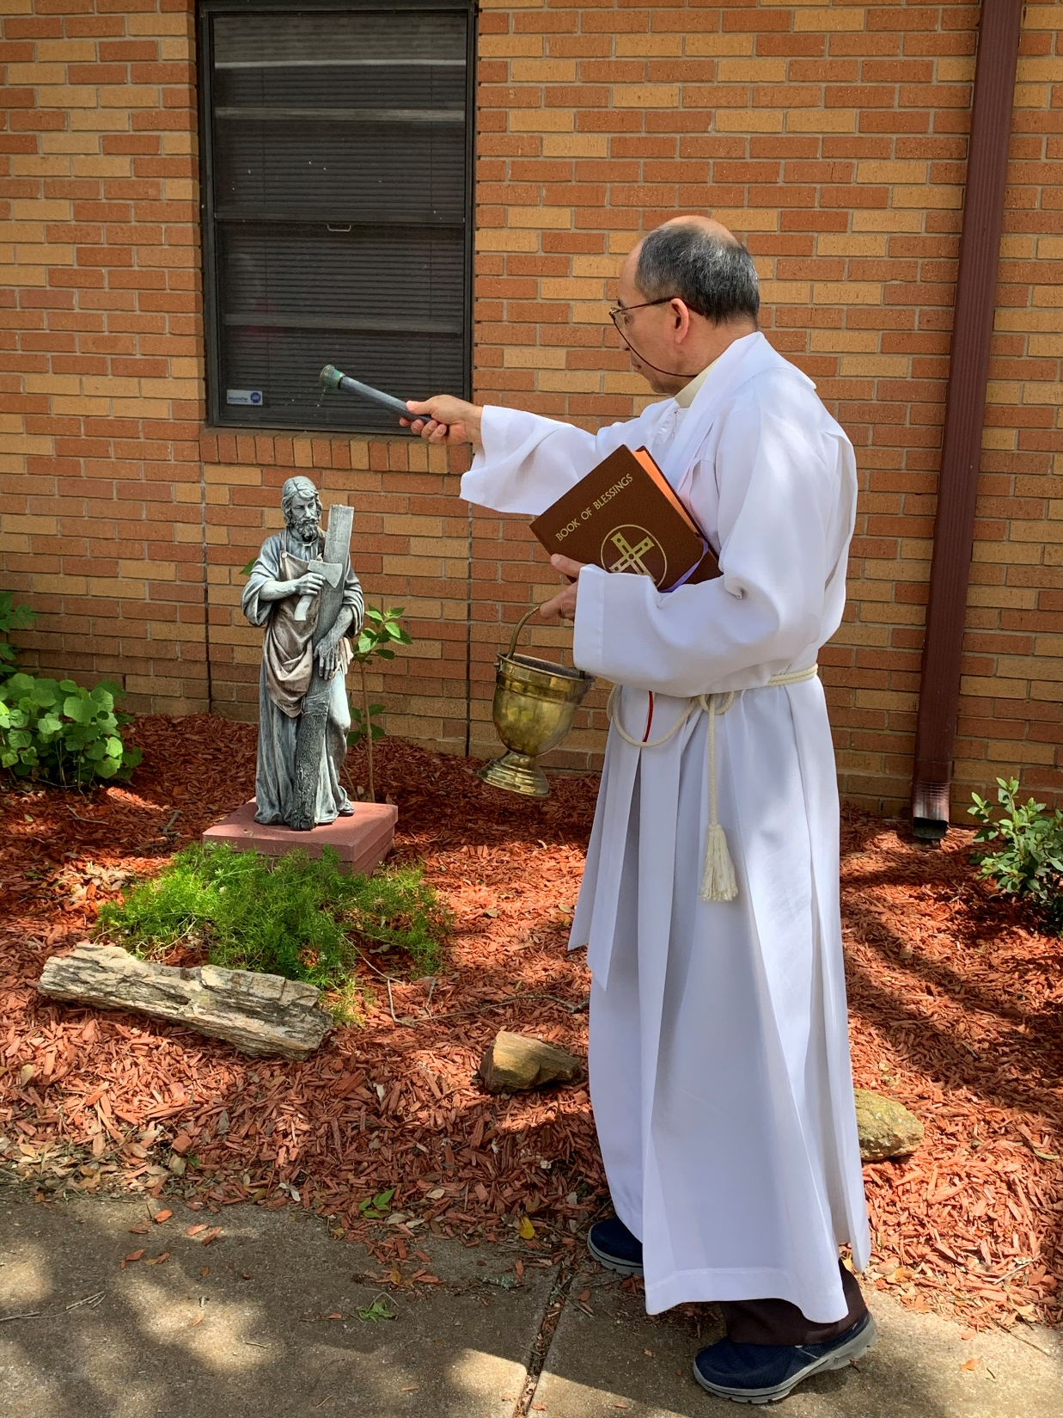

Slide 33
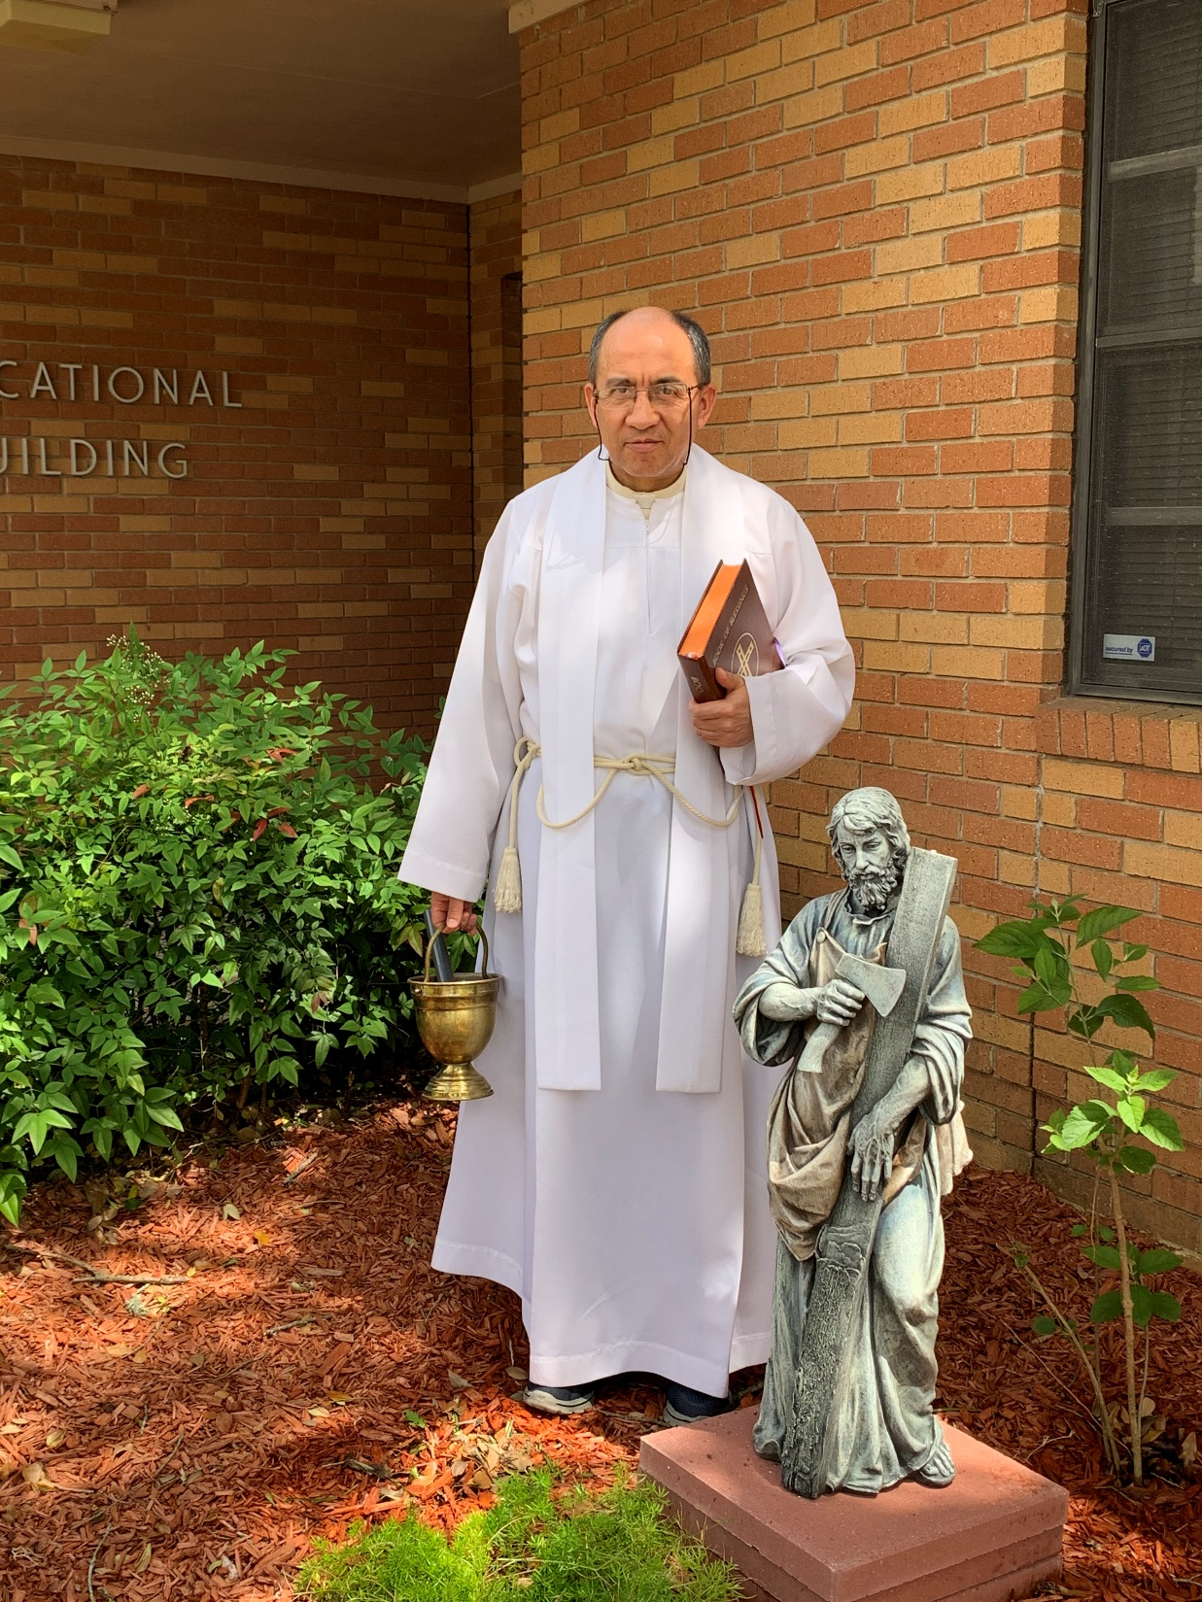

Slide 34
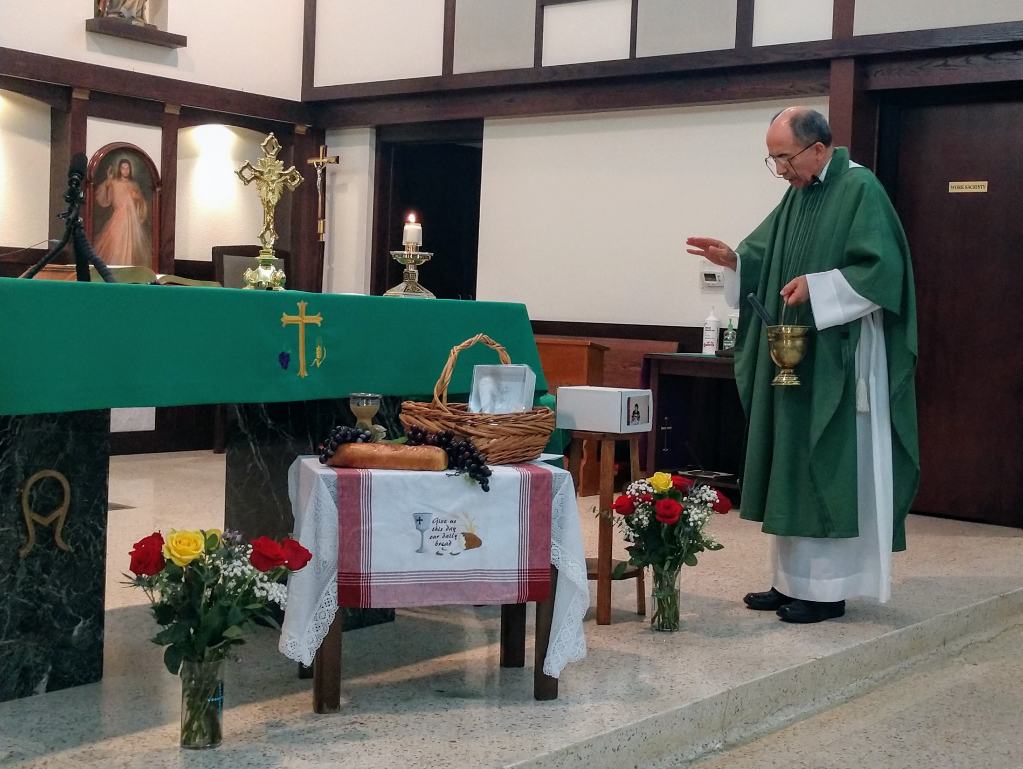
Blessing Ashes of the deceased – October 2020

Slide 35
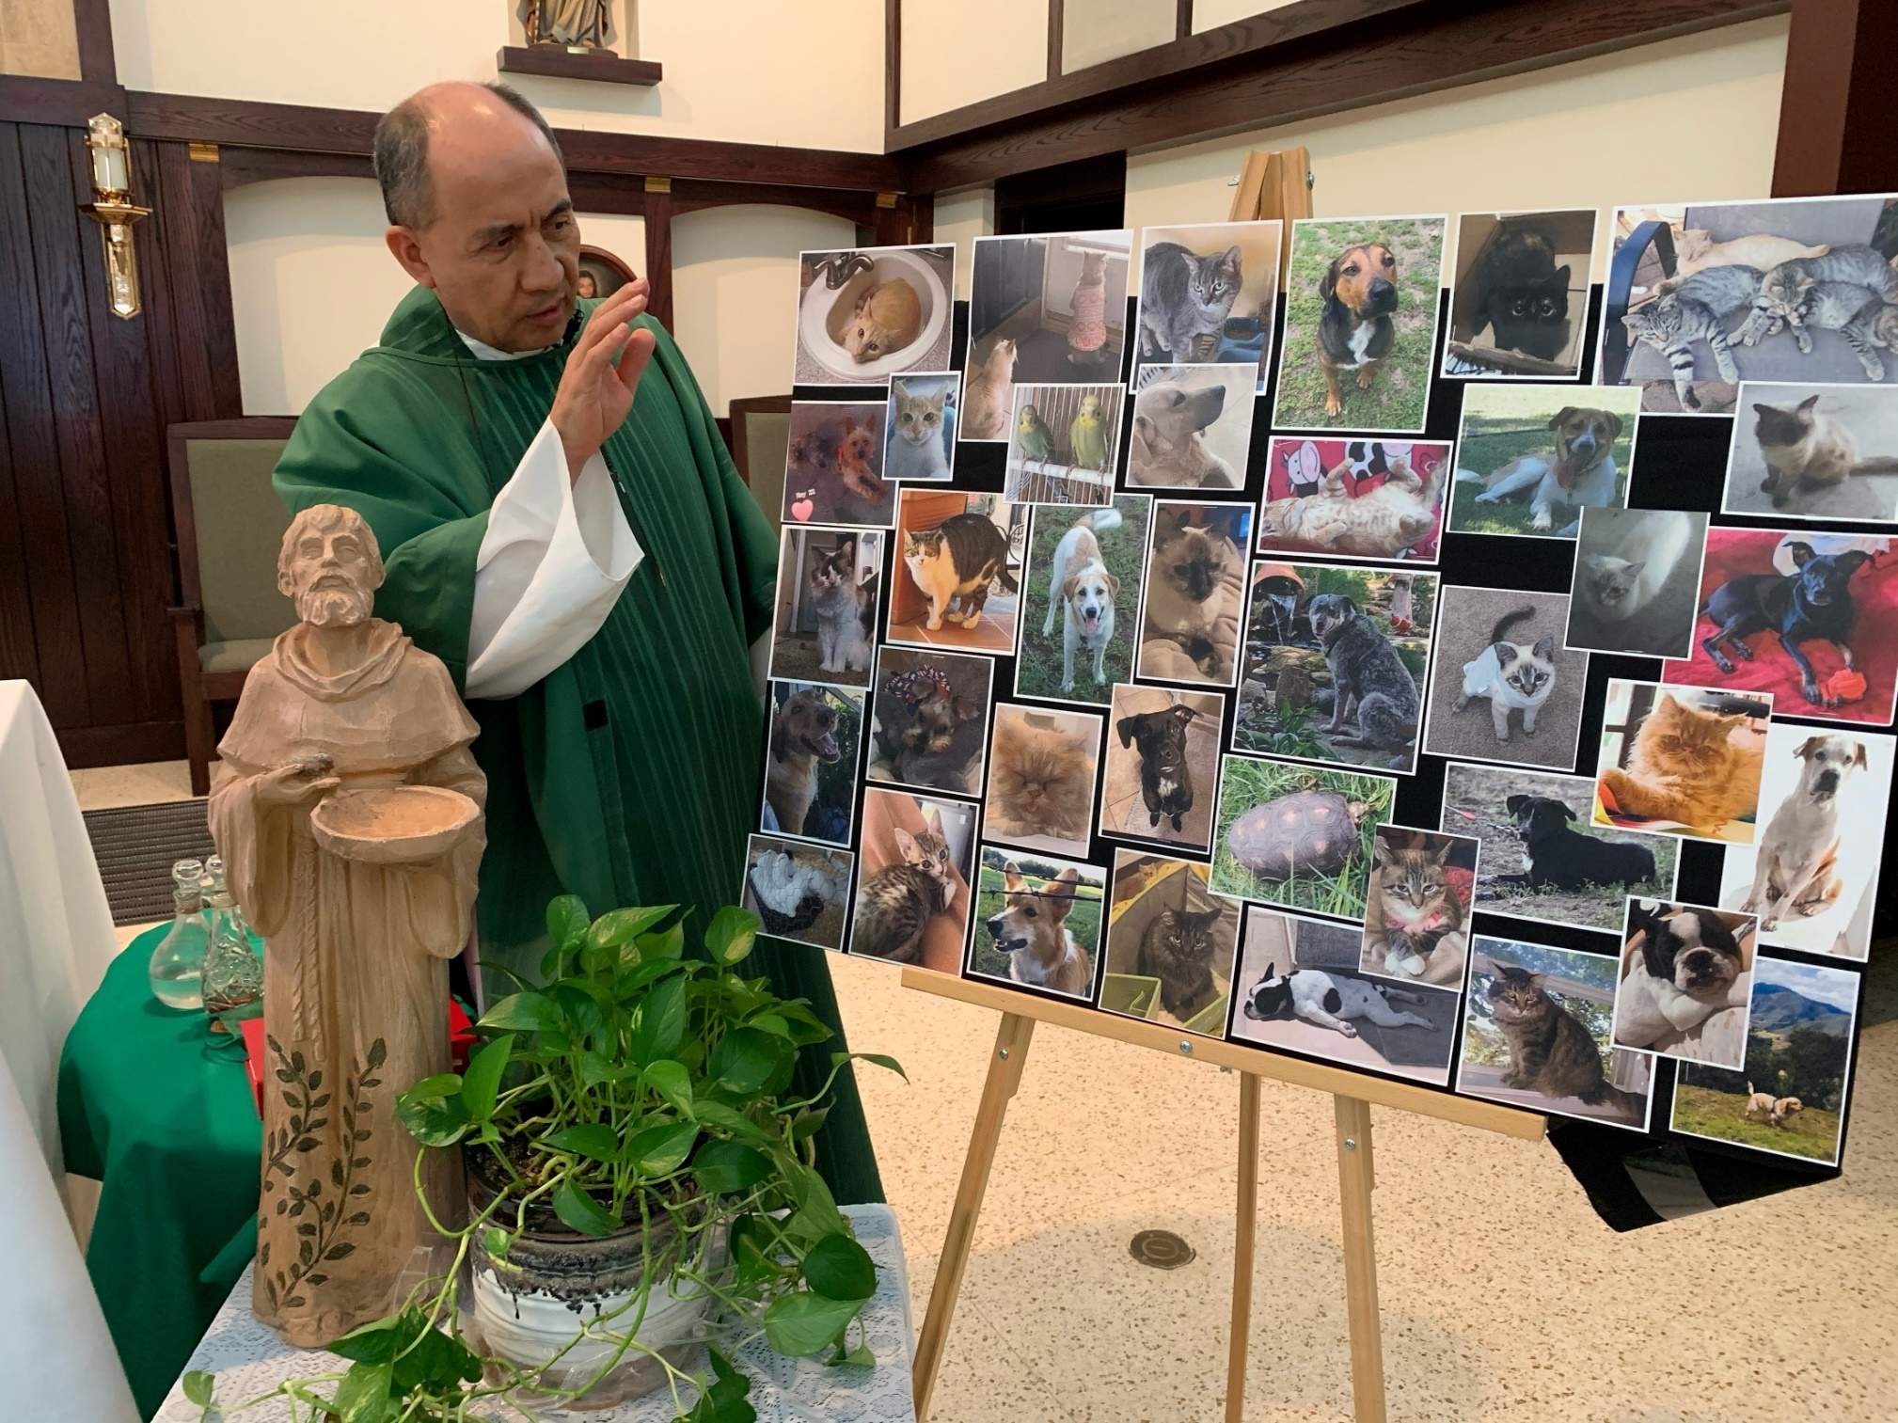
Virtual Blessing of the Pets 10/2020

Slide 36
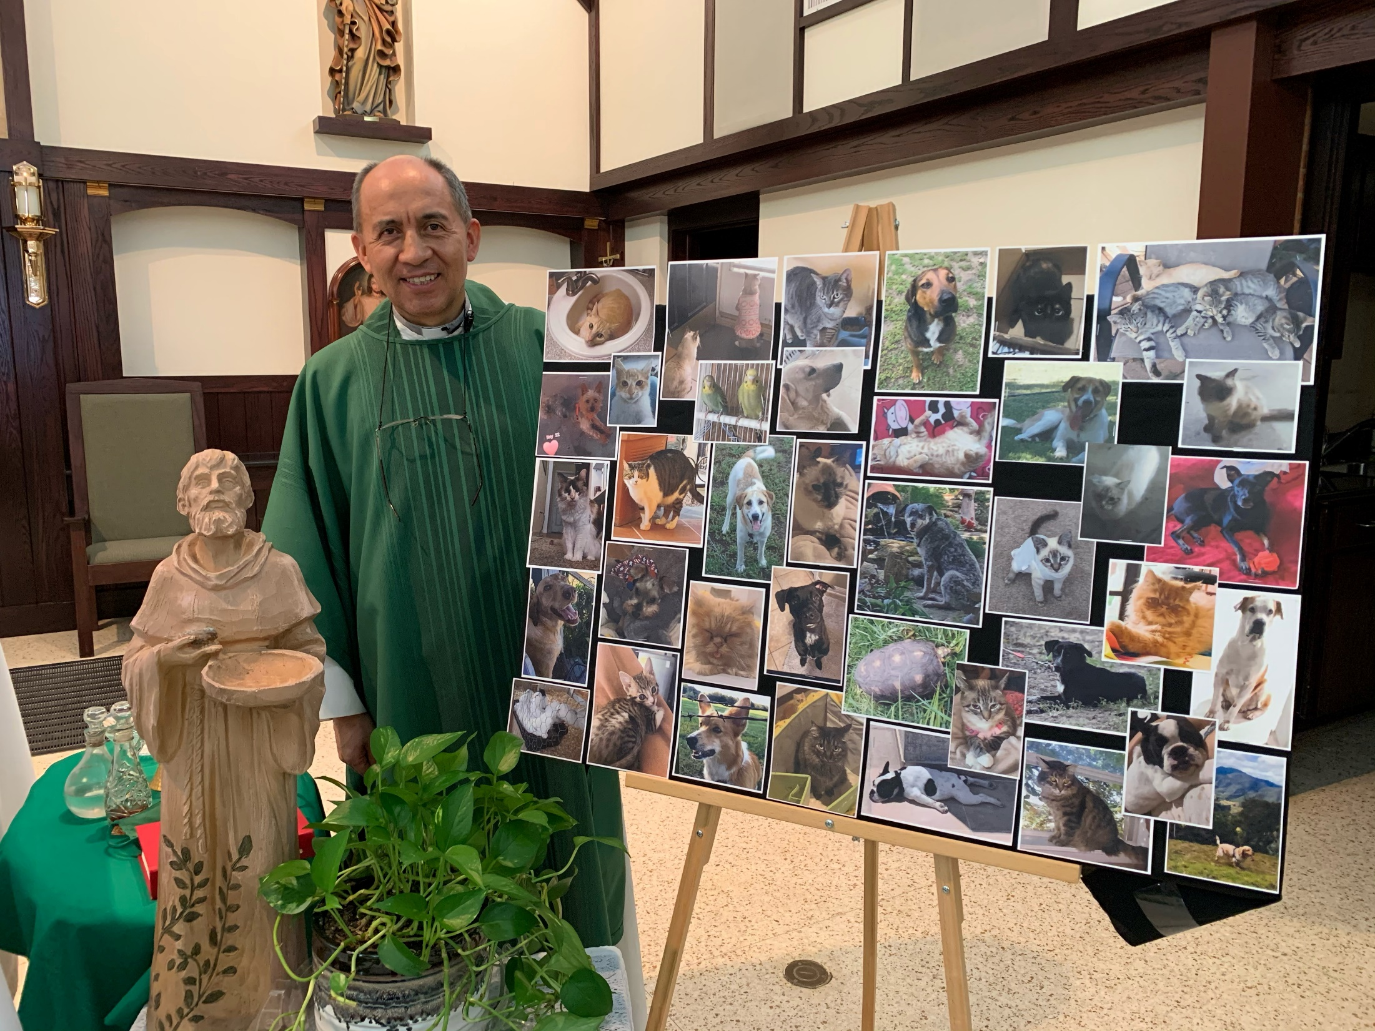

Slide 37
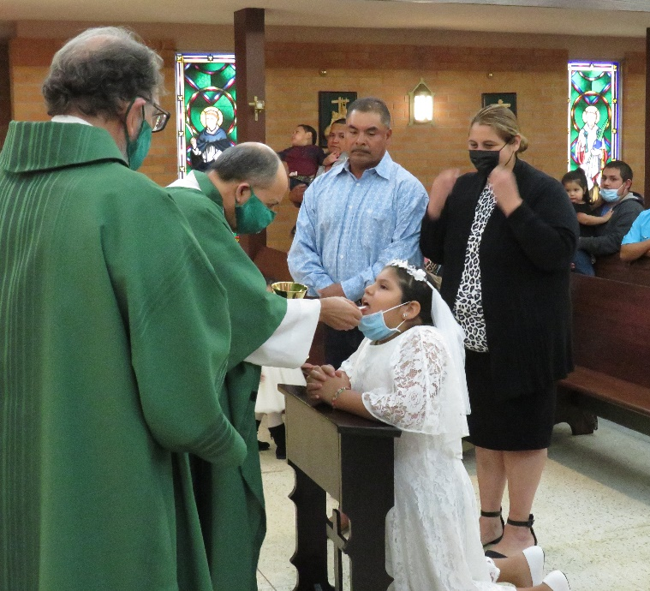
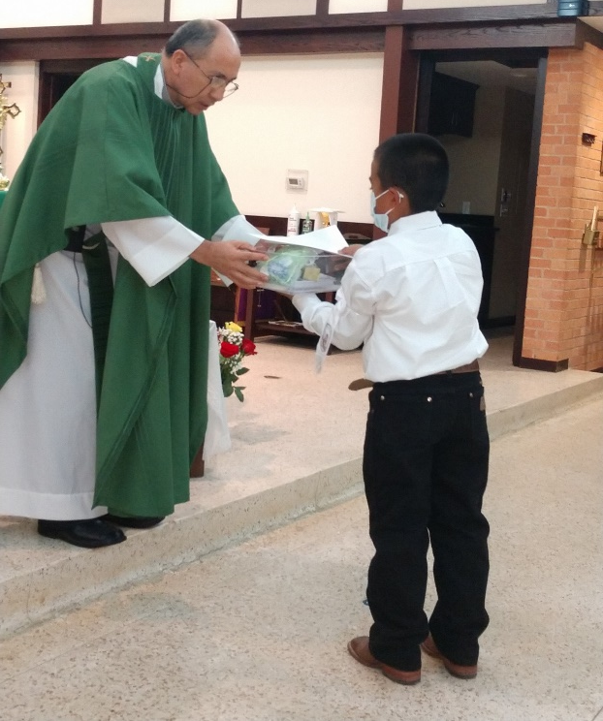
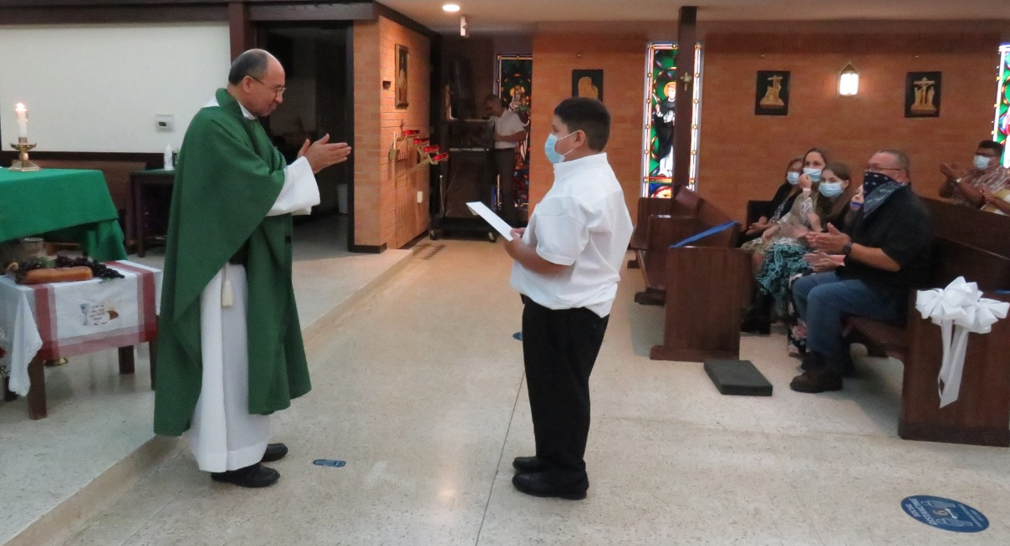
1st Communions - October & November 2020
Yobani Barron
Camila Cardona
Nicholas Zapata

Slide 38
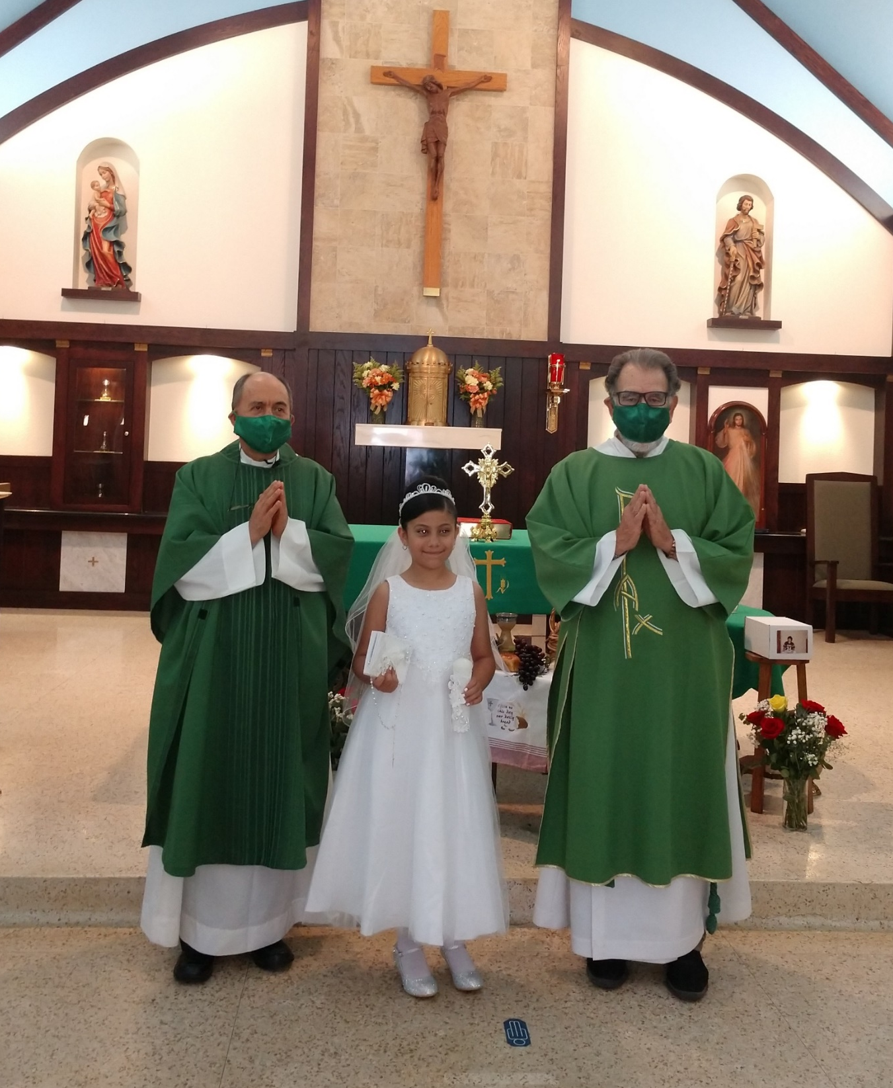
Ariana Mora

Slide 39
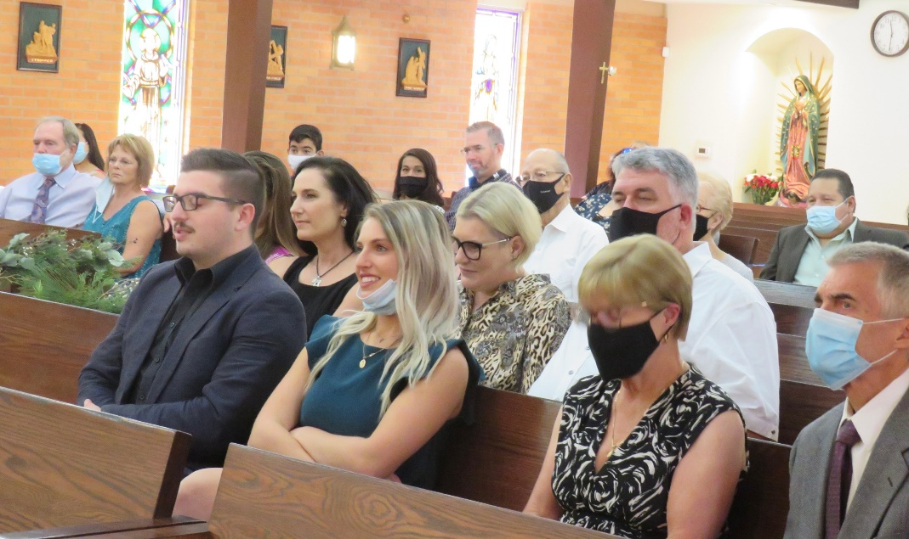
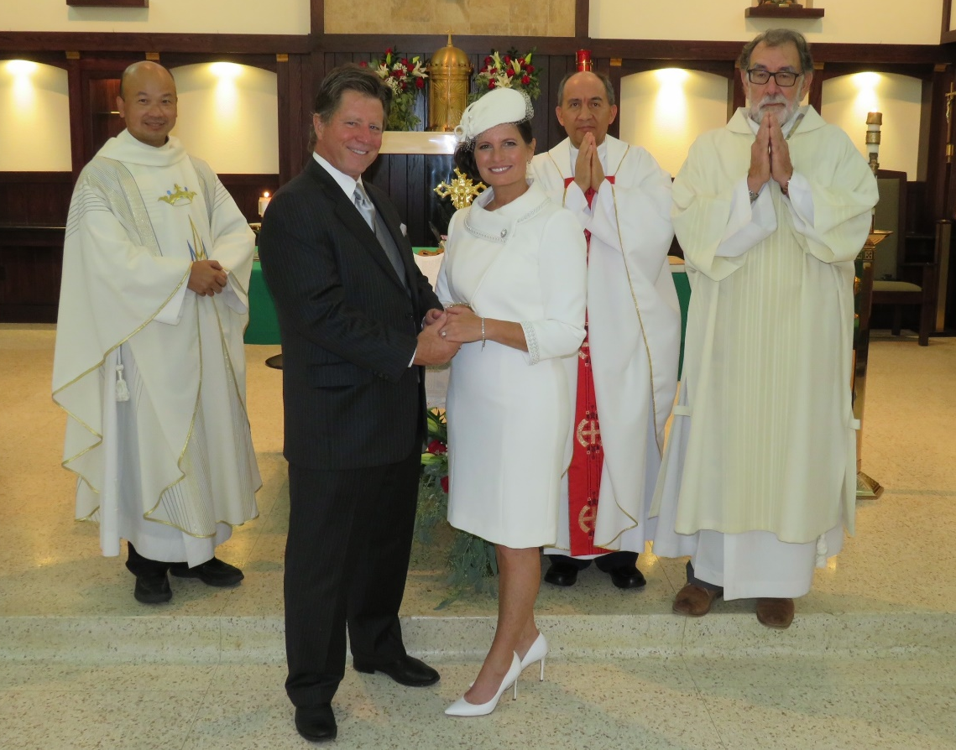
Alan & Natalie Noack Wedding
November 2020

Slide 40
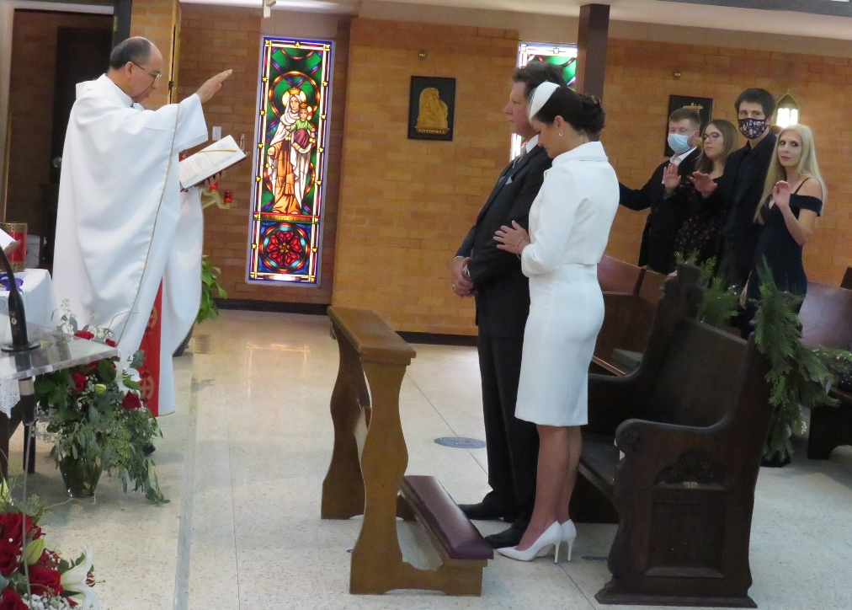
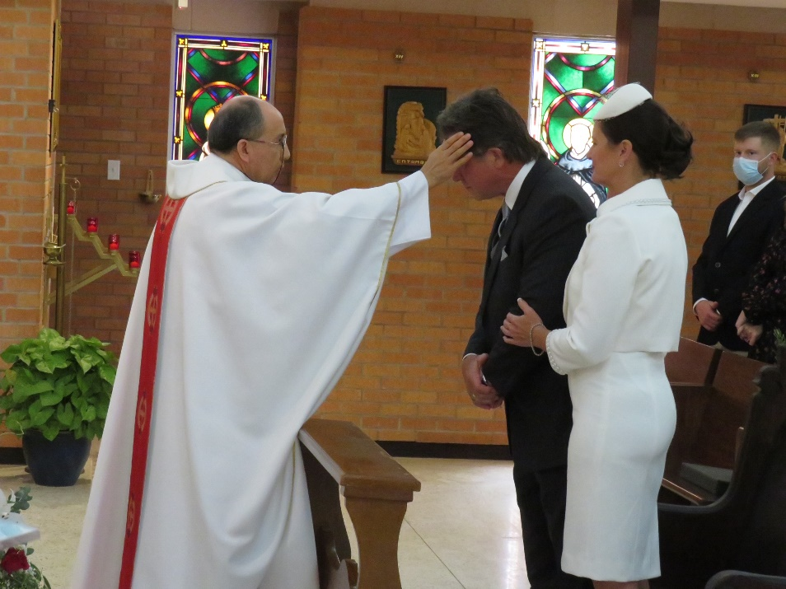
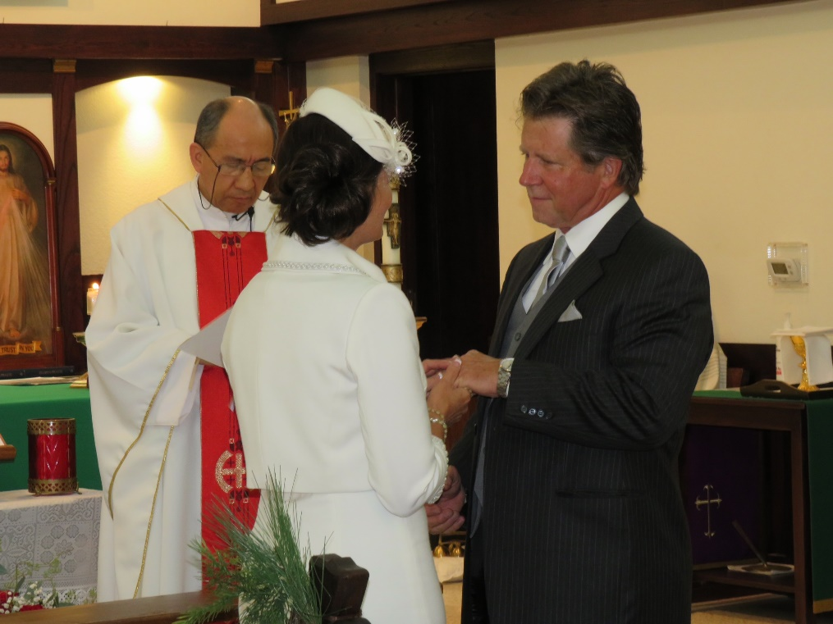
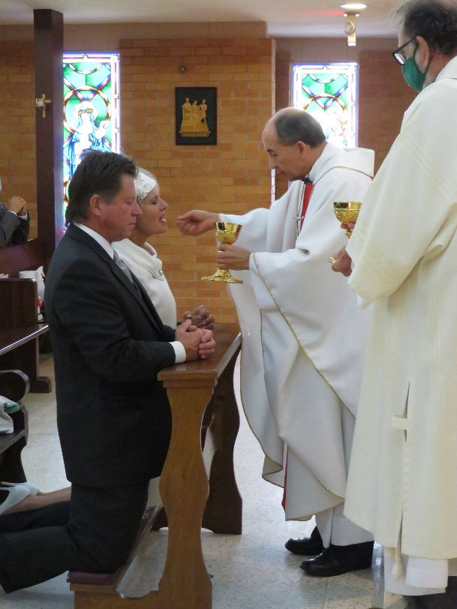

Slide 41
Fr.’s 35th Anniversary (Come & Go) 11/24/2020

Slide 42
Christmas 2020

Slide 43
Rite of Initiation – March 2021
Marley Rubio

Slide 45
End of RE Year awards – May 2021
Odalys Flores

Slide 46
Graduation Sunday May 2021

Slide 48
Clerical Endowment Fund of the Austin ADCCW
6/11/2021

Slide 50
BJ Silvey’s funeral 9/23/2021

Slide 51
Fatima Rosary for peace - October 2021

Slide 52
Fr.’s 35th Anniversary of Ordination - 11/24/2021

Slide 55
Mass of Remembrance – November 2021

Slide 56
1st Communion - November 2021
Isabelle Flores

Slide 57
Fr.’s 36th Anniversary of Ordination
11/24/2021

Slide 59
Fr.’s Christmas gift - December 2021

Slide 61
Christmas 2021

Slide 62
Christmas gift from Ladies Society – 2021

Slide 63
Youth Mass
February 2022

Slide 64
Confirmation – March 2022

Slide 65
Holy Thursday – April 2022
Odayls Flores

Slide 66
Edison Bui

Slide 67
Good Friday - April 2022

Slide 69
Easter Vigil - April 2022

Slide 71
Marley Rubio

Slide 73
Catechist End of Year Party - April 2022

Slide 74
1st Communions – May 2022
Arianna Reyes
Juan Rivera
Katelyn Battles, Caylee Butler, Yamilet & Kennia Gallegos

Slide 75
Mother’s Day – May 2022

Slide 76
Closing RE Mass – May 2022

Slide 77
Commissioning The Daughters of Mary – May 2022

Slide 78
Fatima Rosary for Peace – May 2022

Slide 80
Feast of Corpus Christi – June 2022

Slide 84
Lumen Gentium (Maria Santellano) – June 2022

Slide 87
Catechist Day of Reflection - August 2022

Slide 89
The Marian Cenacle’s trip to the Georgetown Convent - 9/4/2022

Slide 90
The Daughters of Mary – September 2022

Slide 92
Donation to CASA
(Nancy Zenner)
11/1/2022

Slide 93
Diocesan 75th Anniversary Opening Mass
November 2022

Slide 95
Property clean up - December 2022

Slide 96
Staff Christmas – December 2022

Slide 97
Christmas 2022

Slide 98
Fr.’s birthday
January 2023

Slide 100
We have truly been blessed to have you, Fr. Pedro, as our Good Shepherd.
May God continue to keep you in the palm of His hand.

